Slide 1
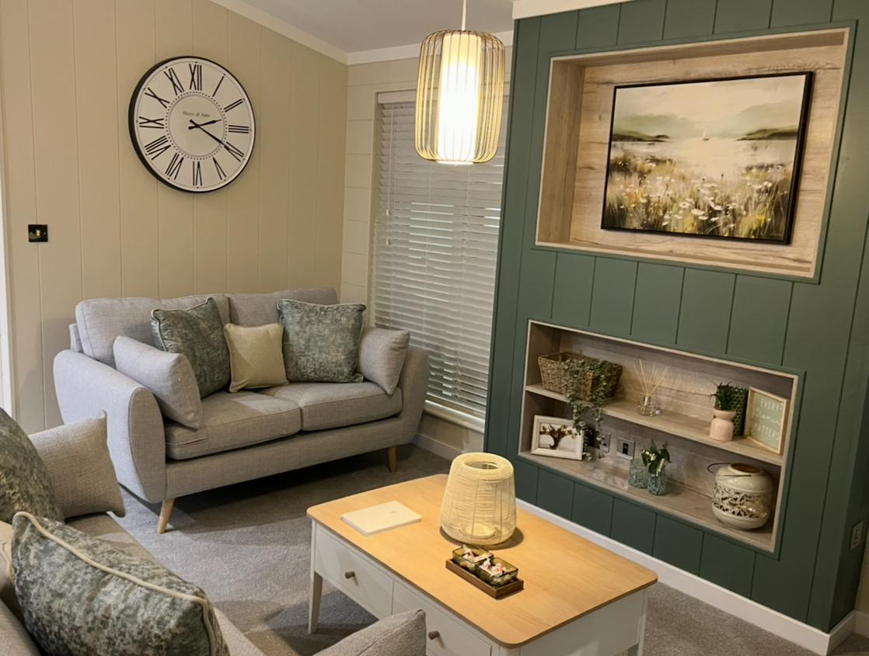

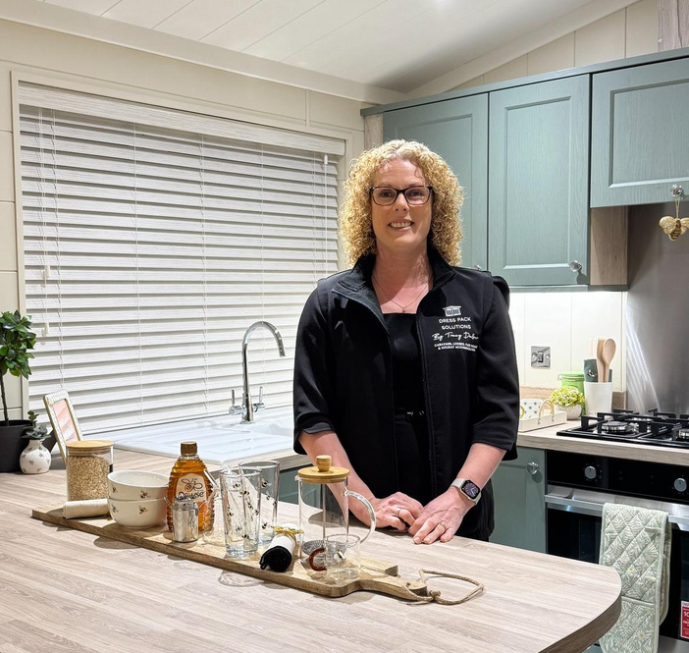
www.dresspacks.co.uk

Slide 2


Slide 3
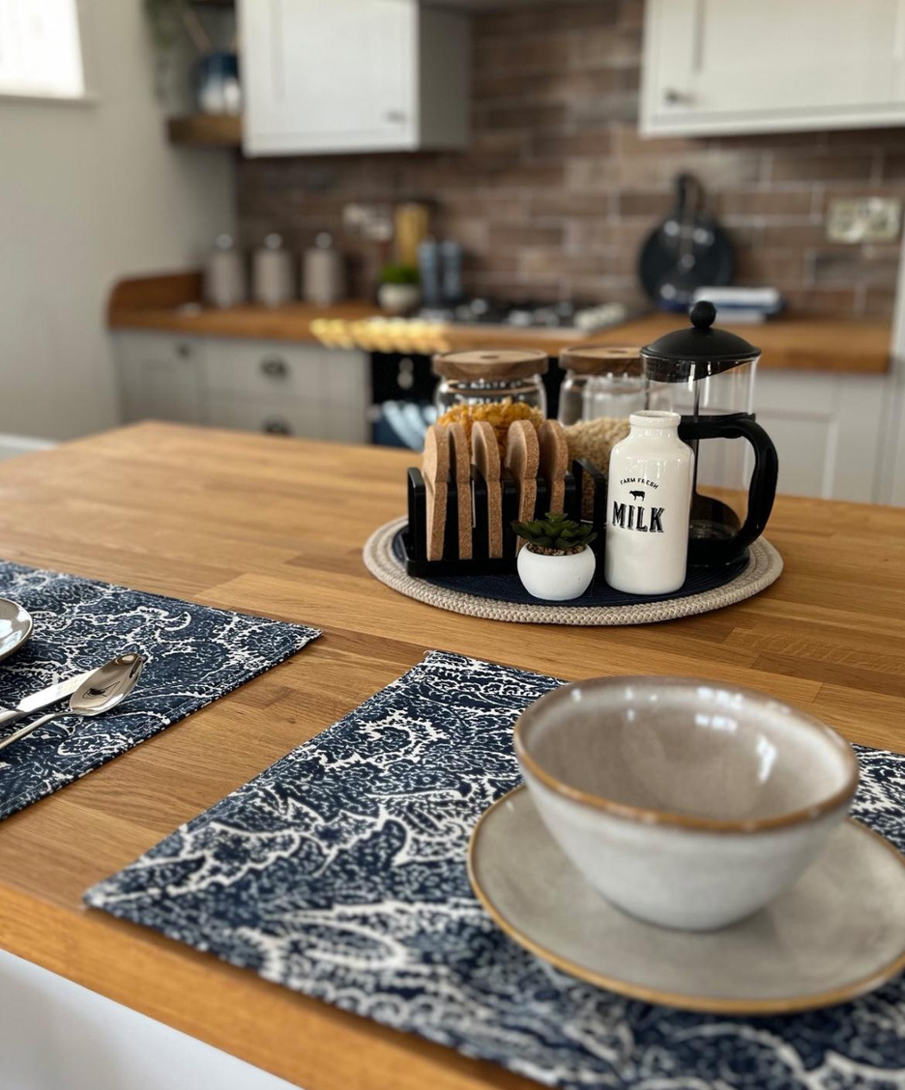

Slide 4
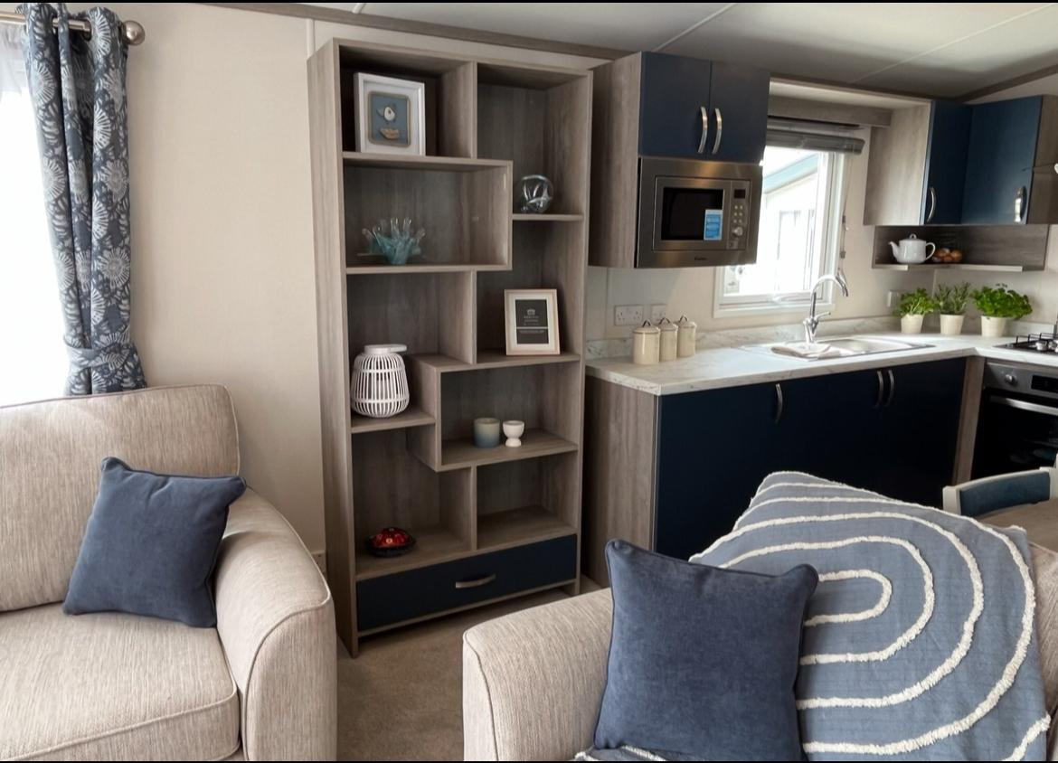

Slide 5
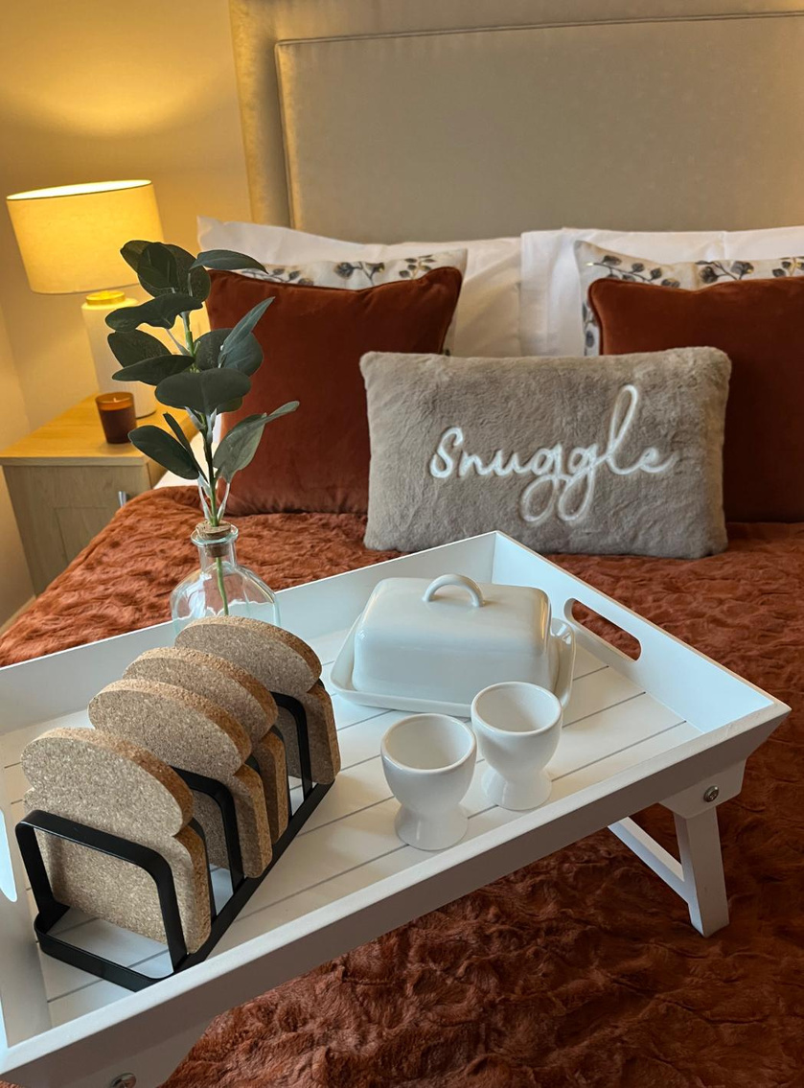

Slide 6
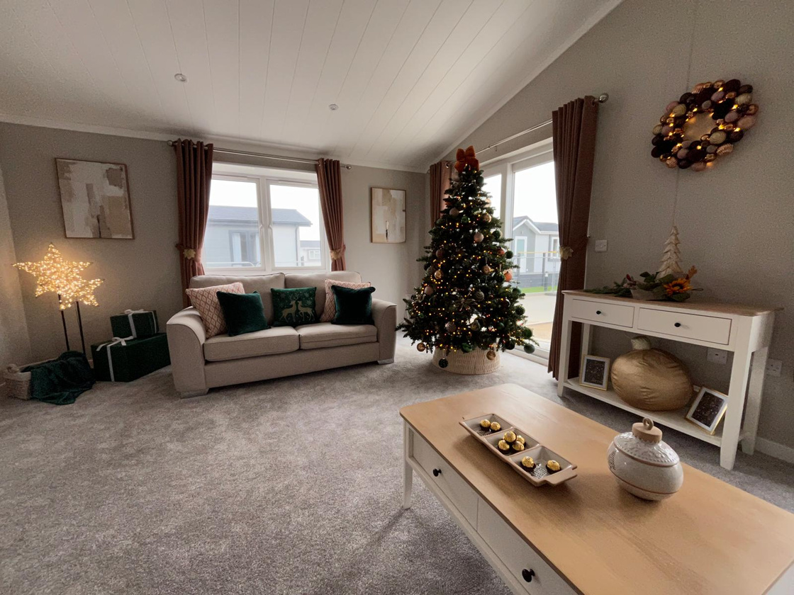

Slide 7
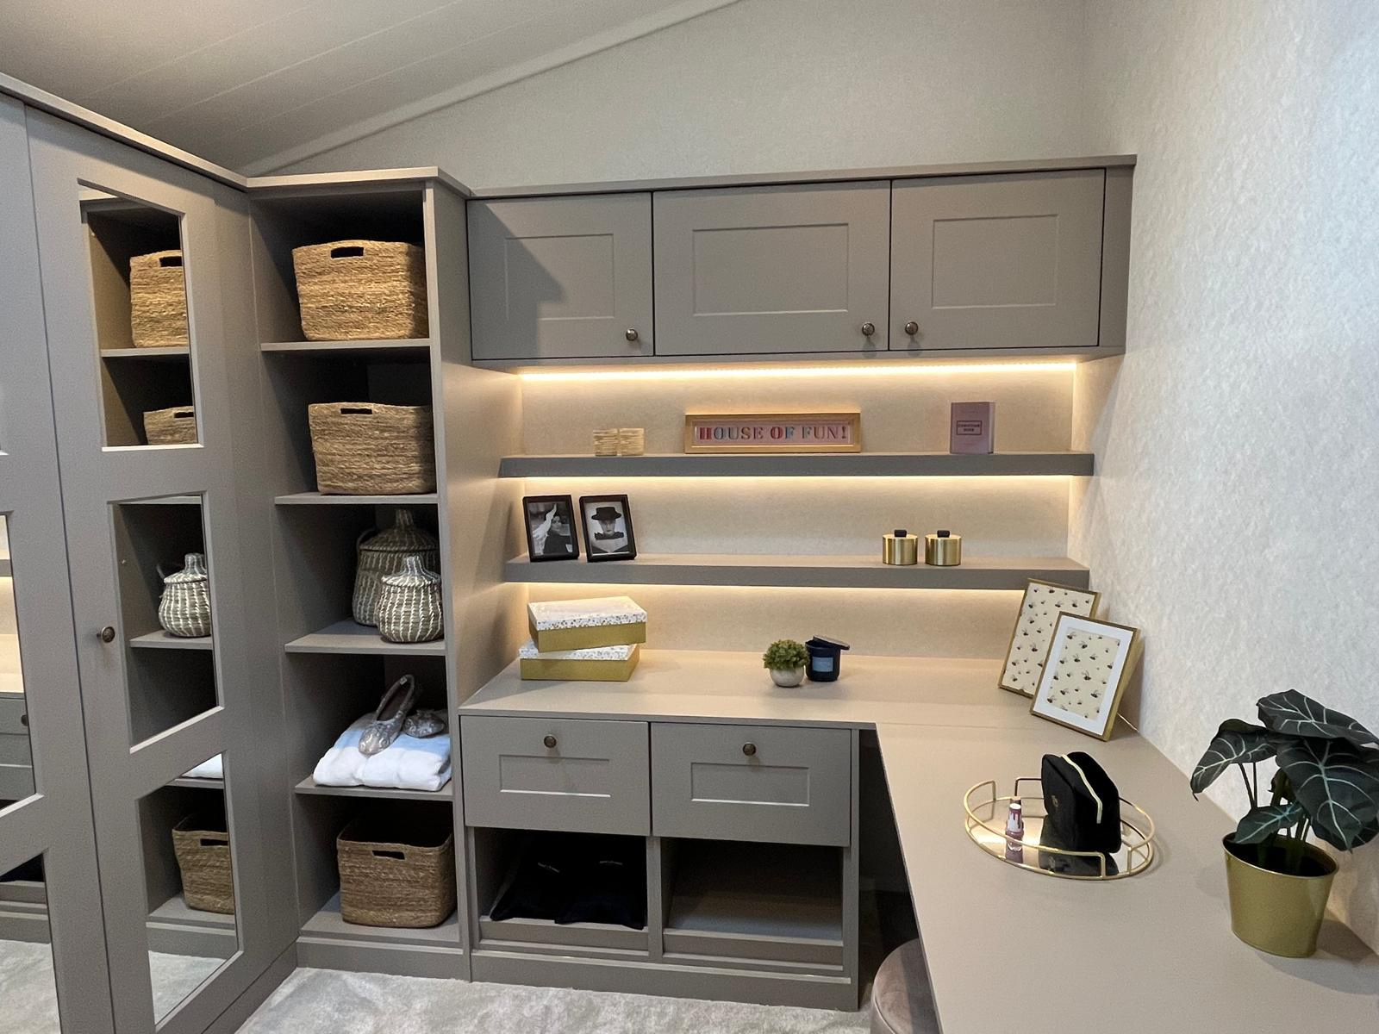

Slide 8
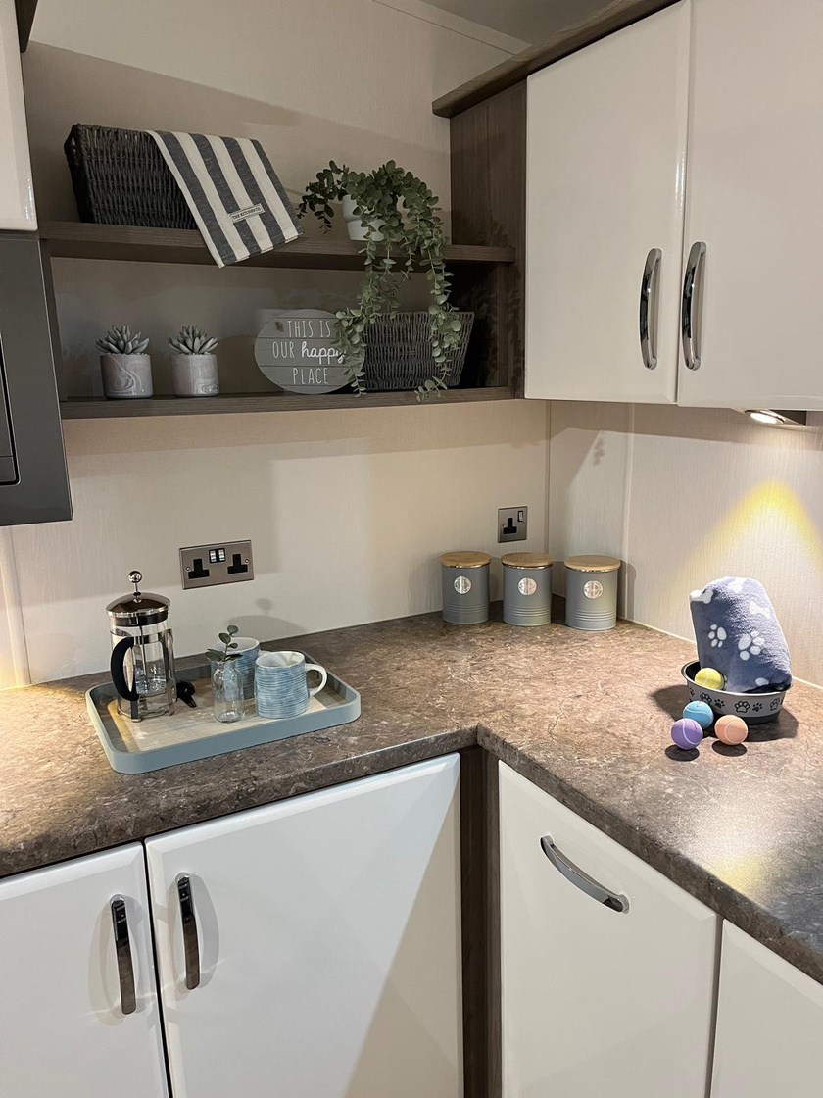

Slide 9
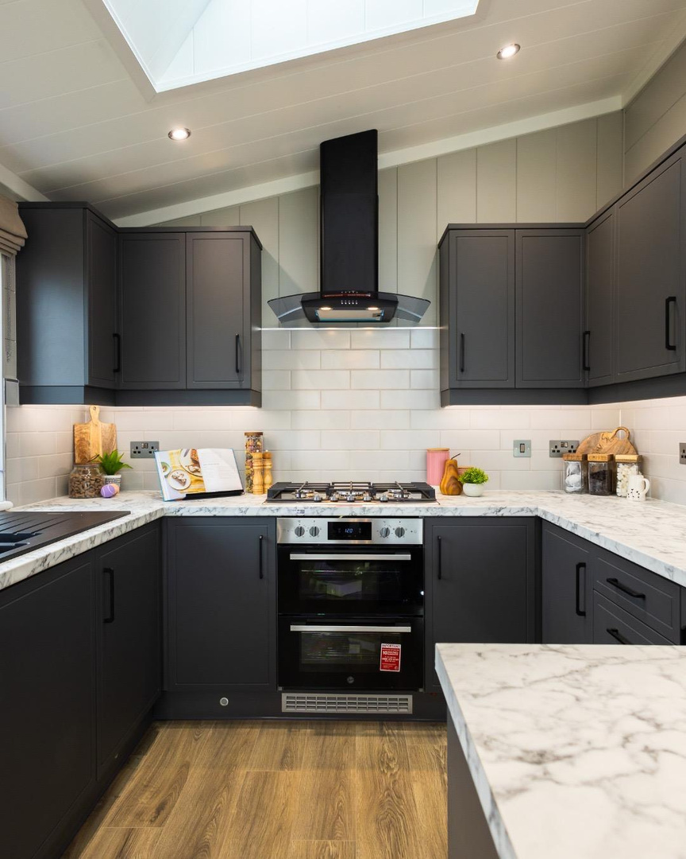

Slide 10
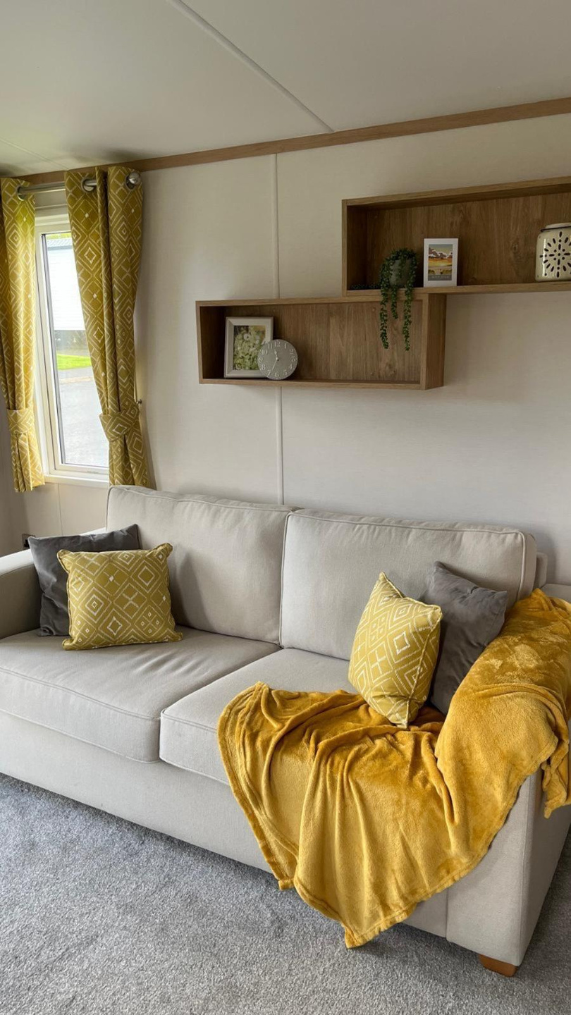

Slide 11
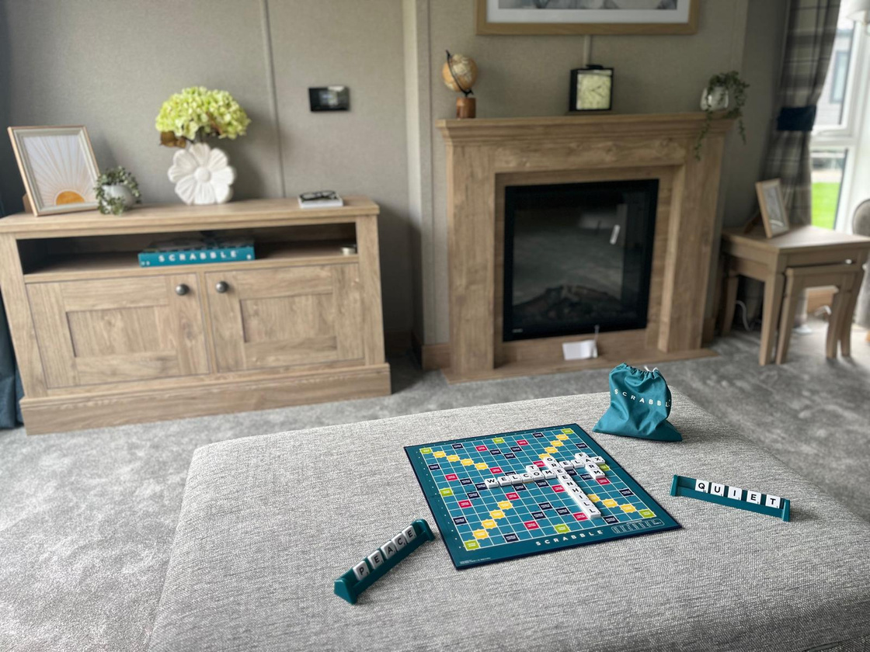

Slide 12
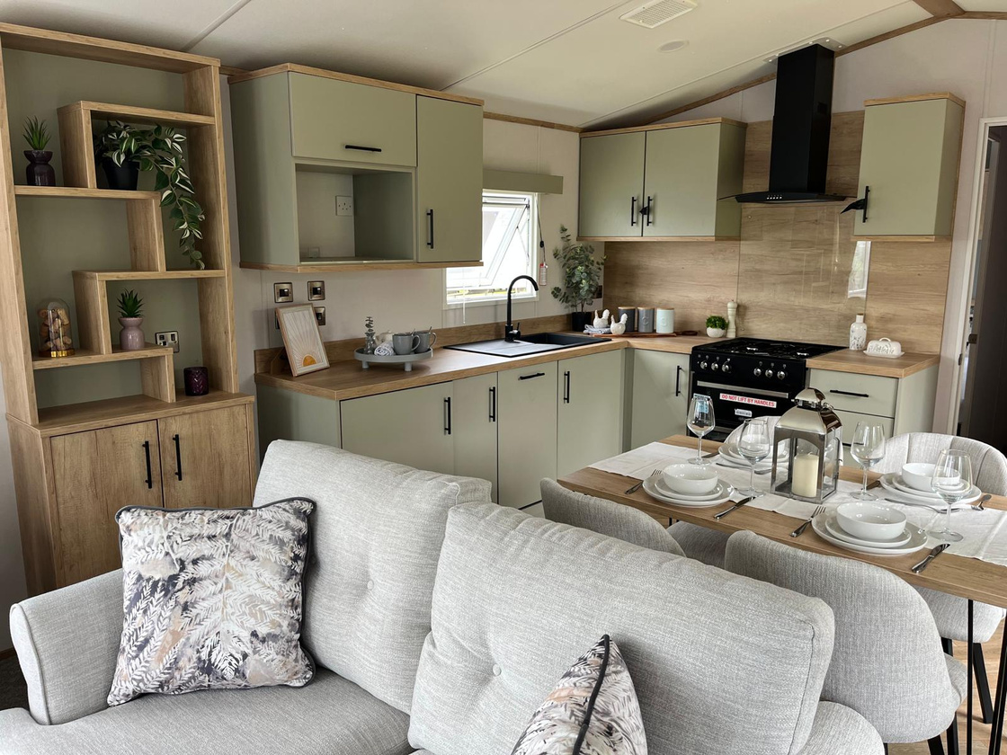

Slide 13
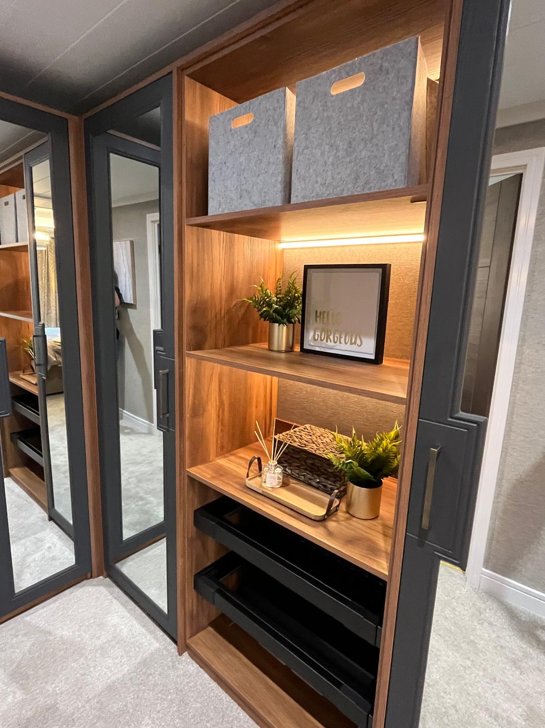

Slide 14
James Evans, Decoco Park Home Interiors
Tracy, you are hands down the best at dressing a home. The way you transform a space with warmth, style and personality is second to none. I've seen first hand how you turn lodges into homes people fall in love with.
WHAT SOME OF OUR CLIENTS SAY ABOUT US
Suzanne Francis, Avon Estates
Having worked with Tracy for many years and seeing her amazing transformations to homes at many shows, I can highly recommend her services!
Clara Baillie-Lane, Omar Group
Dress Pack Solutions has propped Omar Group park homes and lodges at shows for the last couple of years. Tracy is a real pleasure to work with and always very professional.

Slide 15
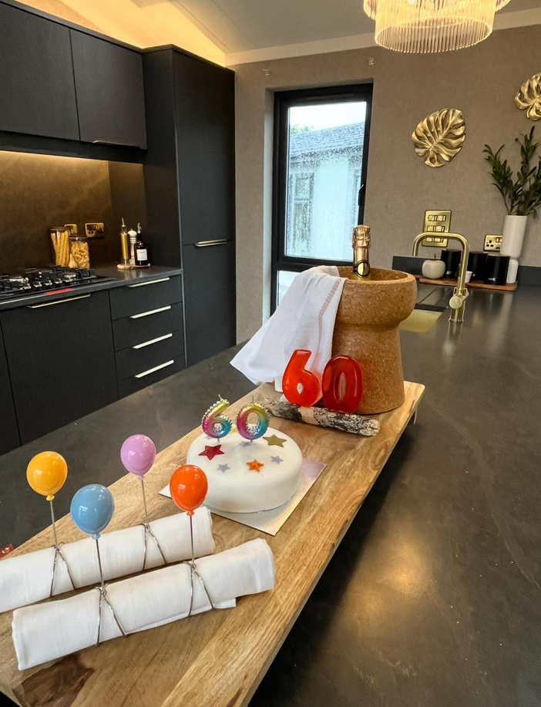
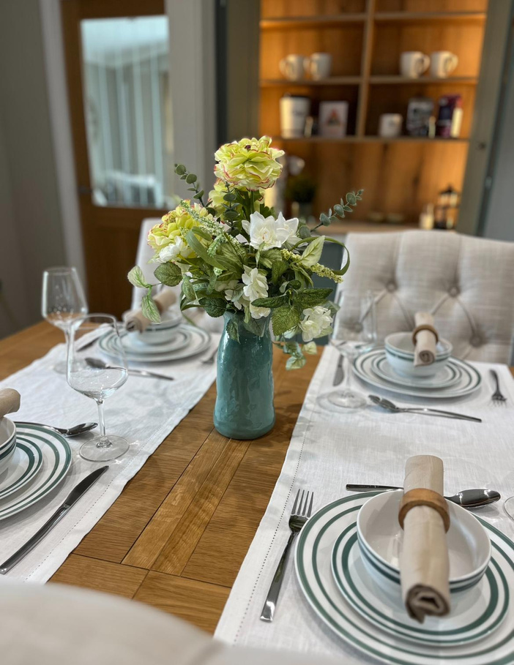
WHY CHOOSE US

Slide 16
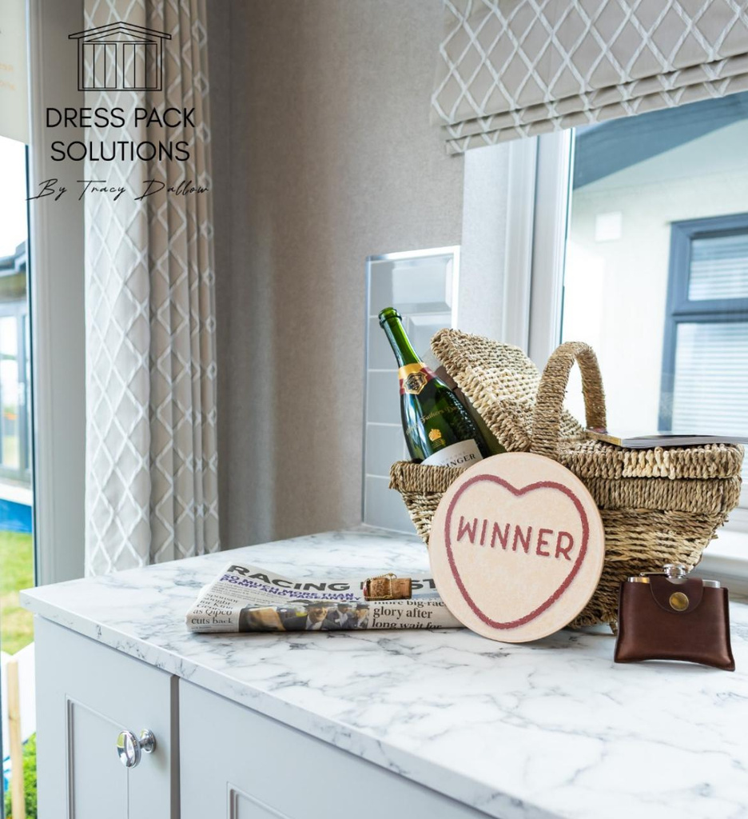
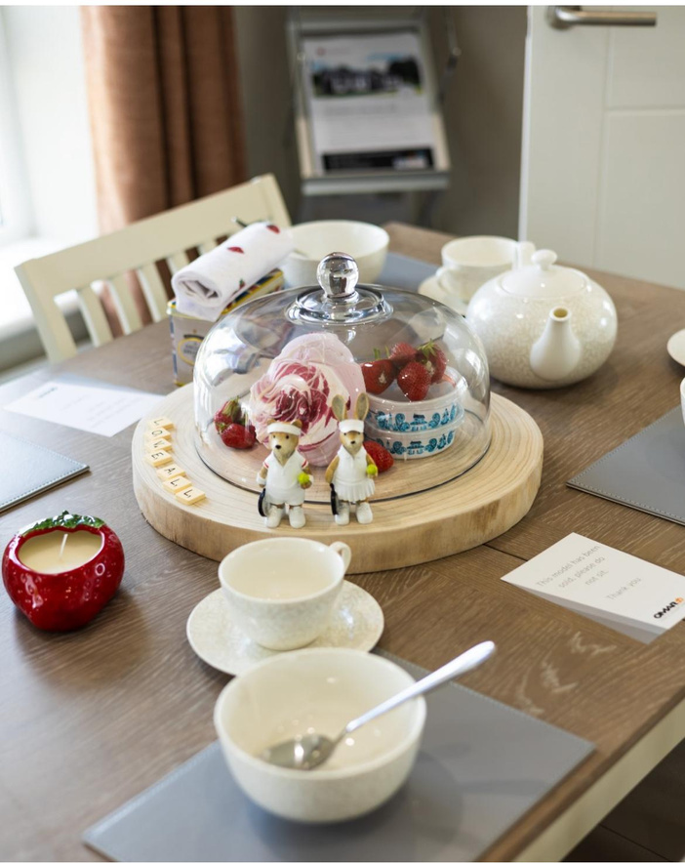
WHY CHOOSE US

Slide 17
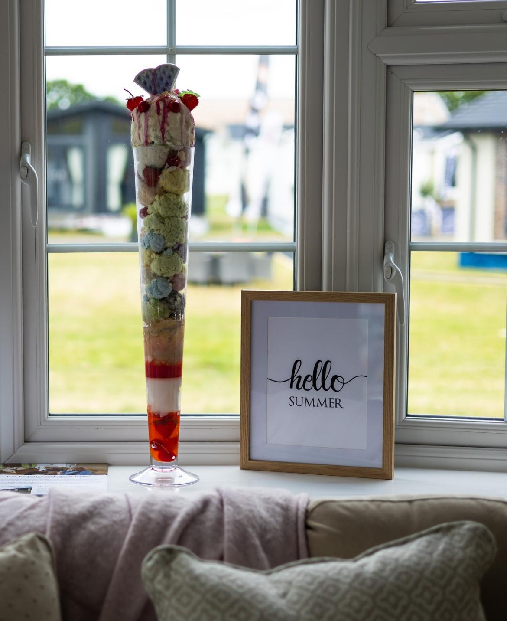
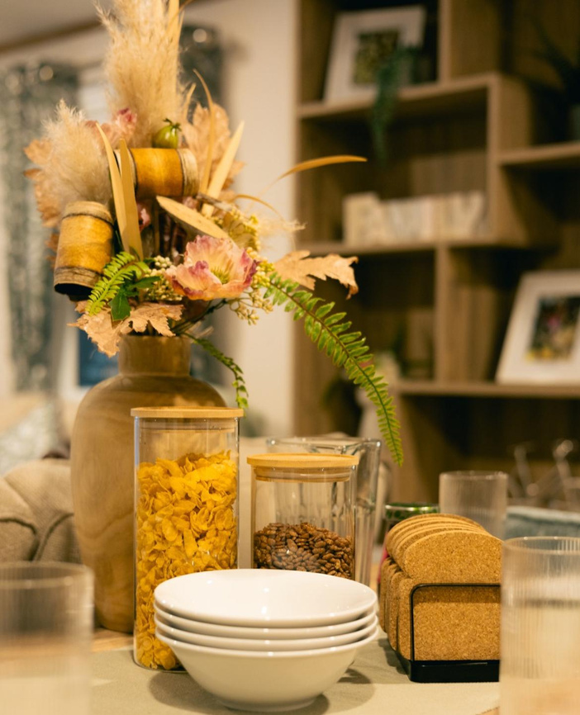
WHY CHOOSE US

Slide 18
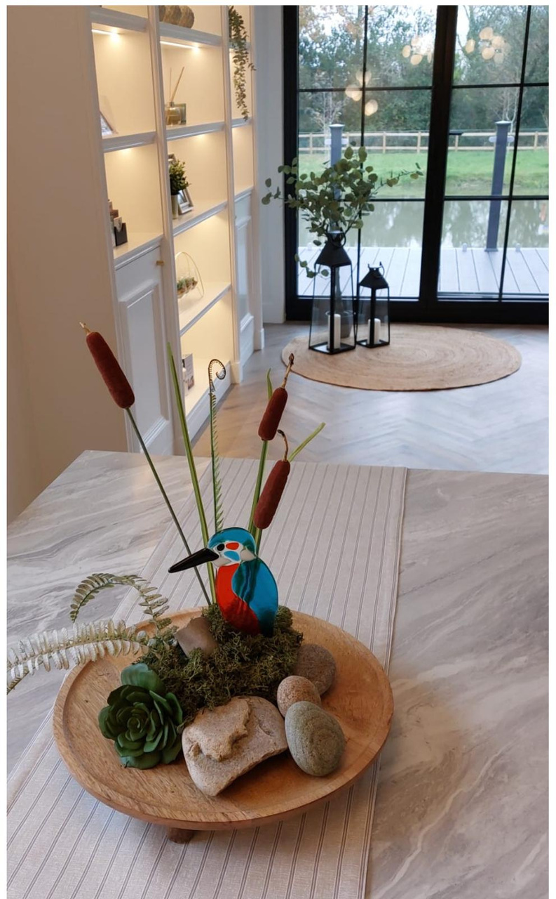
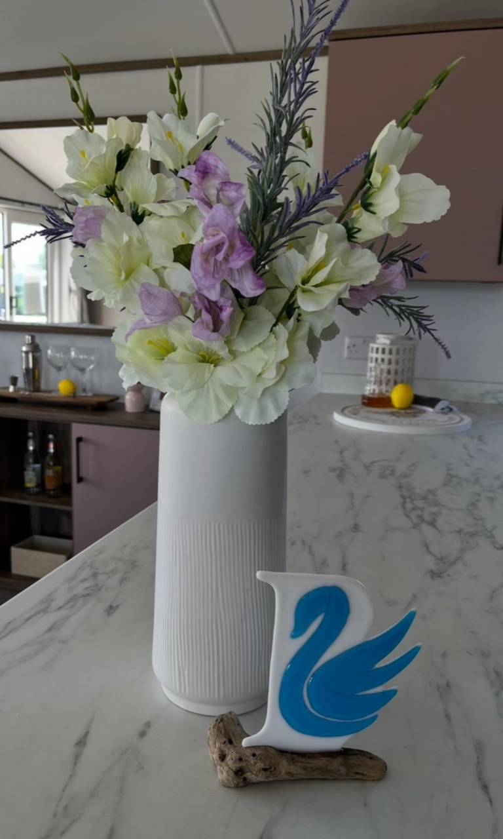
WHY CHOOSE US

Slide 19
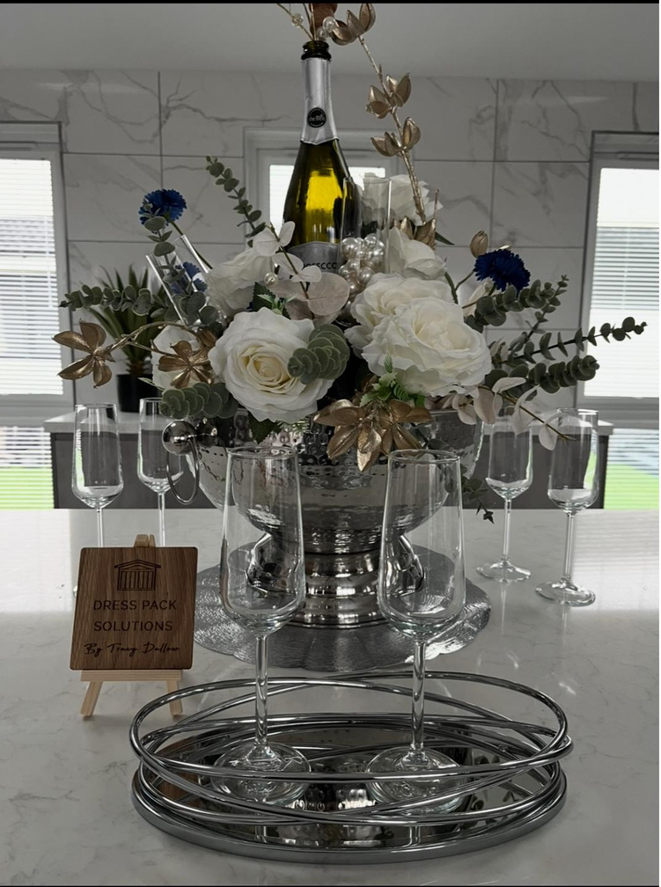

WHY CHOOSE US

Slide 20
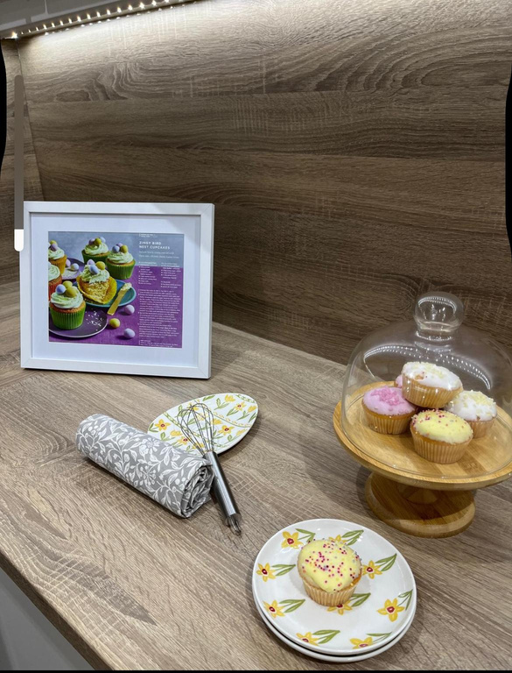
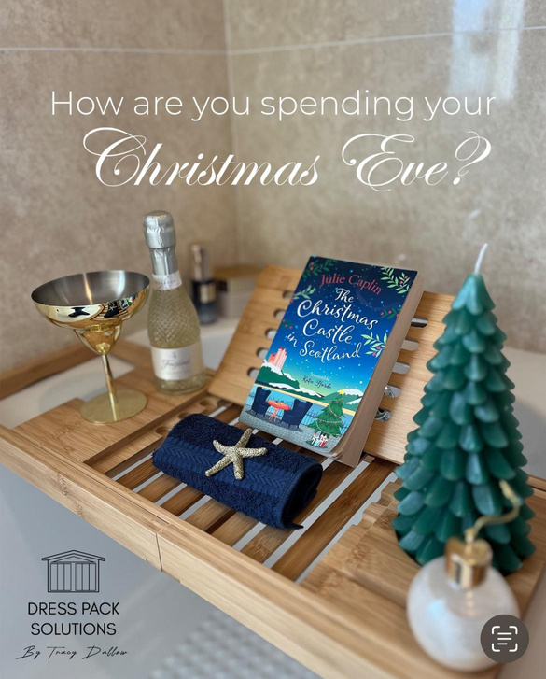
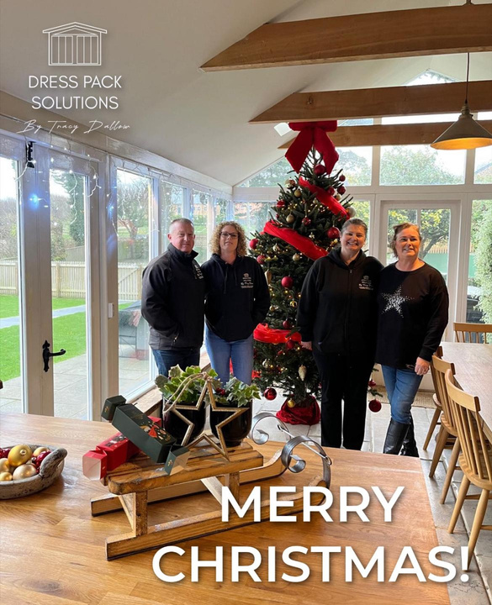
I DIDN’T KNOW YOU DID THAT!

Slide 21
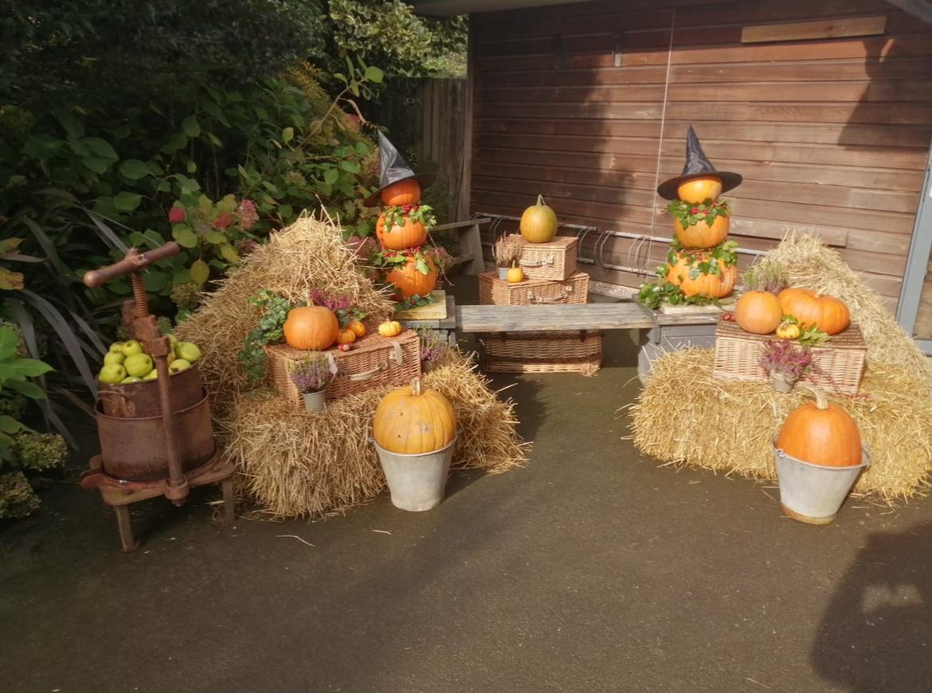
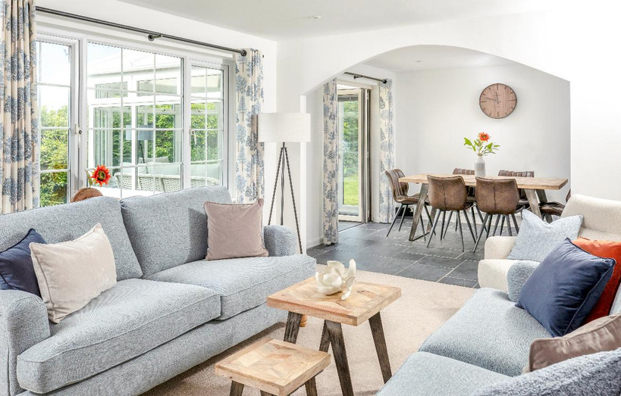
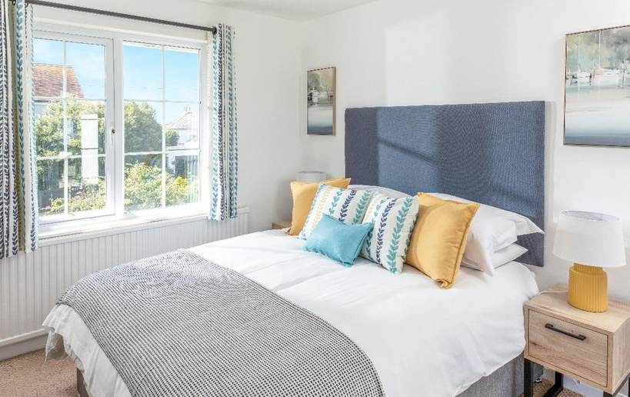
I DIDN’T KNOW YOU DID THAT!

Slide 22



I DIDN’T KNOW YOU DID THAT!

Slide 23

Heatherbank Park
Special mention to Dress Pack Solutions who've made an already beautiful home just stunning!
MORE REVIEWS...
Park and Leisure Homes feature writer, Kelsey Media
I've seen plenty of homes out on parks without dressing and unfortunately that's quite often a reason they haven't sold.
Lovat Parks
Great Job at our park in the New Forest. The Holiday Home looks fantastic and thank you.

Slide 24














Dressing our industry

Slide 25
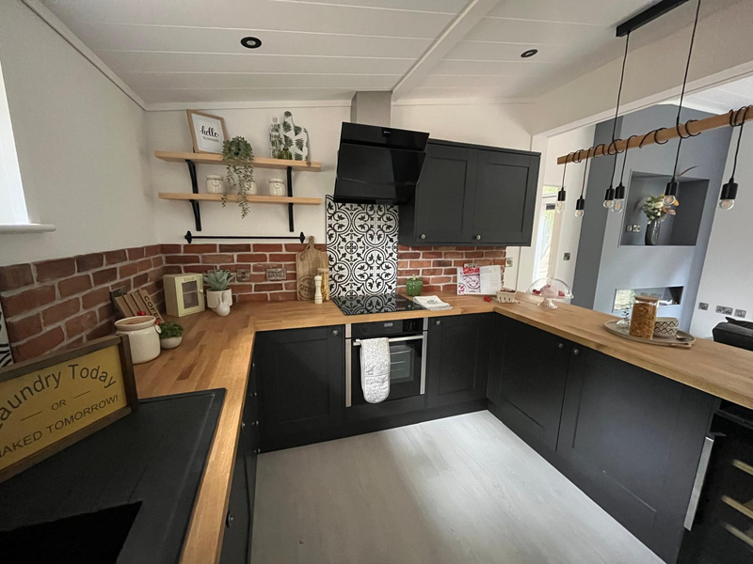
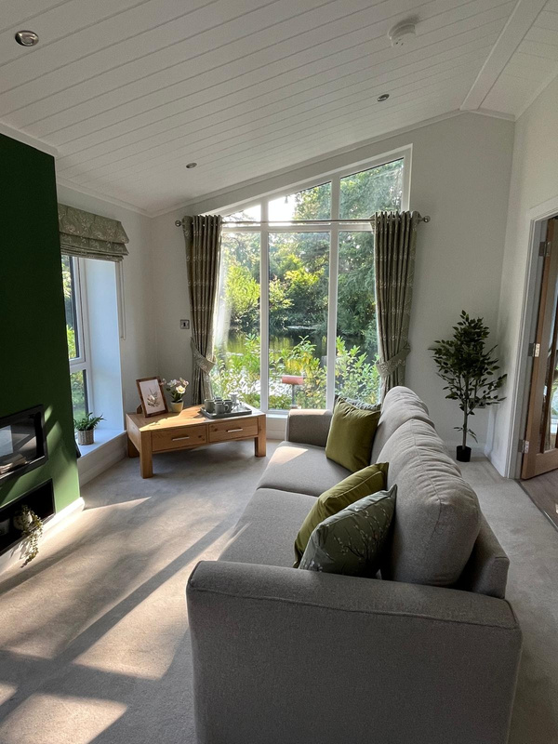

LET US SUPPORT YOUR OPEN DAYS
Let’s make those homes shine for potential buyers

Slide 26
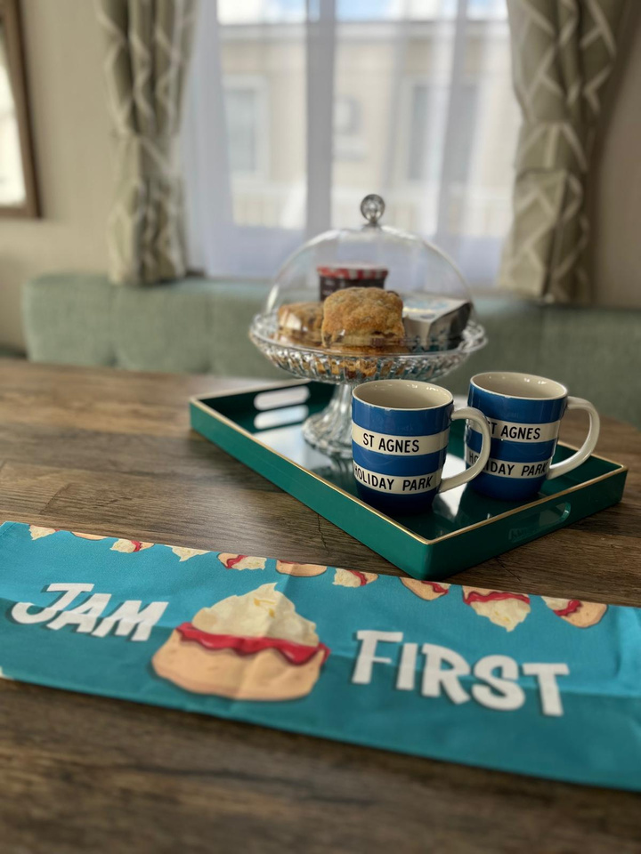
SPRINKLE IN SOME FUN

Slide 27
SPRINKLE IN SOME FUN

Slide 28
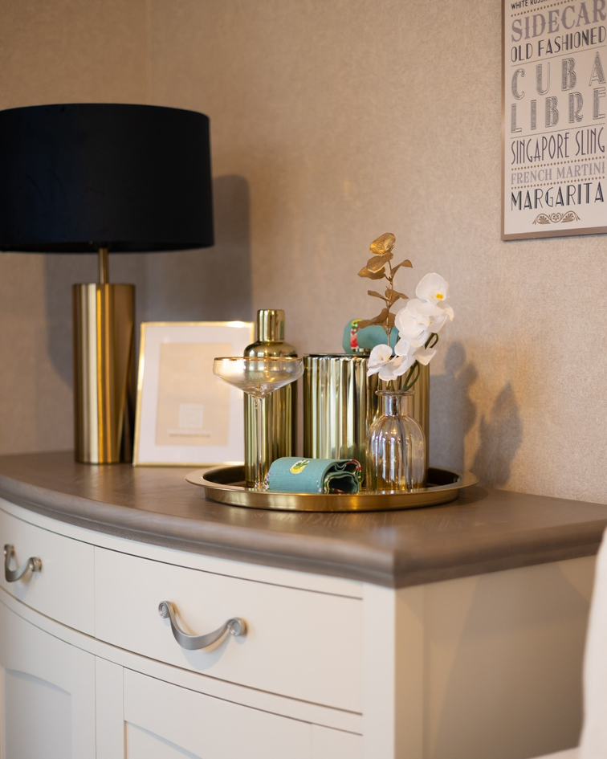
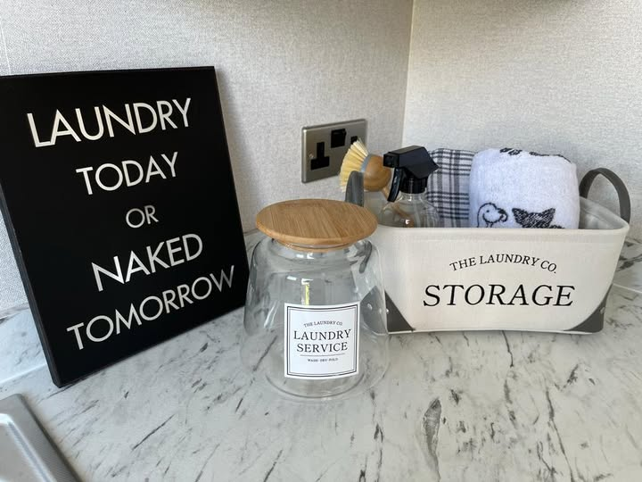
SPRINKLE IN SOME FUN

Slide 29
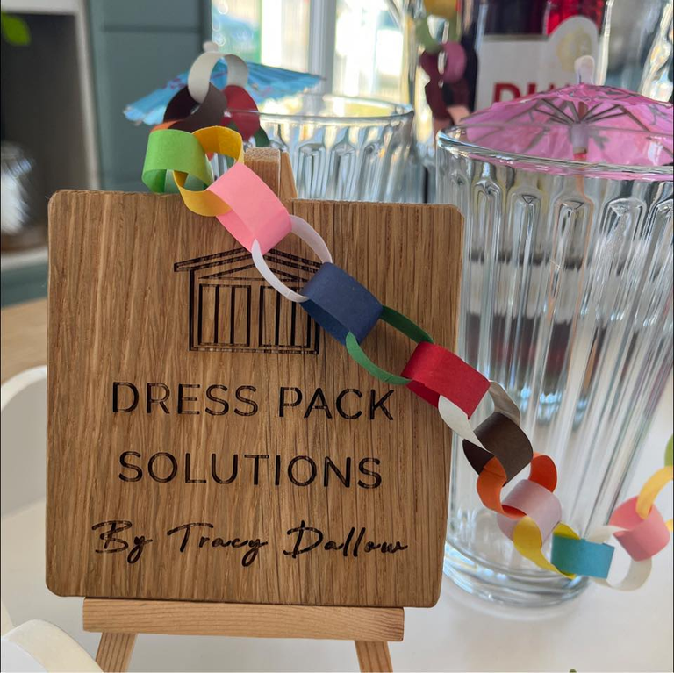
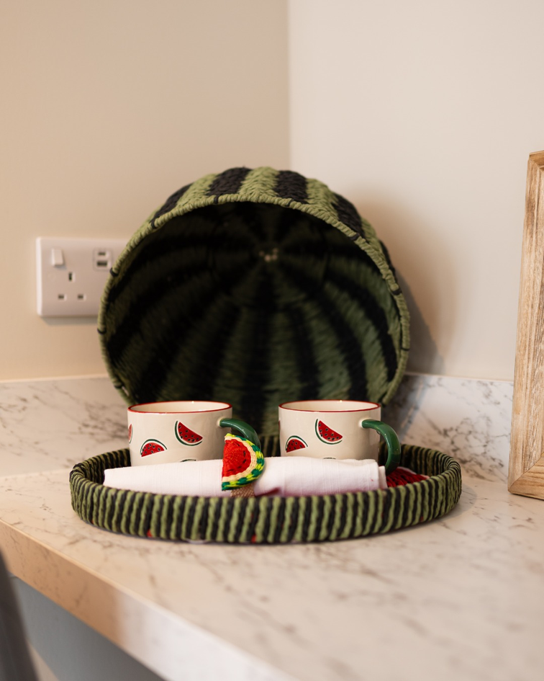
SPRINKLE IN SOME FUN

Slide 30
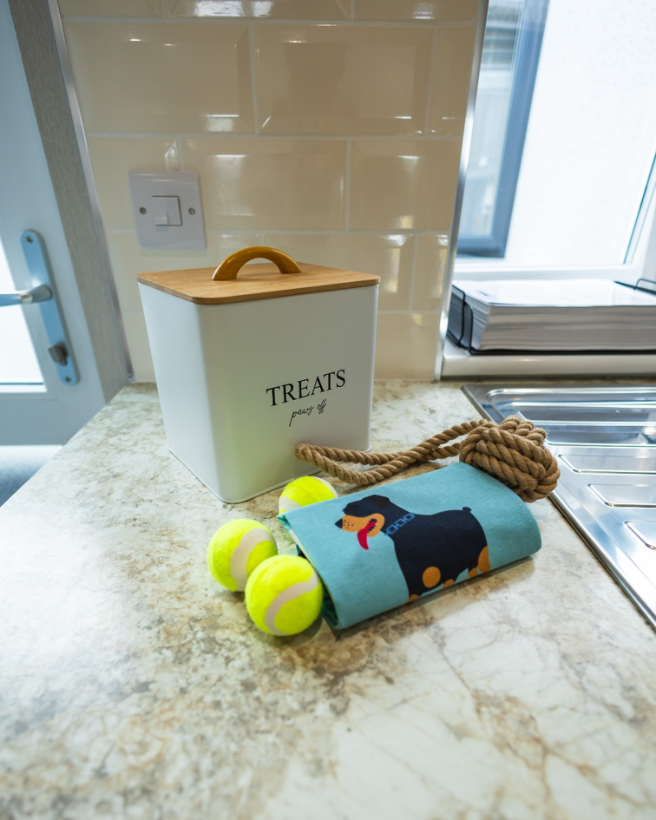
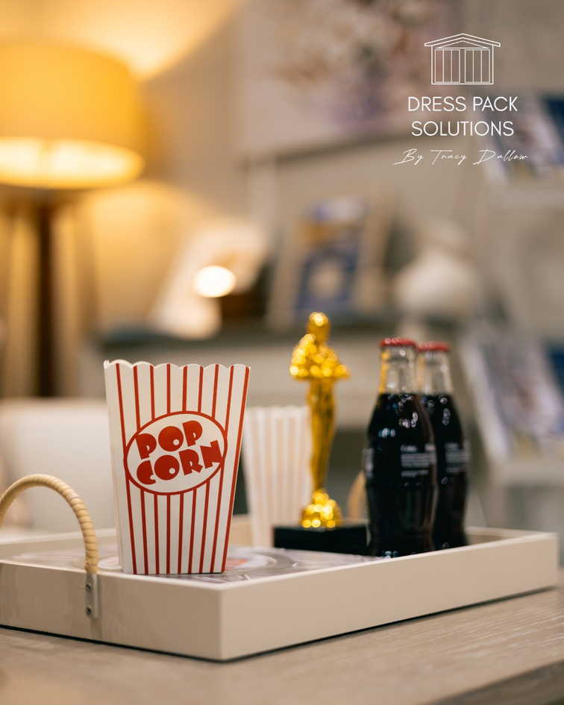
SPRINKLE IN SOME FUN

Slide 31
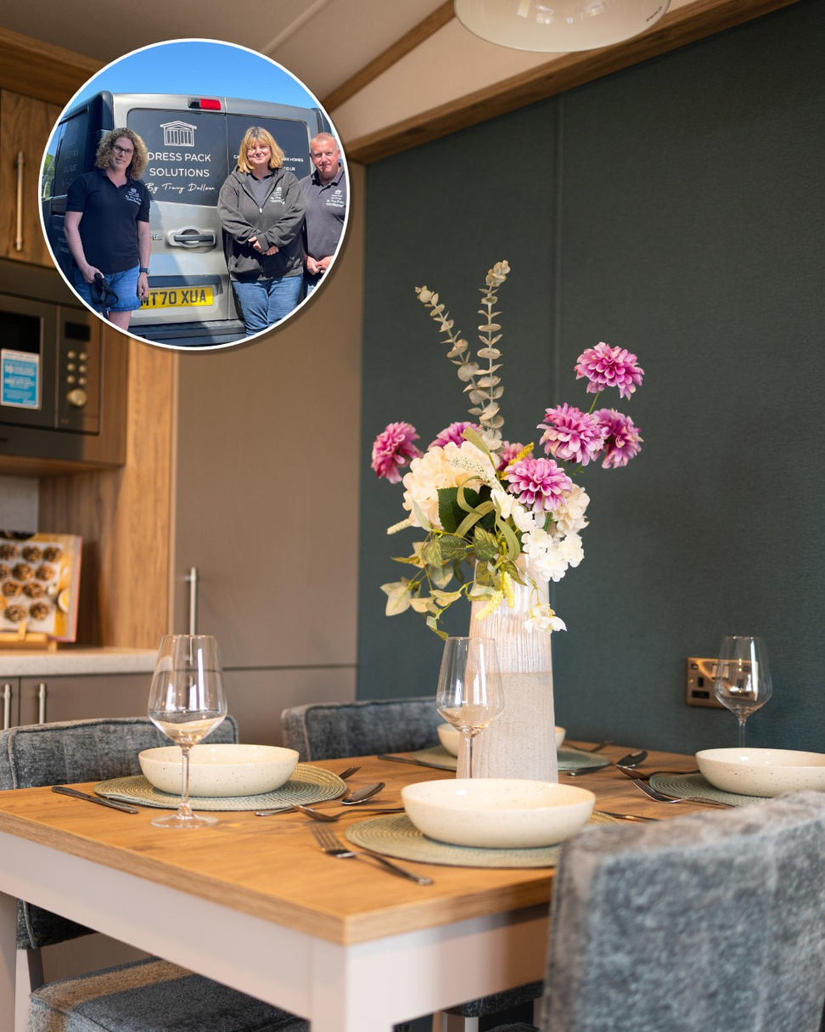
WE’RE JUST A SMALL TEAM OF NICE PEOPLE!
www.dresspacks.co.uk

