Slide 1
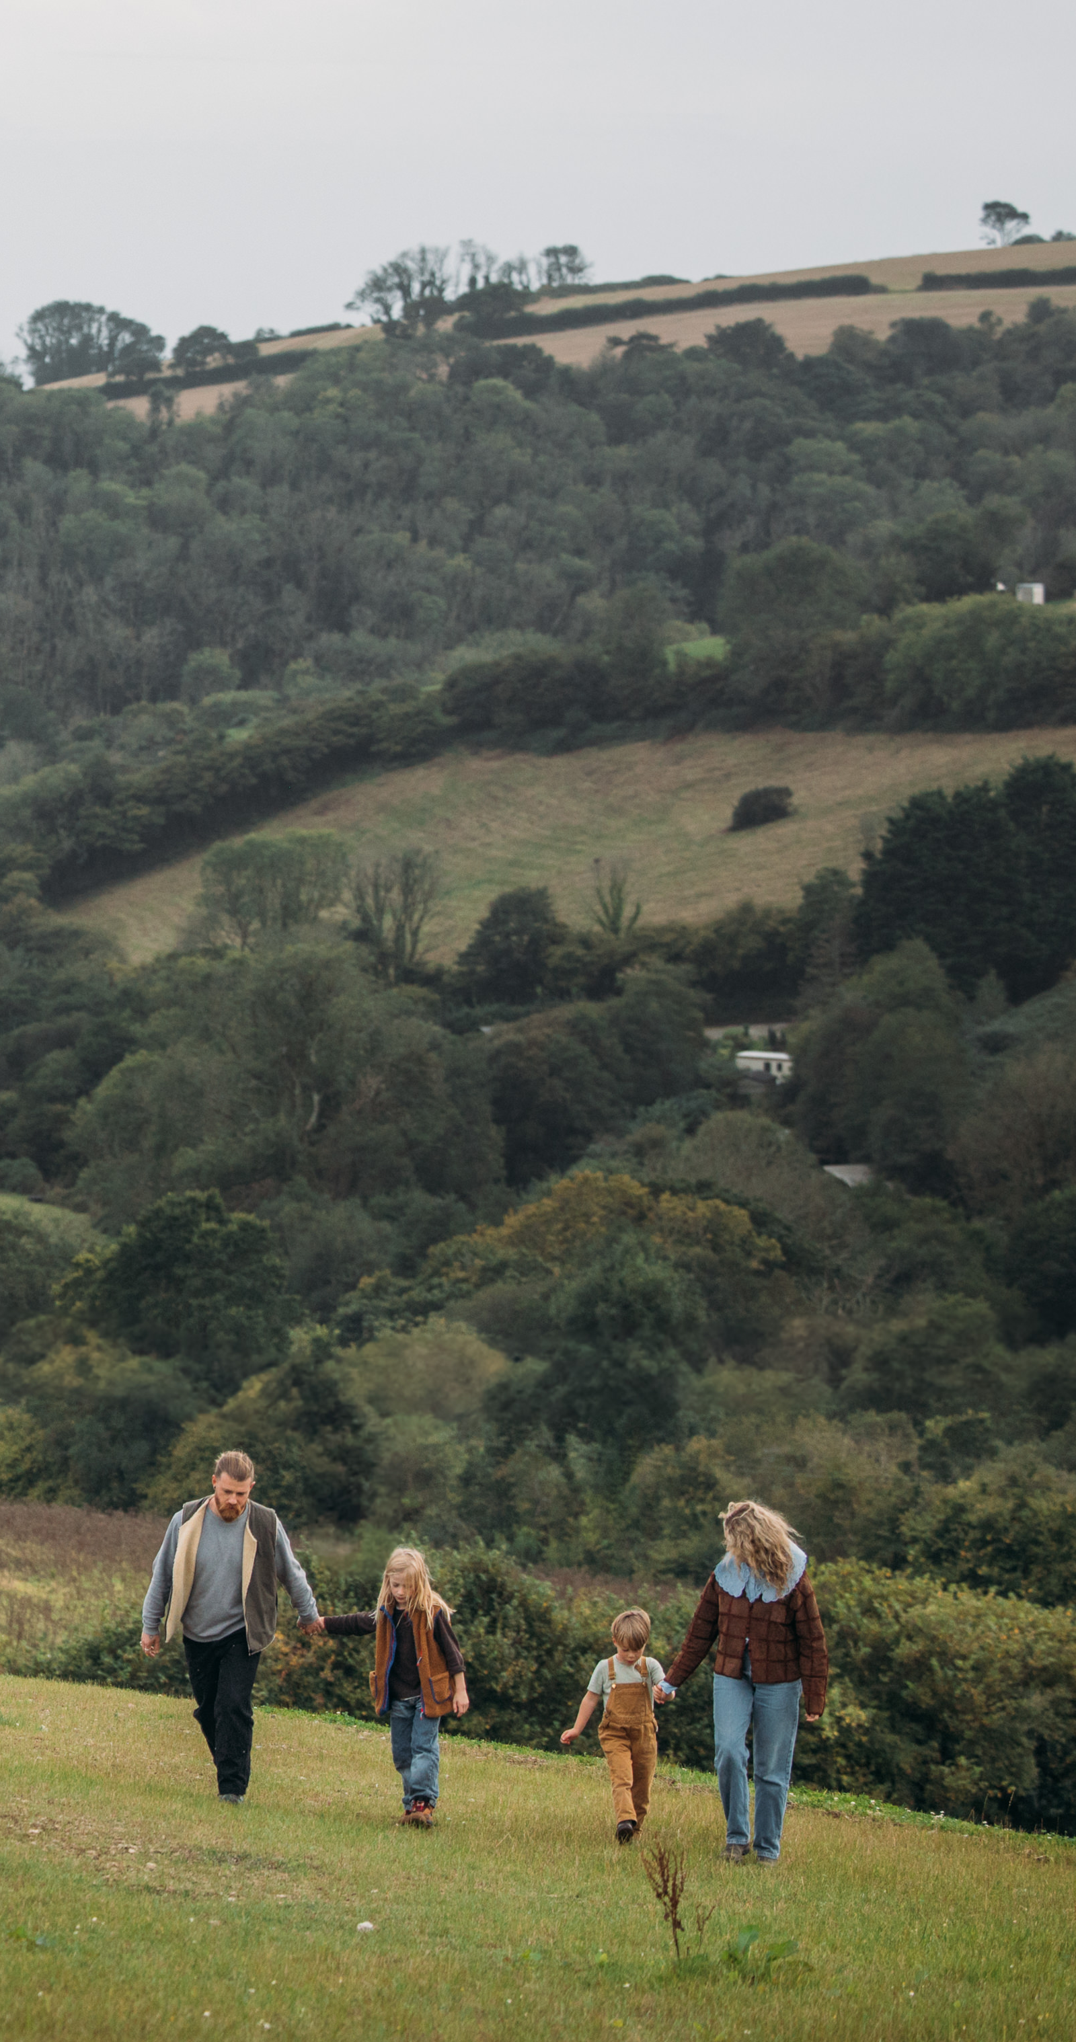
How to Grow Your Business for the Climate-Conscious Consumer
Rob Cartwright, Founder/Managing Director
Notes:
Okay….How to grow your business for the climate conscious consumer.
In this presentation I will talk about opportunities facing your industry with the growing demand from climate-conscious consumers
what challenges this creates for operators like yourselves
and I will share some practical solutions that can help you meet this demand whilst improving your margins.

Slide 2
What guests want
71% of UK holidaymakers are interested in seeing information about the sustainability of a holiday before they make a booking
Source: Mintel 2025 report, UK sustainability in Travel Market report
Notes:
Through the work that skentel does with holiday parks and hotel owners, we are seeing a shift in guest expectations.
And as this statistic shows, there is a clear appetite among holidaymakers for learning more about the environmental impact of their travels.
The climate-conscious consumer represents a growth opportunity for holiday parks that can demonstrate genuine environmental credentials.

Slide 3



The reality for operators
Rising costs: Energy, Wages, NI contributions
Time Constraints: Stretched operational teams
Sustainability Pressure: Regulatory & consumer expectations
Notes:
But here's the challenge – You’re facing a triple squeeze.
First, costs are rising everywhere - energy bills, wages, and now increased National Insurance contributions. Your margins are under pressure.
Second, your operational team may be stretched. And it’s time consuming to walk the site checking equipment and reading meters.
And third, there's growing pressure to demonstrate real environmental improvements with measurable reductions in carbon footprint and energy waste.
So the question becomes: how do you meet the demands of climate-conscious consumers without it costing you more time, more money, and more resources?

Slide 4



Key opportunities
Smart Energy &
Water Management
Costs
Operational
efficiency
Time
Proof
points
Environmental
credentials
Notes:
Faced with this triple squeeze, where are the opportunities?
I am going to focus on three key areas that directly address these challenges:
Smart Energy & Water Management… to reduce costs.
Operational Efficiency… to free up time.
And the proof points you need to support your environmental Credentials
These three opportunities are interconnected - and as I'll show you soon, one solution can deliver all three simultaneously.

Slide 5
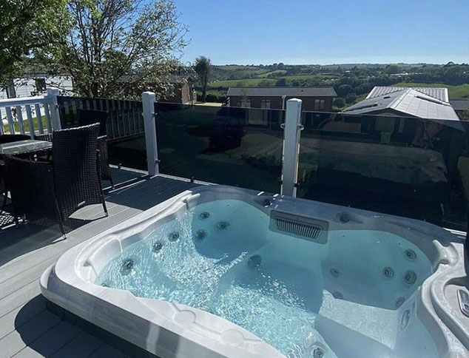
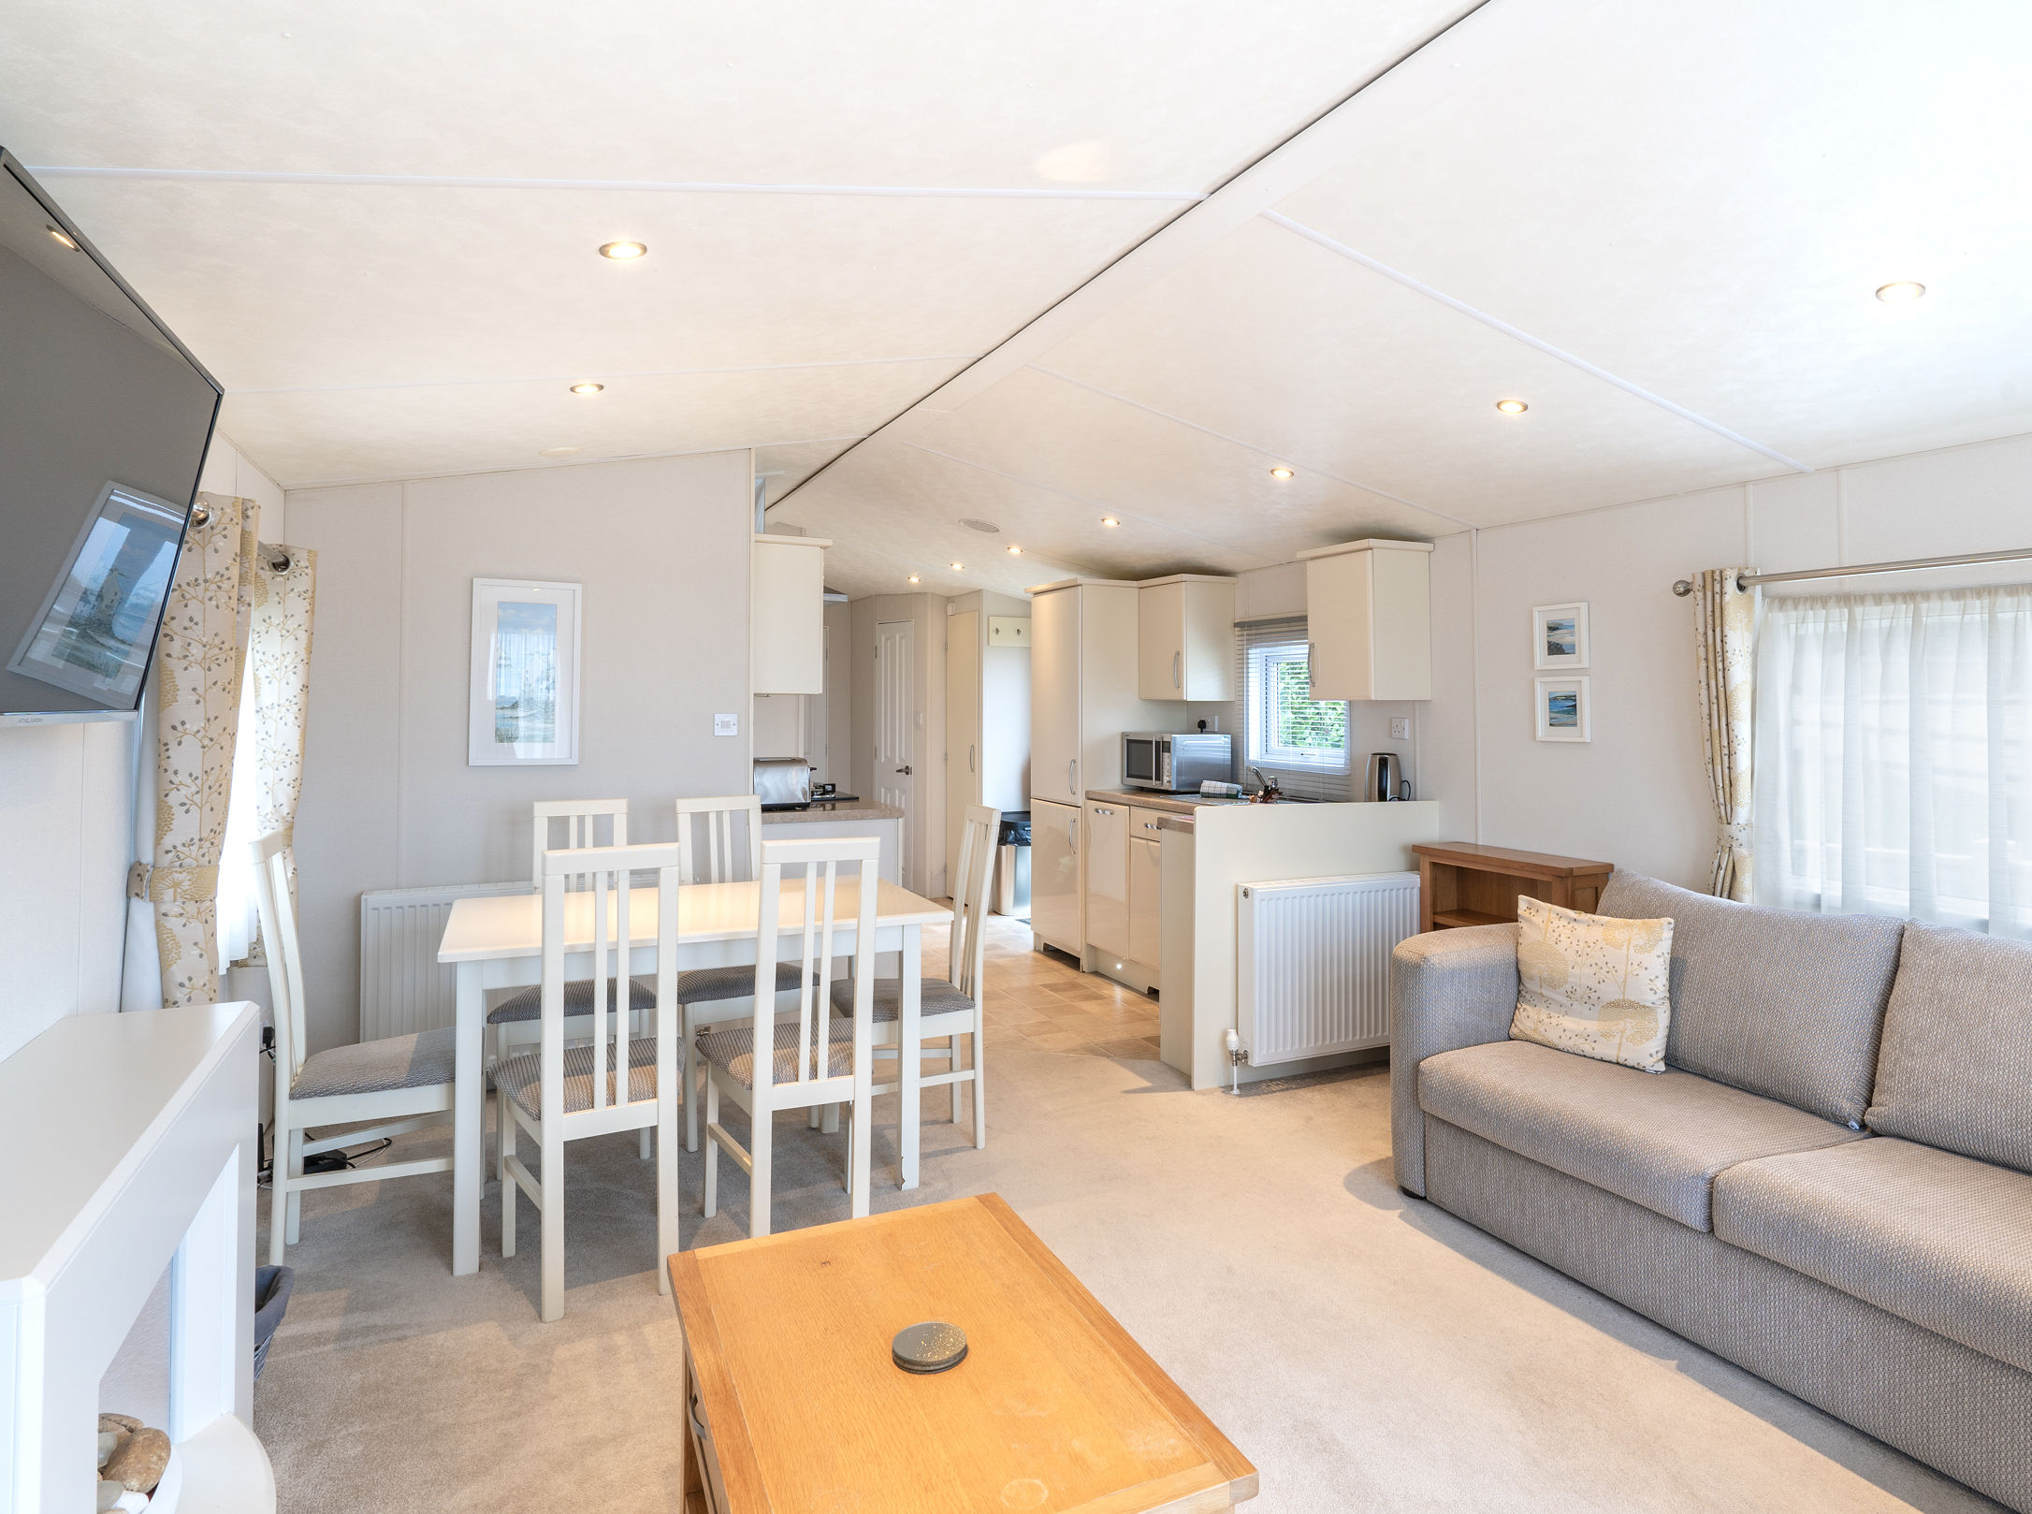
Smart Energy & Water Mgt
Heating accommodation based on occupancy
Pool and spa temperature optimisation
Lighting controls across distributed facilities
Hot water systems efficiency
Notes:
The first opportunity is smart energy & water management.
Think about what happens now - lodges sometimes sit empty with heating on because someone set the thermostat high. Hot tubs run 24/7 even when guests aren't using them.
With smart, automated systems, you can heat accommodation based on actual occupancy, schedule hot tubs to power down overnight, and optimise all your energy-intensive equipment.
That's money back in your pocket AND a genuine sustainability story to tell guests but not at the expense of guest comfort and satisfaction

Slide 6


Operational efficiencies
Automated & continuous meter readings
Automated equipment checks
Automated alerts
Predictive maintenance scheduling
Notes:
The 2nd opportunity to save your own time and that of your team.
How many hours are spent walking the site checking equipment and reading meters? When you eliminate those daily rounds, you free up your team to focus on guest experience instead.
More importantly, automated alerts shift you from reactive to proactive. You catch problems early, before they affect guests or cascade into bigger failures. Your team spends less time firefighting and more time on work that actually adds value

Slide 7





Environment credentials
Quantified carbon reduction
Water management & leak prevention
ESG reporting data
Green certification support
Notes:
The third opportunity is to turn sustainability from a cost centre into a genuine competitive advantage.
You cannot just say you are sustainable – guests want proof, so you need to get comprehensive data to be able to make these claims and to report on what you are contributing in terms of carbon reduction, energy savings and water management.
This data will also prepare you for future mandatory government requirements of reporting on sustainable practices.

Slide 8
The challenges
Your Reality:
📝 Manual meter readings
💡 Energy waste in empty units
⏰ Daily rounds checking equipment
🚨 Reactive maintenance
Guest Expectations:
🏠 Everything ready on arrival
✅ Reliable facilities, no breakdowns
🌱 Proven sustainability
😊 But no compromise on comfort
Notes:
We've identified three key opportunities. But here's the challenge: how do you deliver these, without adding more work to your team?
Right now, manual monitoring is time-consuming. Daily rounds checking equipment across large sites. Reactive maintenance - you only know there's a problem when guests complain.
Meanwhile, guest expectations keep rising. They want Lodges that are comfortable on arrival. Facilities that work reliably. Proven environmental responsibility and no compromise on comfort.
Something has to change …. and that's where smart connectivity comes in.

Slide 9




The solution: smart connectivity
Notes:
Smart connectivity is about giving you one central connection to all your assets however remote or dispersed they are, across one site or different sites.
You get Automated meter readings, heating, air conditioning and hot tubs automatically switch off when a guest checks out . Equipment monitoring such as water boosters, water storage tanks, pool filter pumps and heating plant and more!
skentel isn't selling you a technology. Instead we provide a service to save your time. Time for your team to do work that matters. Time for you to run a business instead of chasing meter readings and time because reports write themselves as the data flows automatically.

Slide 10
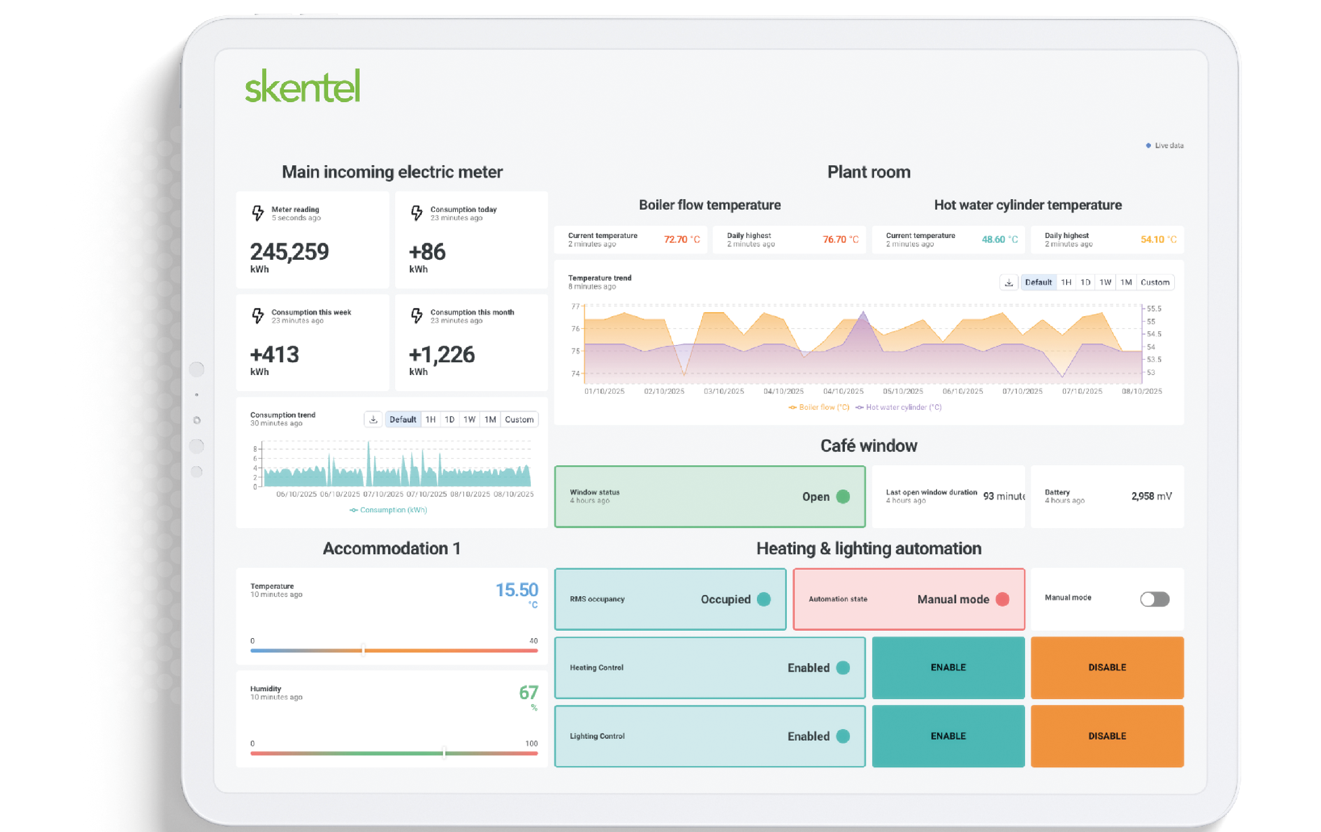
.
Your control centre
A cloud-based dashboard
Bespoke reports
Live and historical data
Access anywhere, anytime
Secure & compliant
Alerts before equipment fails
Automated controls
Booking system integration available
Notes:
And the central point for all your connected assets is on a cloud based dashboard.
The data visualisation provides valuable insights on the performance of your assets, highlights potential issues and allows for easy comparison across multiple parks. The latter is also possible between park owners as we are building a community of like minded leaders with our platform as a place to meet and share ideas.
The data visualisation isn't just pretty charts - it's pattern recognition. When you can see the performance of all your assets at a glance, you start to notice things. For example: you might notice that this park uses 30% less energy than that one. This hot tub filter is about to fail.

Slide 11
Turn your achievements, in Marketing gold
Marketing:
Achievements
Hot tub automatically switched on ready for your arrival
30% reduction in energy waste
🏆 Improved ESG status
✅ Green Tourism compliance
📊 Measurable achievements
Fewer miles travelled to reduce our carbon footprint
Smart systems to prevent equipment failures
Notes:
Other than getting savings that will directly improve your bottom line, another benefit comes when you market your green credentials and turn your investment into marketing gold! The savings are nice, but the story is priceless.

Slide 12
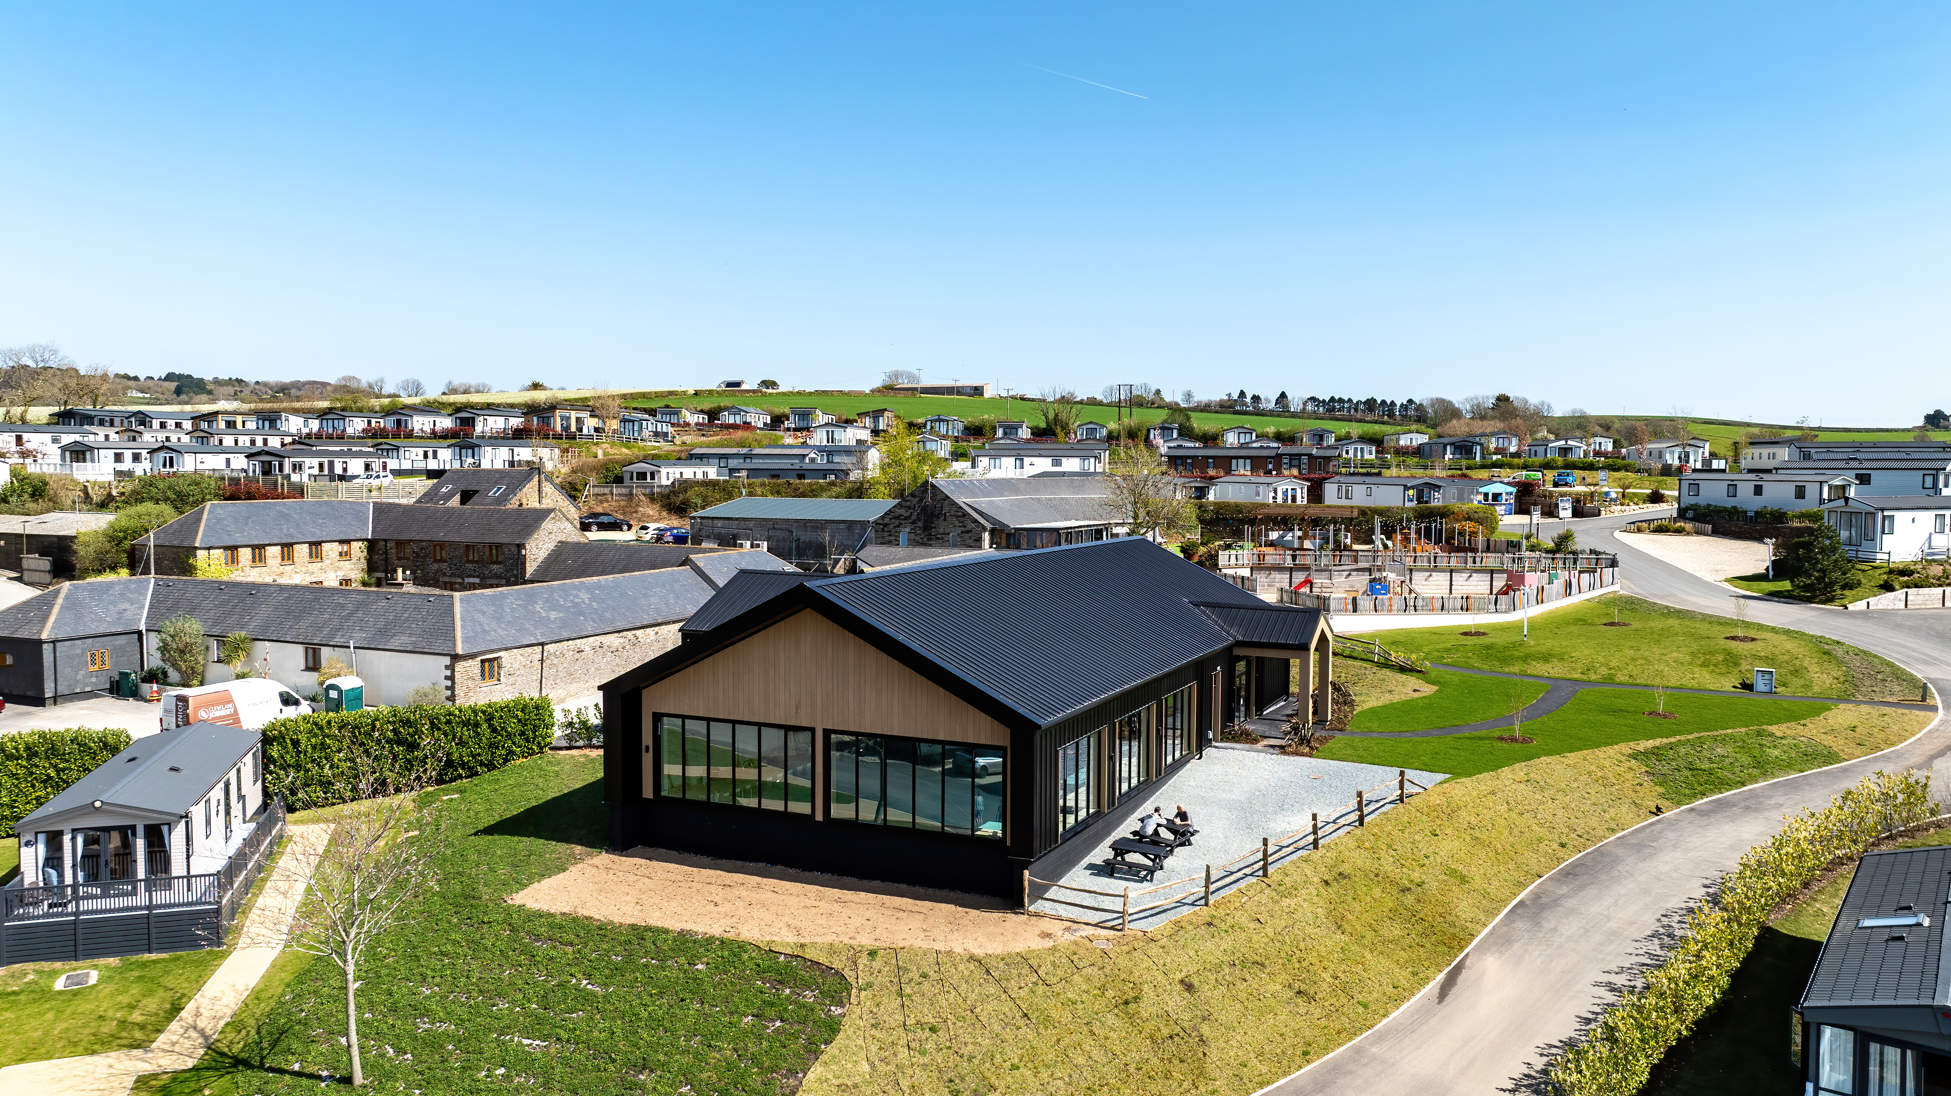
Case study
Tregoad
The challenge
Rising energy costs across the enlarged estate, combined with commitment to sustainable practices, created urgent need for smarter resource monitoring. However, standard off-the-shelf systems had limitations that would compromise operational requirements.
30%
energy
reduction
Live visibility
of energy
consumption
Quick facts
The Solution
Automated shut off of hot tubs across the site.
skentel implemented comprehensive remote monitoring and control solutions through a single, user-friendly dashboard.
Electrical management systems: Real-time energy consumption tracking across the site and individual assets
Energy-saving automated controls: Scheduled hot tub operation (11pm-7am shutdown)
Borehole monitoring and automated control: Water level monitoring with automatic pump control and backup activation
Tregoad Holiday Park spans 55 acres of rural Cornwall near Looe, offering diverse accommodation from luxury static caravans to premium lodges with private hot tubs. Acquired by Waterside Holiday Group in 2019, the new owners invested over £8 million in transformative improvements.
Real time energy monitoring
Site wide water management and control solutions
Instant energy saving
Notes:
So, what better way to illustrate this than a case study of a real live example where skentel has made great savings in time, energy, water and often, all three!
This is Tregoad holiday park in Cornwall which is part of The Waterside Holiday Group. We also have a printed copy of this case study for you to take away.
Stories beat statistics every time. You can talk about smart systems and connected assets all day, but what really matters is a guest arriving at their lodge to find the hot tub perfectly heated whilst using less energy than the old “always-on” approach.

Slide 13
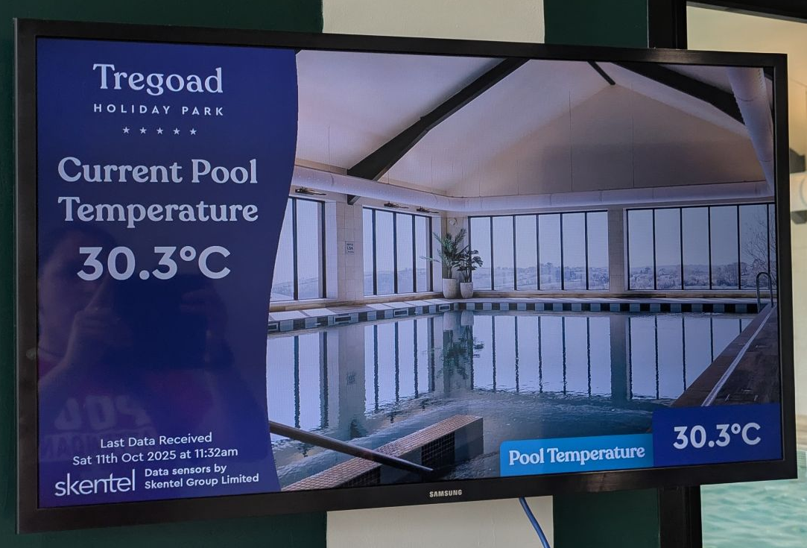

Notes:
I have included this photo simply to explain what we do.
The image on this screen is served up by Holidaymaker, the pool temperature sensor was installed by the pool chemical dosing company and we sit in the middle gathering useful data into our platform and present it to Holidaymaker.
Whether that is a temperature sensor, a pool occupancy profile or stats on how much solar energy have been generated. skentel is the clever connectivity provider.

Slide 14
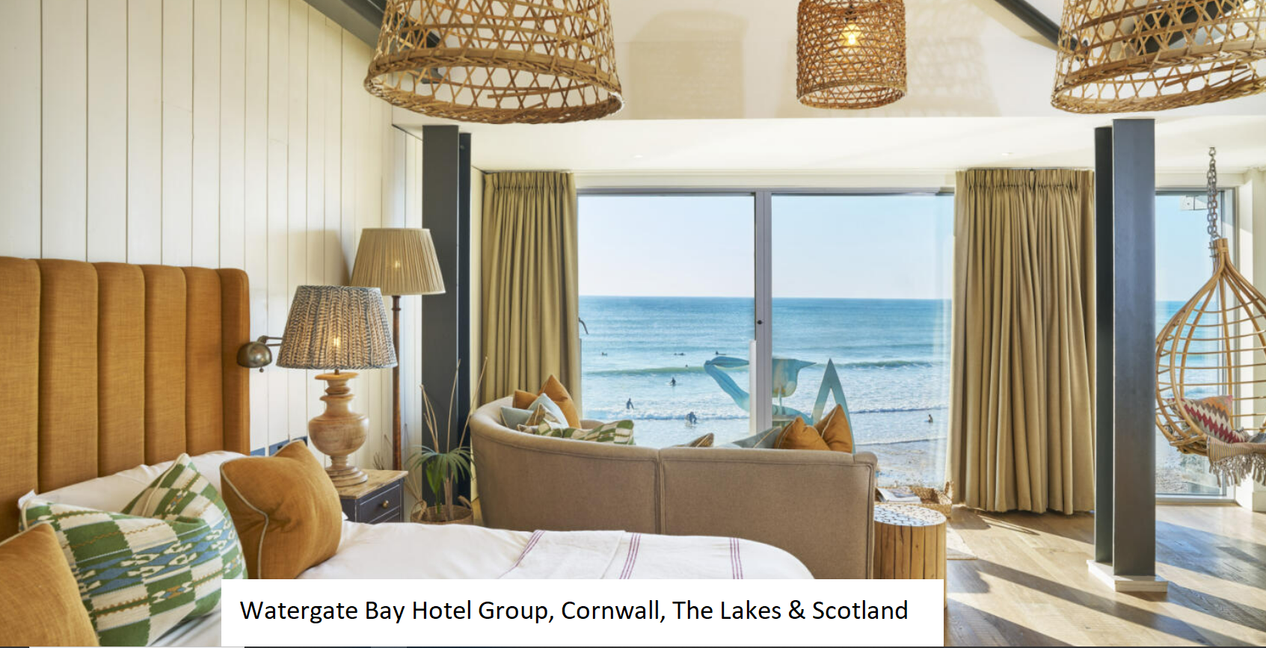
Case study
Tregoad
Environmental, Social, Governance (ESG)
skentel provide monitoring, insights and
B Corp ready reporting on the following:
All electric, gas and water meters
People counting in pools and cafes
Waste water and sewer systems
Hot Water Systems
Automated energy saving via booking
Pool & Spa systems
Live visibility
of energy
consumption
With hotel and resort properties across Cornwall,
The lake District and on a remote island in Scotland, Watergate Bay Hotel Group recognise the role the leisure industry has to play in a sustainable future and like skentel have already begun their journey to becoming a B Corp business.
Notes:
Another example of our clients benefitting from a strategy focused on the climate conscious holiday guest is the Watergate Bay Hotel Group.
We work with their ESG Manager, their Facilities Managers and Group Estates Director to monitor assets widely distributed across the UK with a focus on sustainability and the circular economy.

Slide 15
Action plan
Connectivity assessment
Smart implementation
Results and recognition
Survey of current assets
Where are biggest
challenges and waste
Custom solution design
Identify potential benefits
Improved data & insights
to inform improvement plans
Link to your booking systems to
Automate routine tasks
Use data to promote your
achievements
Costs savings enables
further improvements
Notes:
So what’s next? It is a 3 step action plan
Step 1 is to commission a connectivity assessment which starts with a site survey. The most stand out items are highlighted and a proposal for a remote monitoring solution written up and discussed in person to explain the return on investment both environmentally and financially.
Step 2 – is to implement our smart solutions. There is also the opportunity to make the system even smarter by linking to your booking system to create some automated actions
Step 3 - Use the data to shout about your results, and use the costs savings to drive further improvements

Slide 16
Why?
Who are skentel?
16 years in remote monitoring and control
We eliminate the need to travel to assets, to save time, energy and natural resources
Becoming a B Corp
We want to use our business as a force for good, both environmentally and socially. That’s why we’re currently going through a rigorous assessment to become B Corp certified.
Notes:
So who are skentel? We are 16+ years in remote monitoring and control.
Why do we do what we do? We eliminate the need to travel to assets to save waste. Be that wasted time, wasted energy or wasted natural resource.
This year we started our journey to B Corp and are currently going through the rigorous assessment to become certified summer 2026.
A Strategy is a philosophy of becoming, who do you want to become?
skentel is becoming a thought leader in connected solutions for sustainable asset management eliminating the need to travel to assets.
If you would like to join Tregoad Holiday Park and Watergate Bay Hotel and make a difference please come and talk to skentel.

Slide 17
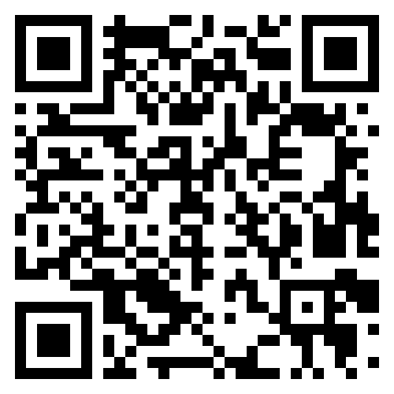

Thank you
Any questions?
Contact
solutions@skentel.net

