Slide 1
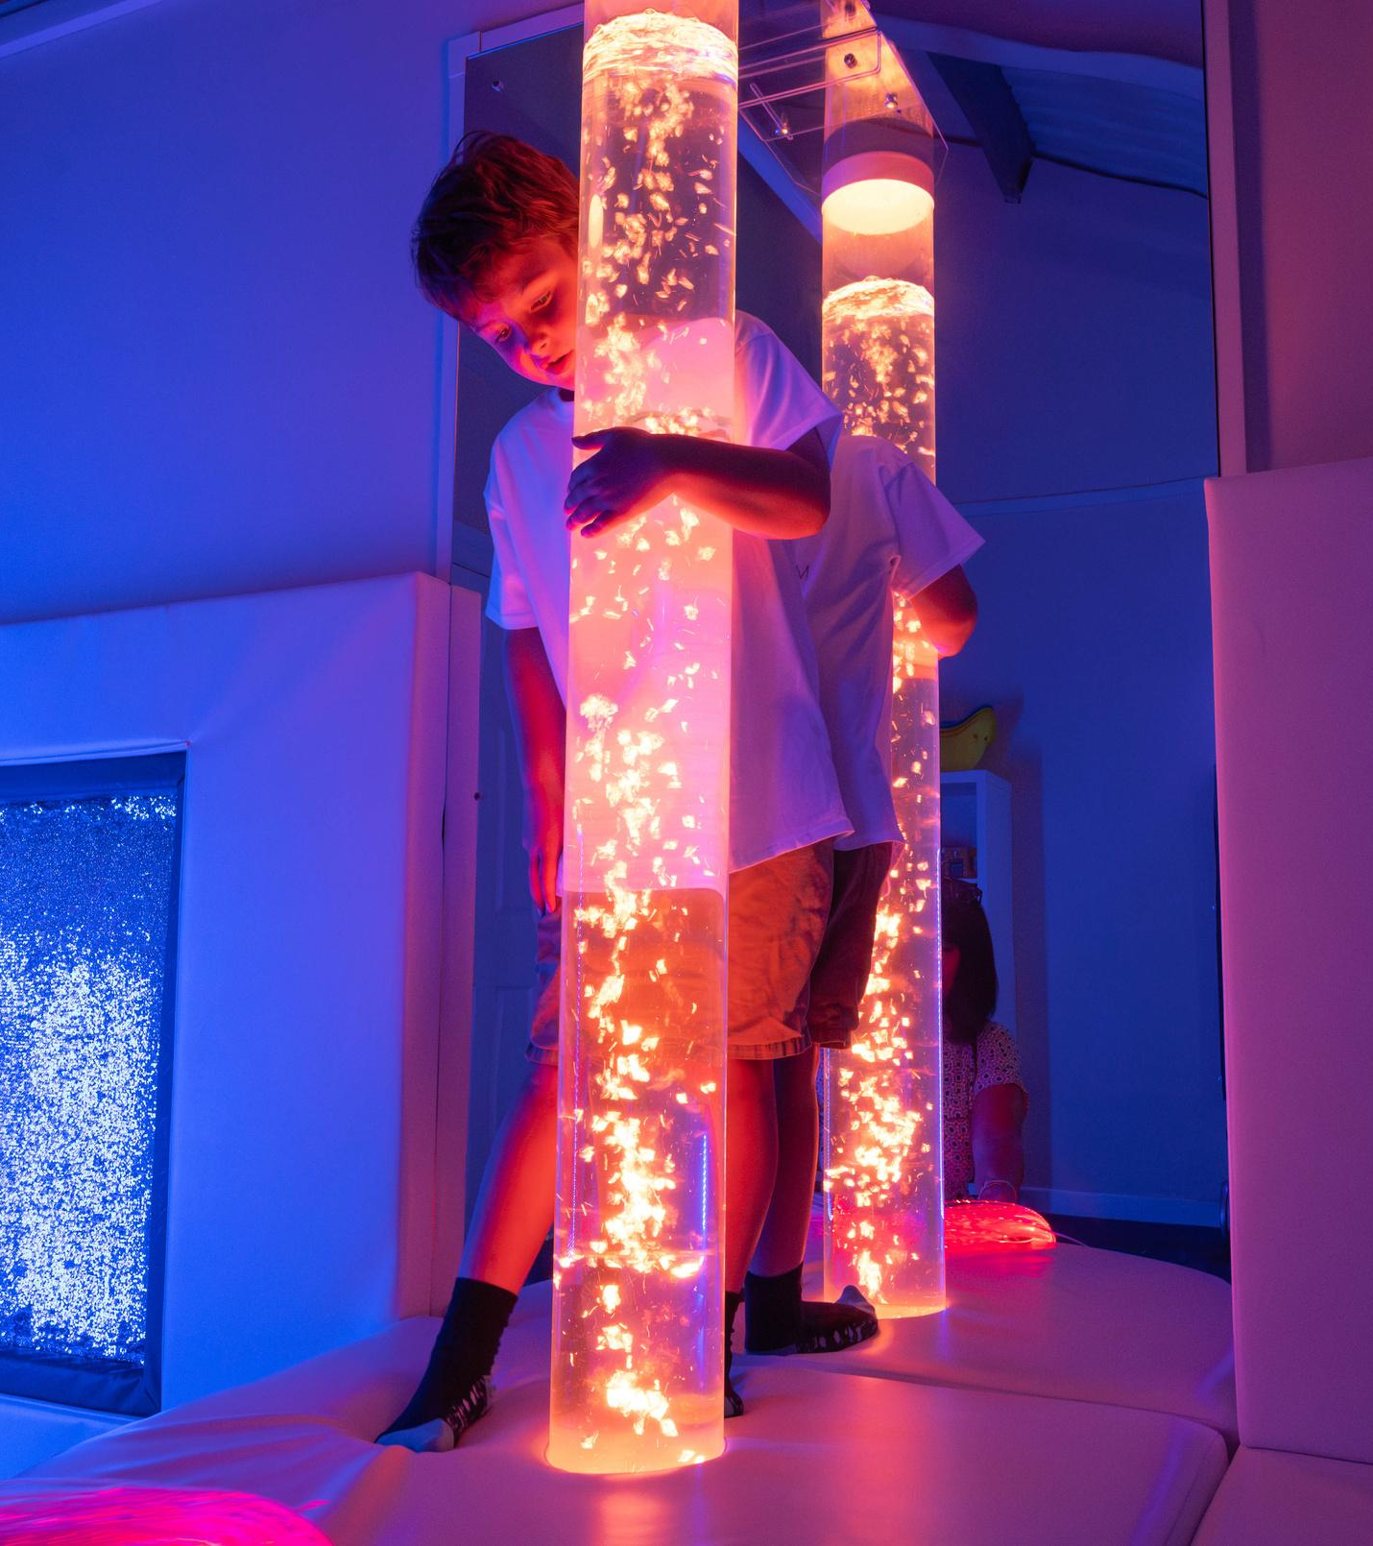

Creating
Neuro-Inclusive Environments
SUPPORTING GUESTS AND YOUR STAFF

Slide 2
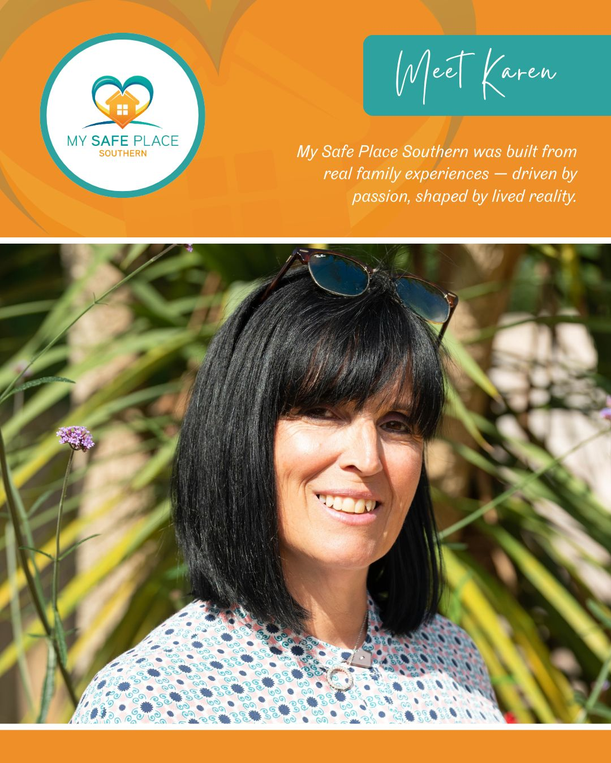
My Journey
Over 35 years experience working in the holiday & park home industry.
21 years supporting my brothers 3 neurodivergent children.
The conversation that stopped me in my tracks.

Slide 3

What Is Neurodiversity?
Neuro
Refers to the nervous system - Brain - Spinal Cord - Nerves.
The nervous system sends messages between our brain and our body sight, smell, taste, touch and hearing as well as balance, movement, and spatial awareness.
Diversity
Refers to variations or differences within a group.
When these significant differences are ‘neurocognitive’ the group is described as ‘neurodivergent’.

Slide 4
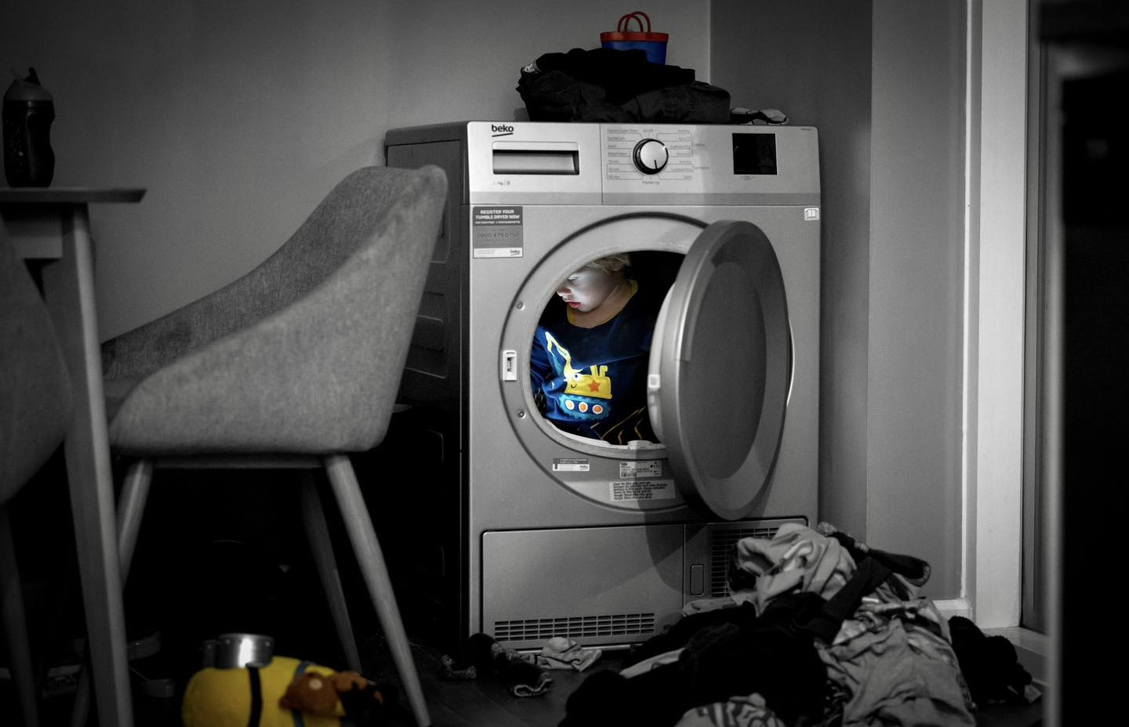
Neurodivergence - UK Statistics
Autism Spectrum Disorder
2.8 Million Families Affected In UK
ADHD -Attention Deficit Hyperactive Disorder
2.6 Million In UK
Dyslexia
9 Million In UK
Dyspraxia
6 Million In UK
Tourette Syndrome
300,000 In UK
Companies already embracing NEURODIVERSITY include:
TUI - JET2 - TESCO - J P MORGAN - ROYAL NAVY
BOURNEMOUTH AFC - AIRPORTS ….AND MORE.

Slide 5
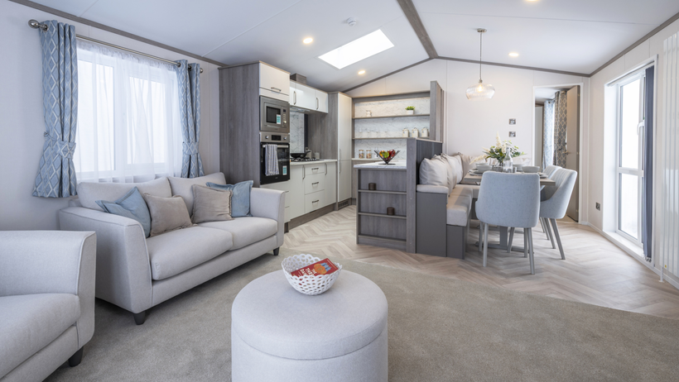
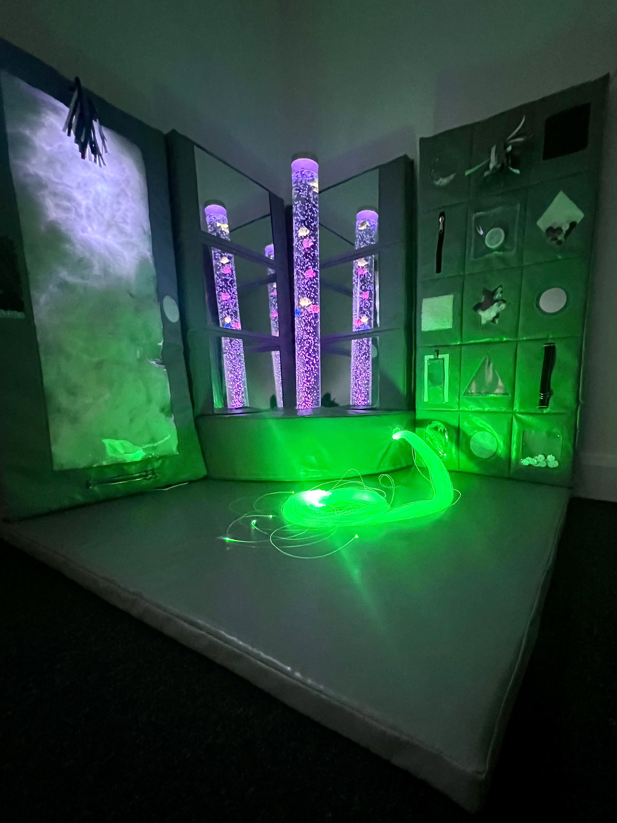
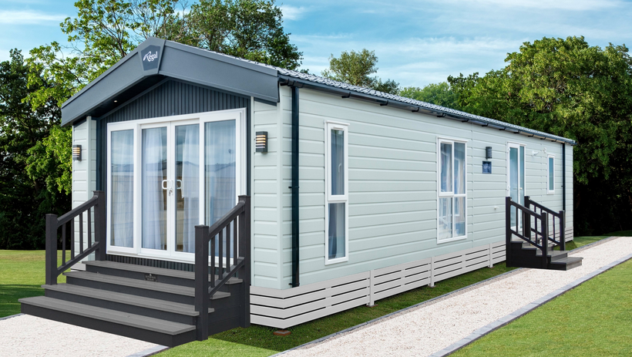
My Safe Place – What We Offer.
ND Park Audit & Report – Seeing the business through the eyes of a neurodivergent guest and provide feedback.
My Safe Place Accommodation – Bespoke ND specification with safety and sensory in mind embraced by manufacturer’s and suitable for any family with young children, so not to restrict bookings.
Staff Training – from seasonal to senior management, and tailored packages for entertainment and activity providers.
Sensory Room/Sensory Garden - Design & Install
Accreditation Scheme – Industry Benchmark
My Safe Place Holidays – Dedicated website to direct ND families/charities/local authorities to your park.
Holiday Home Ownership – Sales support for ND enquiries

Slide 6
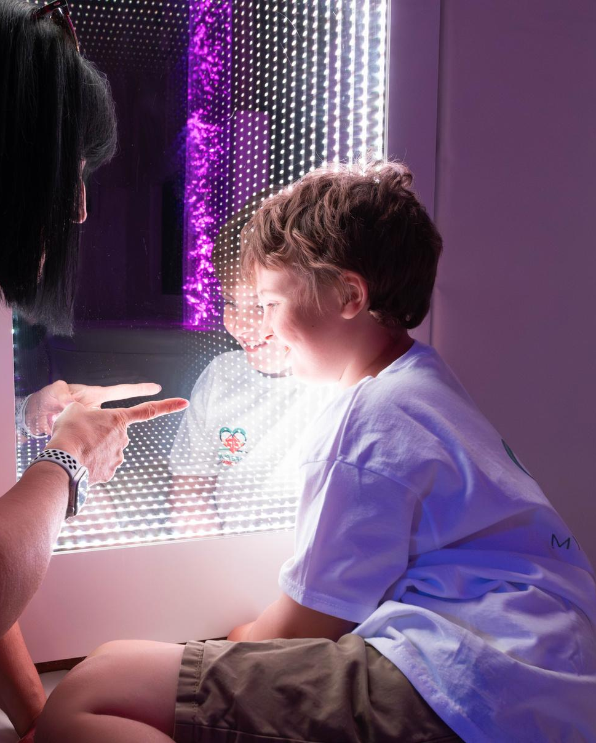
Case Example – My Brothers Experience
Family arrived overwhelmed by the journey - holiday excitement – change in routine.
Had a lengthy wait for keys in busy facility building which added to the anxiety.
Staff had no experience of a neurodiverse family and their needs, so when asking for help it was not forthcoming, and they did not recognise the meaning of the Sunflower Lanyard.
The caravan accommodation turned out to be unsuitable as was not safe for ND guests.
The advertised quiet swimming hour was not managed and was not quiet, and there were no other activities on site suitable.
After 2 days my brother and his family returned home.

Slide 7
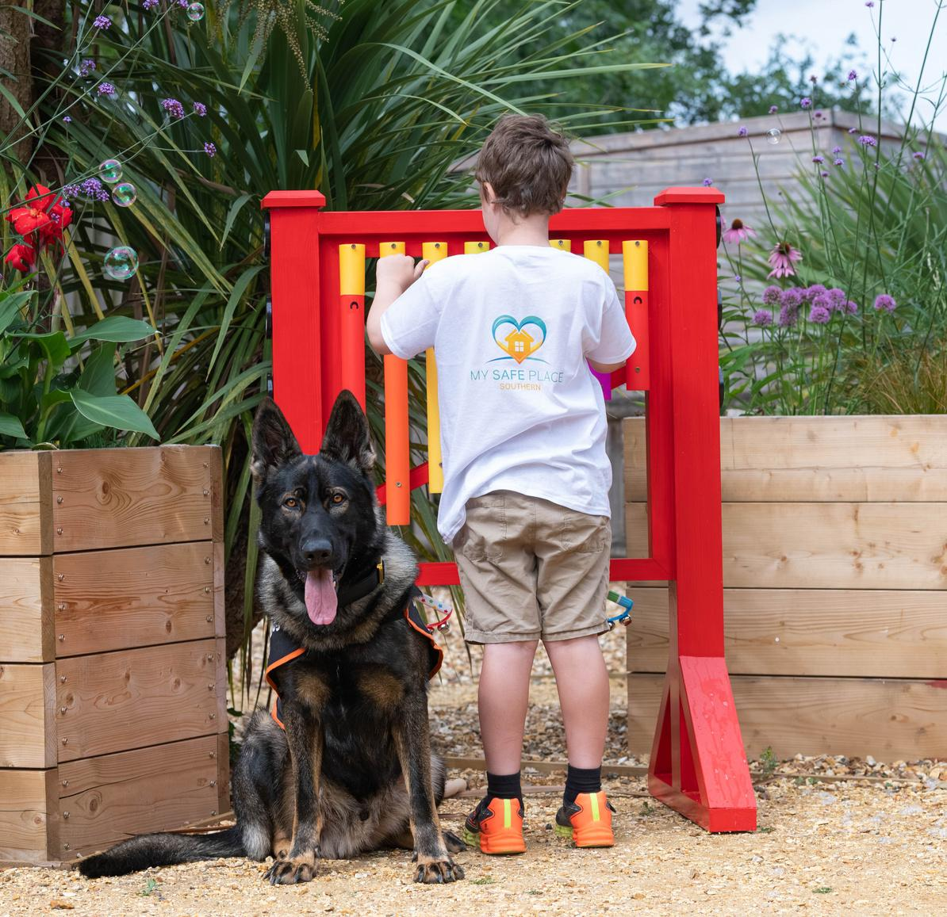
Key Takeaways
By embracing differences and working with My Safe Place holiday parks can become neuro-inclusive.
You can expand your reach and open your park to a wider audience.
Show guests and staff that your business genuinely cares.
Help create holiday experiences EVERYONE can enjoy.
Together we can make a real impact.
Let’s make 2026 the year inclusivity thrives within our parks.

