Slide 1

Holidaymaker XP Update
October 2025
David Lakins
www.holidaymakerapp.co.uk
Co-Founder & CEO
david@holidaymakerapp.co.uk
Notes:
Welcome everyone — great to see so many familiar faces. Since our last XP event, the Holidaymaker ecosystem has continued to evolve — connecting guests, parks, and partners through one joined-up platform. Today I’ll share what we’ve been building, what’s live right now, and what’s coming next….

Slide 2
Welcome
60+
415,000
Holidaymaker in Numbers
Live on Parks
App Downloads since launch
Now live in more than 60 parks across the UK
45,000 users per month
11am-6pm
8-12 mins
Peak Usage Jul-Aug
Average Engagement time
11am
2pm consistently peak time
3-6pm planning for evening
8 – 12 mins per user during Jul - Aug
Notes:
The platform has grown rapidly. We now have over 60 parks across the UK actively using Holidaymaker
There’ve been over 415,000 downloads and around 45,000 monthly active users. Peak usage happens mid-morning and early evening — when guests plan their days or book activities. Session times are up, engagement is rising, and we’re seeing steady increases in direct bookings and upsells across parks.
Every interaction helps us learn more about how guests behave and what drives repeat bookings.”

Slide 3

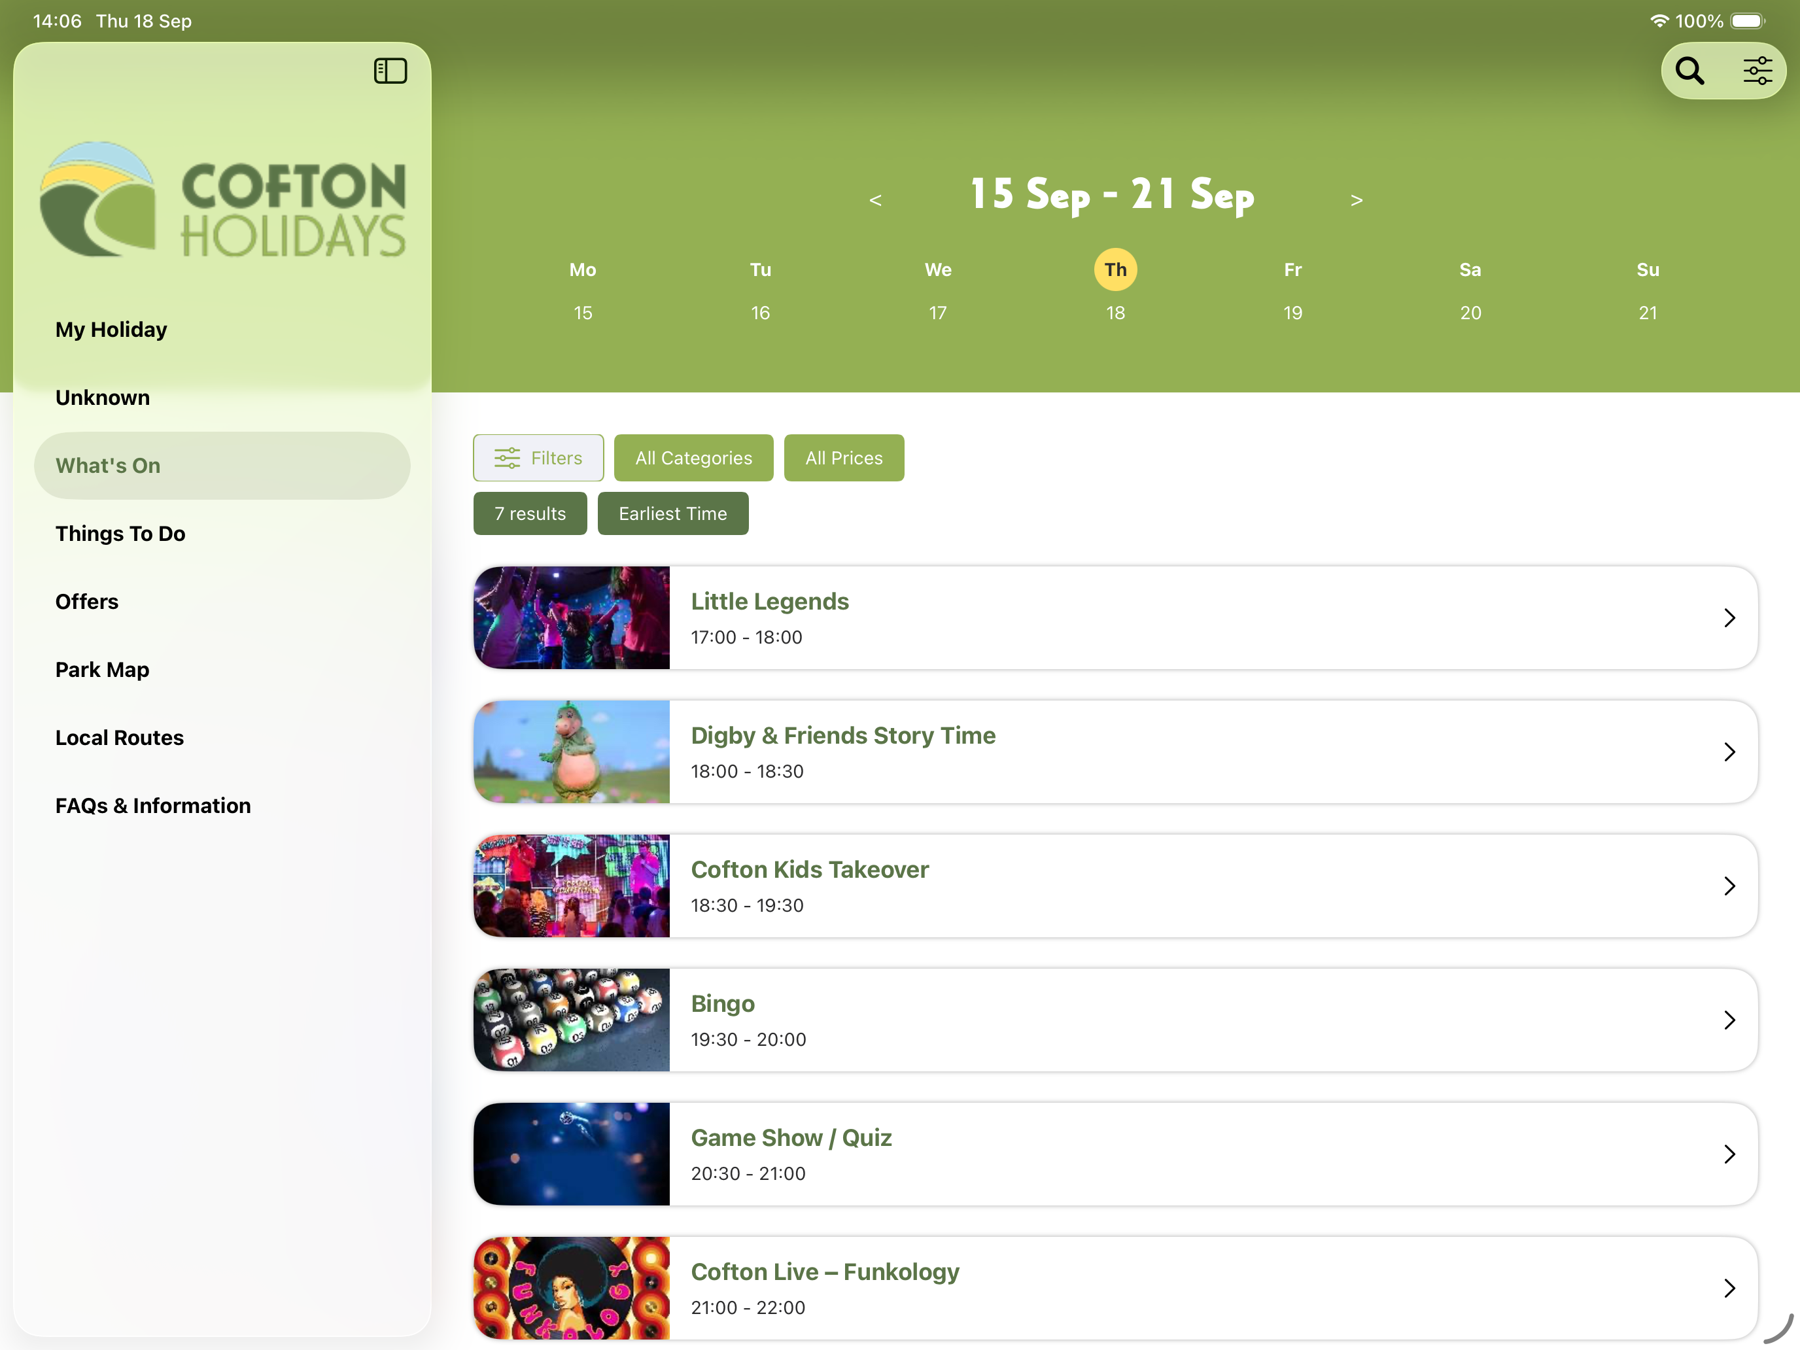
Platform Update
Since the Last XP Event
01
iPad Specific design and navigation
Notes:
Since our last gathering, we’ve focused on creating a more connected, personalised guest journey.
We’ve added full support for iPads – with iPad specific design and navigation.

Slide 4
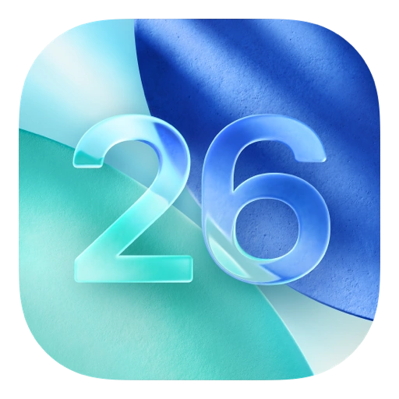
Platform Update
Since the Last XP Event
02
App update for iOS 26
Notes:
We’ve rolled out the iOS 26 update, introduced Apple AI summaries, and enhanced personalisation through new onboarding questions.
“The latest iOS 26 update brings not just a refreshed design but deeper insight too.

Slide 5
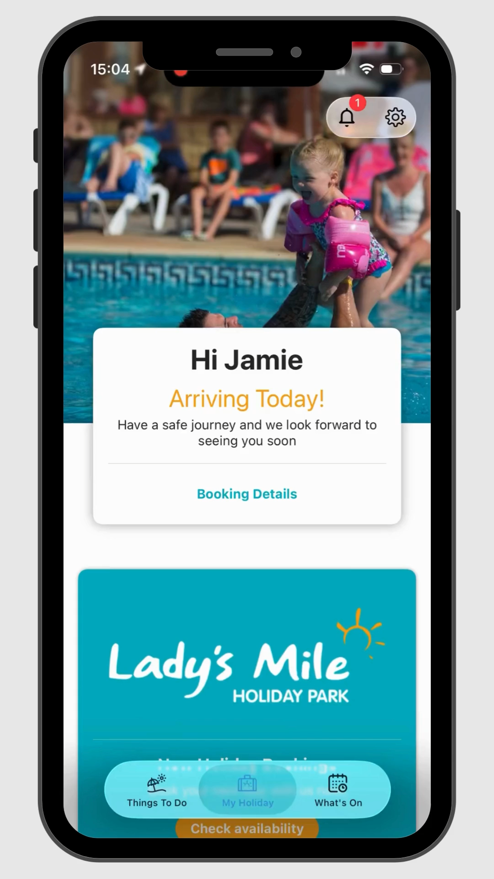
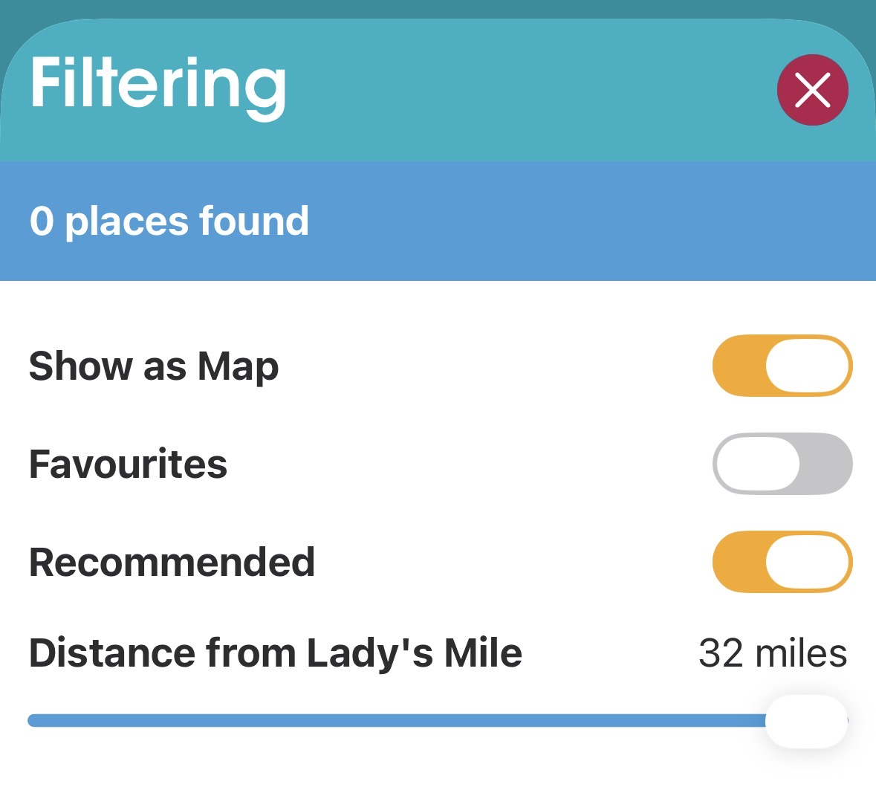
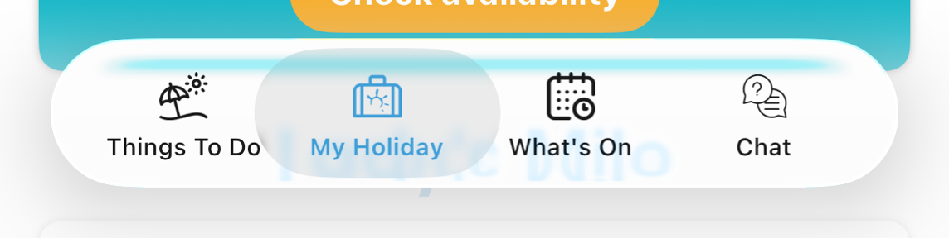
Platform Update
Since the Last XP Event
03
Liquid Glass for iOS26 users
Apple Intelligence Summaries throughout the app
Notes:
We’ve focused on making it feel more personal, more responsive, and more useful day-to-day. From smarter notifications to interactive park maps and location-aware content — guests can now find, book, and engage with everything around them in just a few taps.”
And of course we have included Liquid Glass as well.
We couldn’t showcase a tech update without mention of AI…
We’ve introduced Apple AI summaries throughout the app. This means guests — and staff — can instantly understand key information at a glance, from opening hours to booking confirmations, without scrolling through long pages. It’s a small feature with a big impact on usability — powered by on-device AI, keeping data private and the experience fast.”
HeyGuest integration is now embedded for conversational AI, and Love2Visit brings local experience content straight into the app.

Slide 6

Platform Update
A
Support & Help Desk
Support documents, FAQs, and integration guides, along with quick how-to videos and update notes.
Since the Last XP Event
B
Community & Learning Sections
A growing network of industry partners who share our mission to strengthen the UK’s hospitality and holiday park sector.
04
XP Community Hub
C
New MIS Dashboard
Instant access to your own data, engagement, and performance insights — all in one place.
Notes:
The XP Community brings together our full library of support documents, FAQs, and integration guides, along with quick how-to videos and update notes. You can raise support tickets, share feedback, or find answers instantly through a single, easy-to-use portal.
It’s designed to help park teams get the most from Holidaymaker — faster responses, clearer resources, and a growing knowledge base shaped by the community itself.
The Holidaymaker XP community is built on collaboration.
We’re proud to work alongside a growing network of industry partners and sponsors who share our mission to strengthen the UK’s hospitality and holiday park sector.
From technology providers and booking systems to marketing, payments, and sustainability partners — each contributes to making the ecosystem stronger.
Together, we’re supporting parks, suppliers, and regional tourism bodies to innovate, share knowledge, and elevate standards across the hospitality sector.
The result is a connected community focused on practical solutions, shared learning, and genuine collaboration.

Slide 7
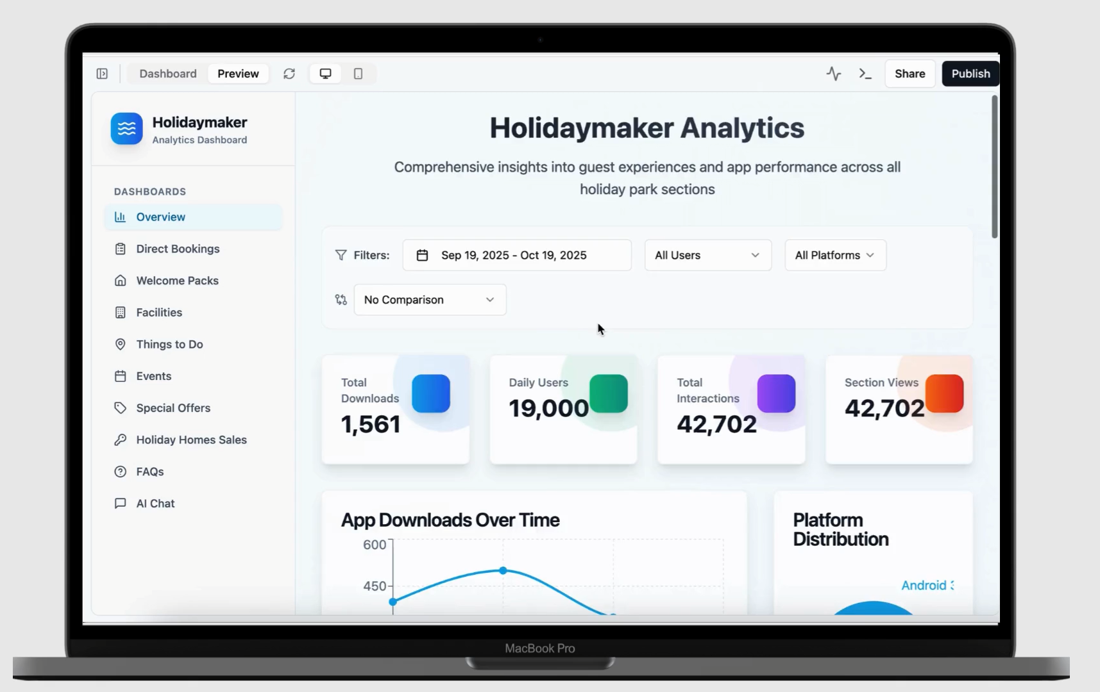
Platform Update
Since the Last XP Event
05
MIS Update
Notes:
We will be phasing out our email copy PowerBI reports and giving you instant access to your own data, engagement, and performance insights — all in one place.
Behind the scenes, our new MIS dashboard lets parks see performance in real time — bookings, push engagement, app usage, and comparisons across sites. It’s visual, interactive, and ready for self-service. The short video here shows just how much clarity and control this now brings to park teams.”

Slide 8














Platform Update
Bookings & Revenue
Notes:
We’ve also deepened our PMS integrations — with RMS, Elite Dynamics, ParcVu, Booking Experts, and GemaPark all now connected.
We’re continuing to deepen our integrations with leading PMS partners — including, RMS, Elite Dynamics, ParcVu Booking Experts and GemaParks.
By connecting more data points across these systems, Holidaymaker can now identify and engage guests throughout their journey — from booking to post-stay.
These deeper integrations unlock new guest opportunities, enabling targeted rebooking prompts, personalised offers, and seamless guest experiences across every touchpoint.

Slide 9
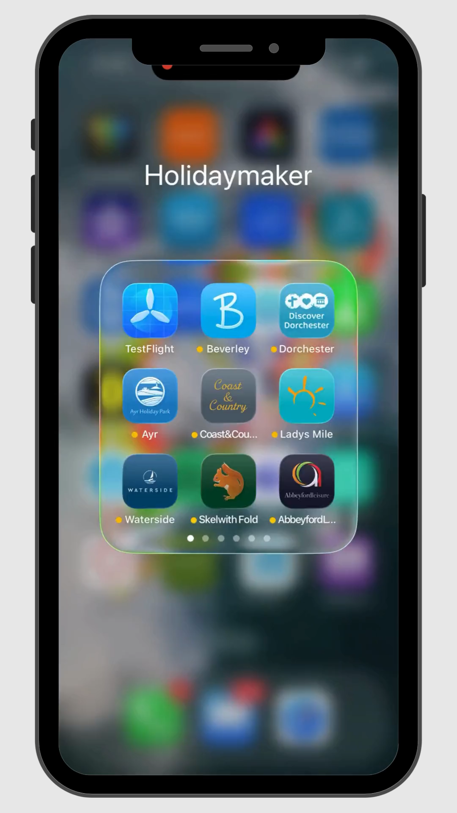

Platform Update
Bookings & Revenue
10x return on platform investment (entirely new revenue)
Notes:
One of the biggest success stories is how in-app bookings are performing.
For example, Beverley Park has already 10x return on their platform costs through app-only bookings. Since launching bookings in mid-May.

Slide 10
01
App bookings are driving new revenue, not replacing existing ones.
Platform Update
Bookings & Revenue
02
Ability to target OTA customers (e.g. Hoseasons) with direct booking incentives and push notifications
03
An effective alternative to PPC and paid-ad spend: use in-app promotions, segmented push offers, and loyalty content to drive direct bookings without external ad costs
04
Every push notification and app CTA is a mini marketing campaign — zero media spend, 100% direct revenue.
Notes:
They’re generating new, incremental revenue — not just shifting existing sales. We’re also using the app to target OTA customers — like Hoseasons guests — and bring them back to book direct next time.
It’s a cost-effective alternative to PPC or paid ads — replacing external media spend with powerful, in-app marketing tools.
Through targeted promotions, segmented push notifications, and personalised offers, parks can reach guests who already know and trust their brand.
Every push notification becomes its own mini marketing campaign — 100% direct, and driven entirely by your own data.
It’s smarter, faster, and delivers results that traditional paid advertising simply can’t match.

Slide 11

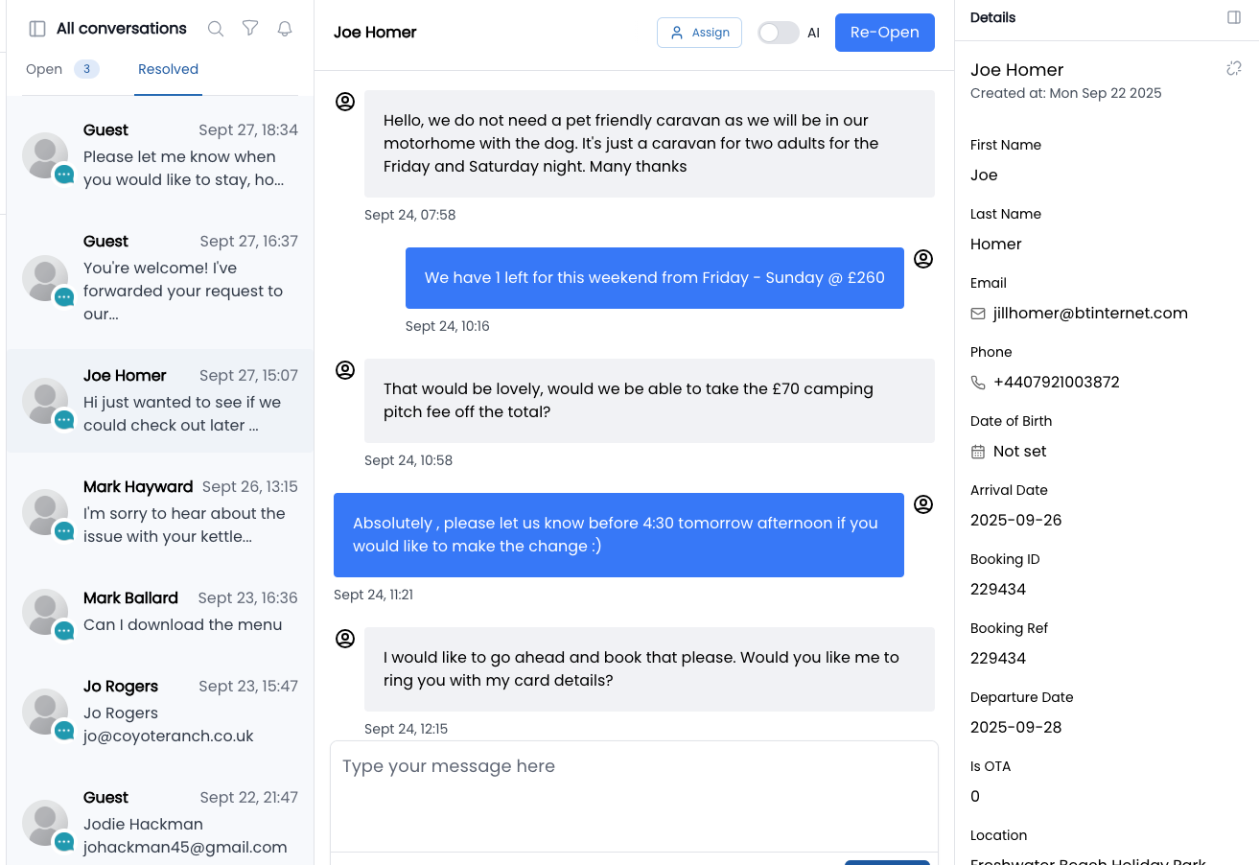
Platform Update
Bookings & Revenue
Notes:
They’re generating new, incremental revenue — not just shifting existing sales. We’re also using the app to target OTA customers — like Hoseasons guests — and bring them back to book direct next time.
It’s a cost-effective alternative to PPC or paid ads — replacing external media spend with powerful, in-app marketing tools.
Through targeted promotions, segmented push notifications, and personalised offers, parks can reach guests who already know and trust their brand.
Every push notification becomes its own mini marketing campaign — 100% direct, and driven entirely by your own data.
It’s smarter, faster, and delivers results that traditional paid advertising simply can’t match.

Slide 12

Platform Update
Segmentation & Personalisation
Segmentation
Targeting
New Module
Target OTA customers
Create unique app views for home owners, staff, VIPs, guests
Target OTA guests (like Hoseasons) with direct booking incentives and push notifications
Onboarding
Data
Personalised app experiences
Behavioural Data
Onboarding questions and tagging to personalise guest information instantly
Behavioural data fuels smarter targeting and upselling
Notes:
The Segmentation Module is now live, allowing each park to tailor the app experience by audience.
Personalisation is now core to the app. With our new Segmentation Module, parks can create custom experiences for owners, staff, VIPs, and guests — all within the same app. When users first log in, onboarding questions tailor the content they see. From offers to events, every guest’s journey becomes unique. This is what allows parks to communicate with relevance — not noise. Home owners, guests, staff — even VIPs — can all see different menus, notifications, and features based on their role. It’s the foundation for personalisation — and it’s what makes automation and relevant content truly possible.”

Slide 13
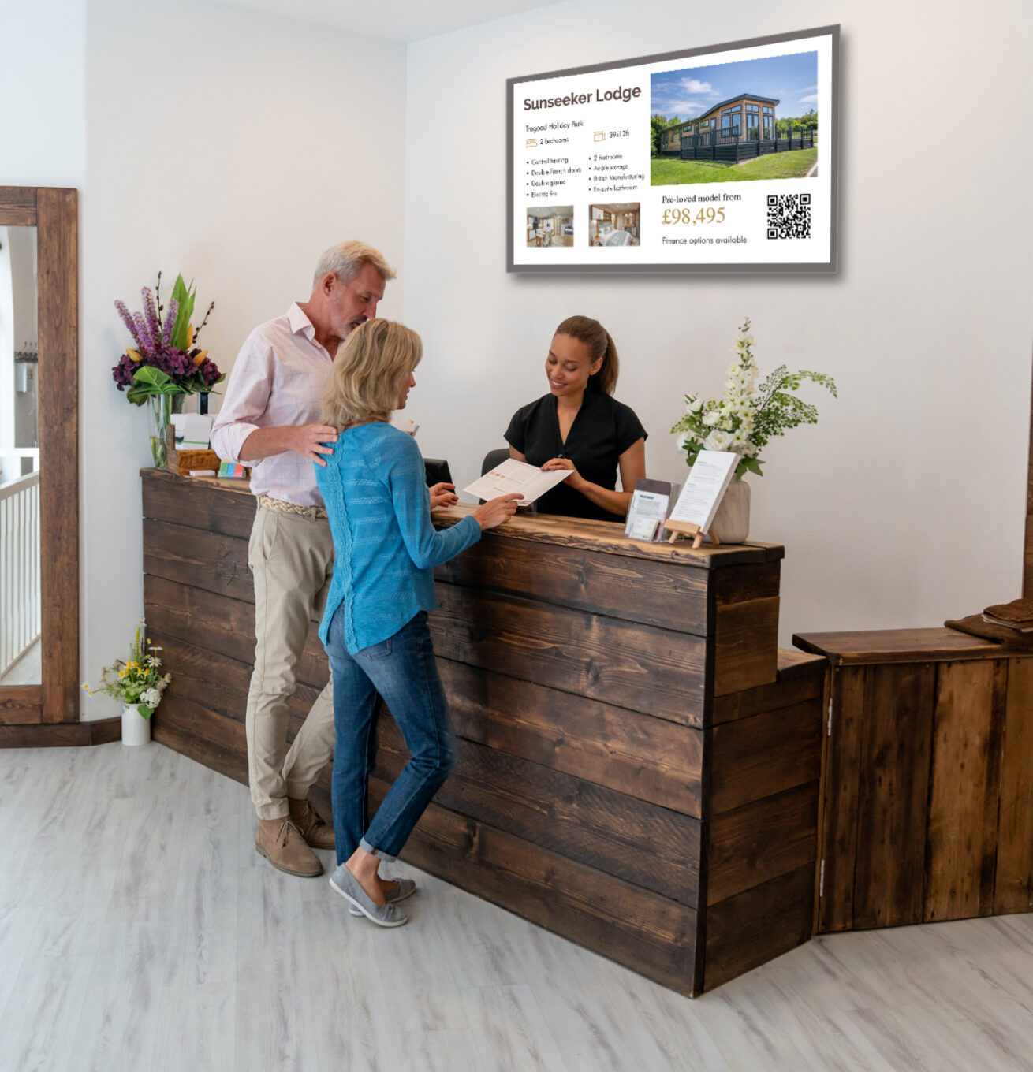
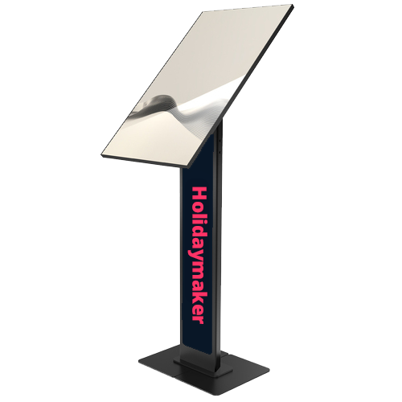
01
Guests can book tables & order food to caravan, view energy or EV charging usage
On-Park Experience
02
SeeView now supports video, images, and Canva embeds
Connecting everything guests interact with on-park
03
Kiosk mode for receptions, local guides, and event sign-ups
Embedded integrations with Zonal, ResDiary, ICR Touch, MetPow,, Hey Guest chat upgrades
Notes:
On the park, we’re bringing everything together under one system. Holidaymaker now embeds with on-park solutions such Zonal, ResDiary, ICRTouch, the Meter app, and more. That means guests can book tables, order food to their caravan, or even check their energy or EV charging usage directly in-app. SeeView screens now support video and Canva embeds — so you can reuse the same creative across digital signage. And the new kiosk mode allows guests to check in, browse local guides, and view real-time updates.
It’s all about one connected ecosystem — one experience for guests, one dashboard for parks.

Slide 14
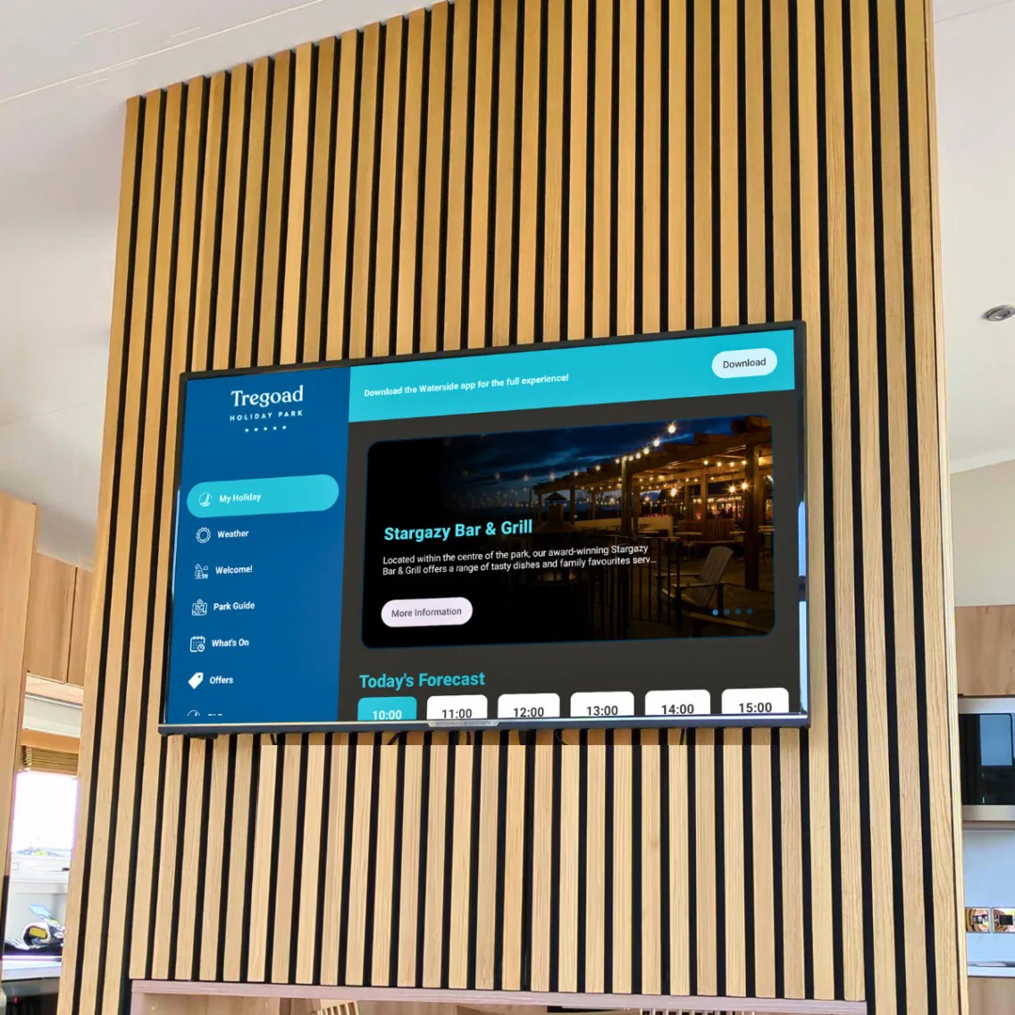
01
Broadcast guest information directly to in-unit smart TVs
On-Park Experience
02
Personalised welcome screens – e.g. “Welcome, Mr Lakins”
Connecting everything guests interact with on-park
03
Transforms the TV into an interactive, direct-booking channel
In-lodge & caravan TV apps - Bringing the Holidaymaker experience right into the living room.”
Notes:
We’re now extending the Holidaymaker experience directly into lodges and caravans through smart TV apps and on-unit broadcasts.
Guests can view live park information, weather updates, menus, and local recommendations right from their TV screen — with QR codes for instant bookings or food orders.
We’re also developing a personalised version, similar to the Premier Inn experience, where each arrival is greeted with a message like “Welcome, Mr Lakins.”
It’s a new, high-impact way to engage guests from the comfort of their accommodation — turning the TV into both an information hub and a direct-booking channel.

Slide 15


On-Park Experience
Connecting everything guests interact with on-park
IoT Data – bringing real-time data to the platform to inform and enhance the guest experience
01
Open API for live pool temperature feed displayed in-app and on digital screens
02
Weather & surf reports, EV charger availability, footfall sensors, car park occupancy, flood risk and warnings & more
03
Live park data = happier guests + smarter decisions
Notes:
We’re also introducing live park data feeds, bringing the Internet of Things directly into the Holidaymaker ecosystem. At Tregoad Holiday Park, for example, we’ve integrated a real-time pool temperature feed into the app and digital screens. Jamie has been working with Rob @ Skentel to develop our own API solution that can request data from various IoT sources.
Other IoT data is coming soon — weather and surf reports, EV charger availability, footfall sensors for cafes, and even laundry or car park occupancy. This kind of live information enhances guest experience and gives park operators better insight into how facilities are used, so you can plan, staff, and communicate more effectively.

Slide 16
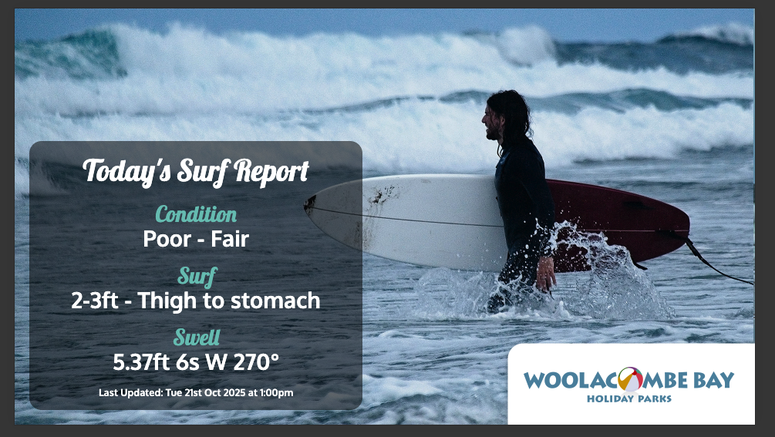
On-Park Experience
Connecting everything guests interact with on-park
IoT Data – bringing real-time data to the platform to inform and enhance the guest experience
01
Open API for live pool temperature feed displayed in-app and on digital screens
02
Weather & surf reports, EV charger availability, footfall sensors, car park occupancy, flood risk and warnings & more
03
Live park data = happier guests + smarter decisions
Notes:
We’re also introducing live park data feeds, bringing the Internet of Things directly into the Holidaymaker ecosystem. At Tregoad Holiday Park, for example, we’ve integrated a real-time pool temperature feed into the app and digital screens. Jamie has been working with Rob @ Skentel to develop our own API solution that can request data from various IoT sources.
Other IoT data is coming soon — weather and surf reports, EV charger availability, footfall sensors for cafes, and even laundry or car park occupancy. This kind of live information enhances guest experience and gives park operators better insight into how facilities are used, so you can plan, staff, and communicate more effectively.

Slide 17

HeyGuest updates
Holly.Bobs - Conversational booking & WhatsApp integration
Notes:
Many of you will remember Polly.AI, the conversational booking system domoed by Duncan at Hall & Woodhouse this time last year. Well, the clever guys at HeyGuest – Adam and Charlton – have taken that concept much further. They’ve been working closely with us on Holly.AI, an intelligent conversational booking tool now built directly into their chat platform. It connects seamlessly with the Holidaymaker ecosystem, so guests can ask questions, check availability, and even make bookings — all through a natural chat conversation on WhatsApp, Messenger, or the park website. It’s fast, human-like, and available 24/7 — helping parks handle enquiries and drive more direct bookings automatically.

Slide 18
Q3-4 Product Roadmap
XP Community Launch
MIS / Analytics
Onboarding & Personalisation
Push Notification V2
HeyGuest Updates
Personalised TV Apps
Oct.
Nov.
Dec.
Jan
Feb
Mar.
Apr.
Notes:
Coming up next quarter, we’re focusing on automation and personalisation.
We will be launching the XP Community – so you and your teams will be receiving logins soon. The new MIS dashboard will give you full control over data comparisons and insights.
Onboarding and personalisation is a big piece of work for us that will lay the foundations for lots of different elements within the platform including the new push notifications.
We’re rewriting the push notification module so you can target segments automatically with rule-based triggers.
And through our HeyGuest partnership, we’ll be enabling WhatsApp as a new guest communication channel. We’re developing personalised TV apps that greet guests by name in their lodges

Slide 19

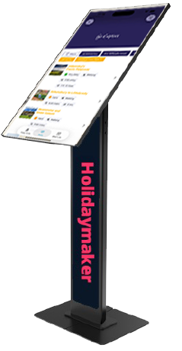
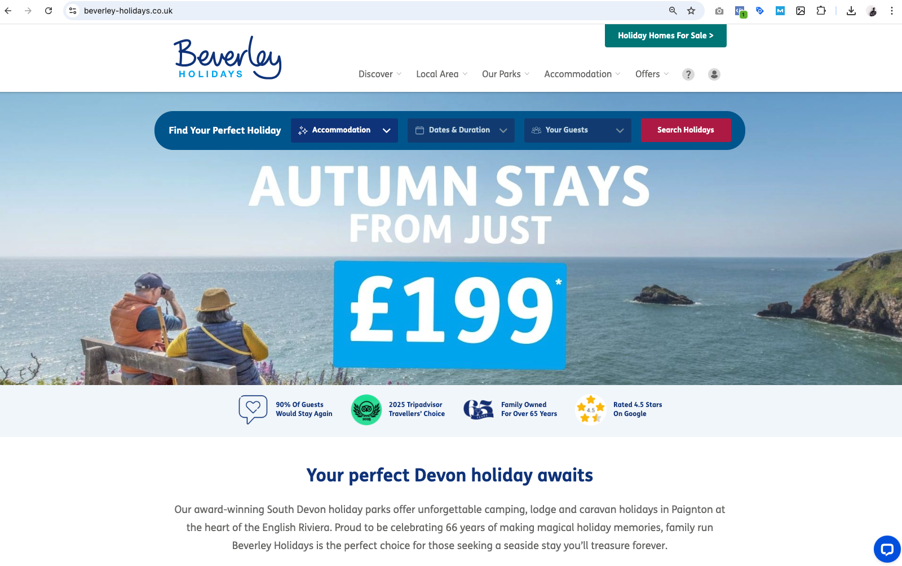
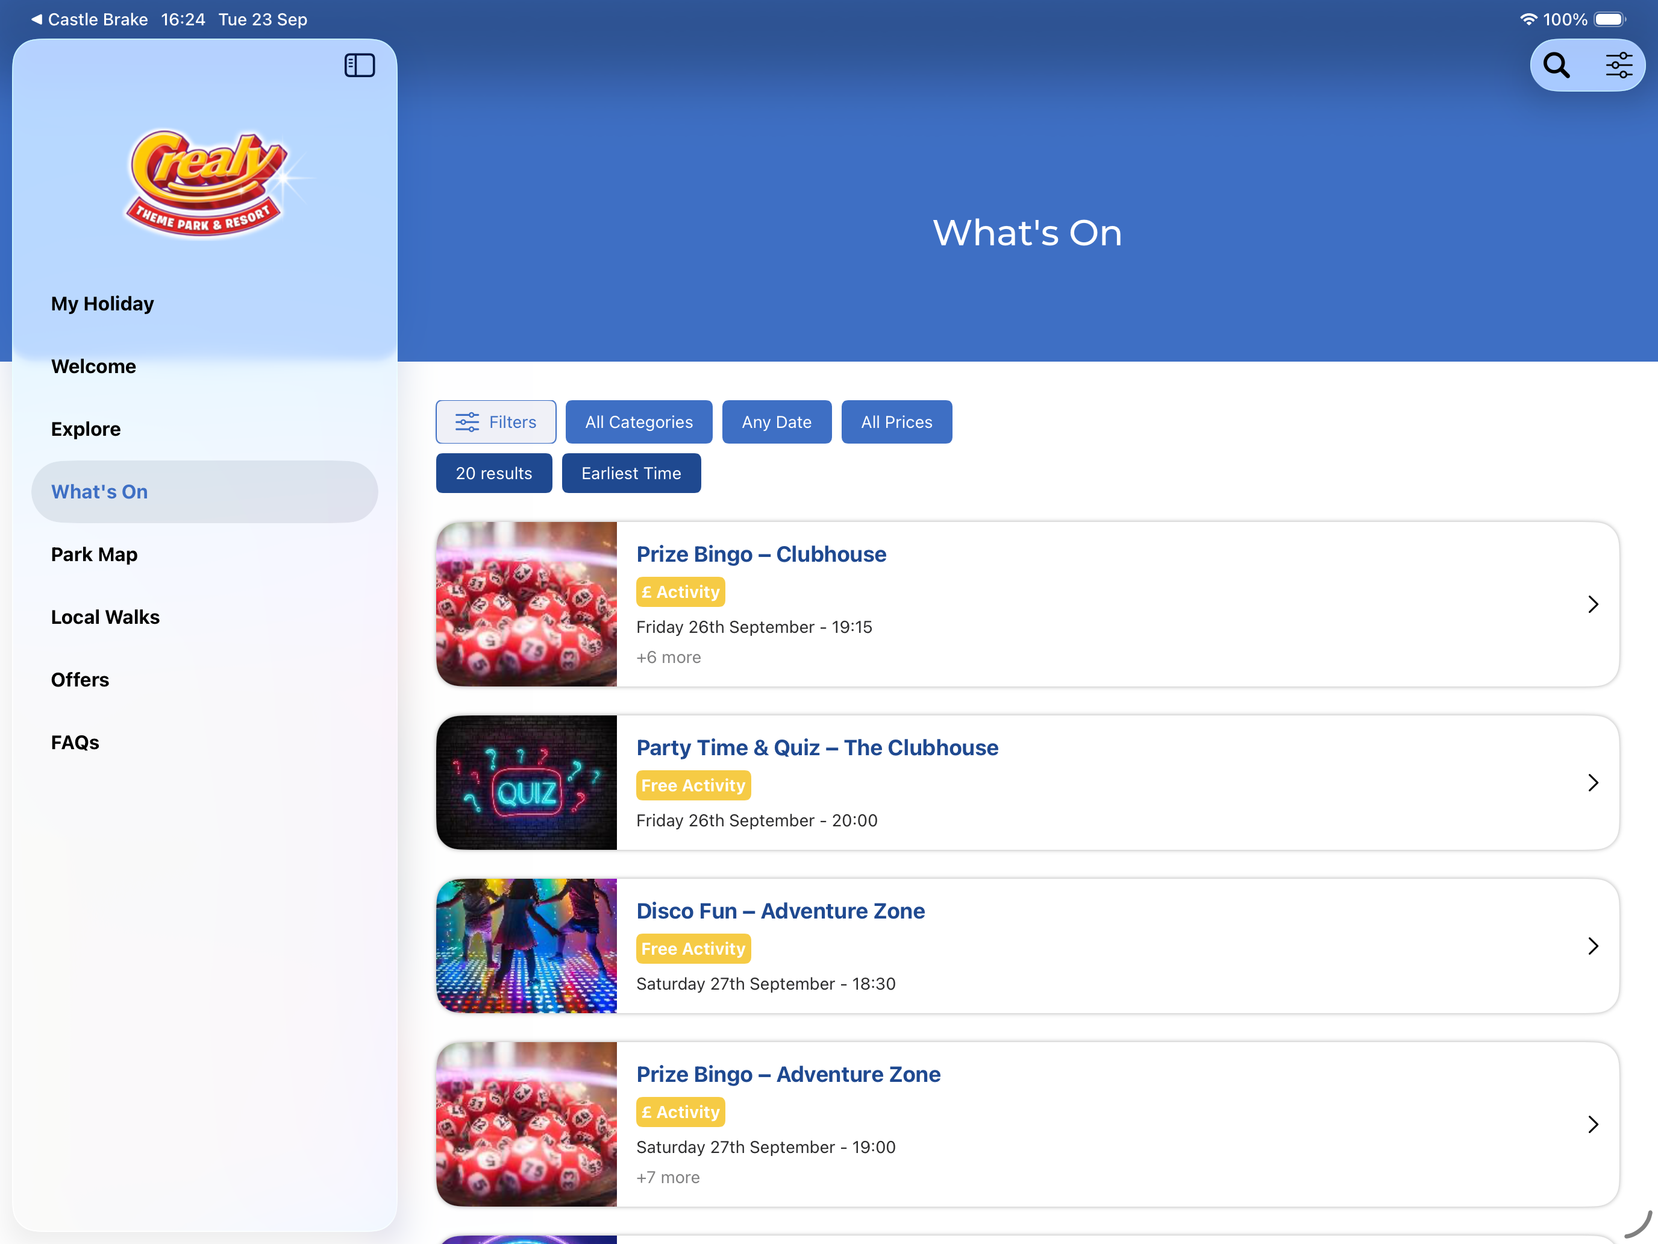


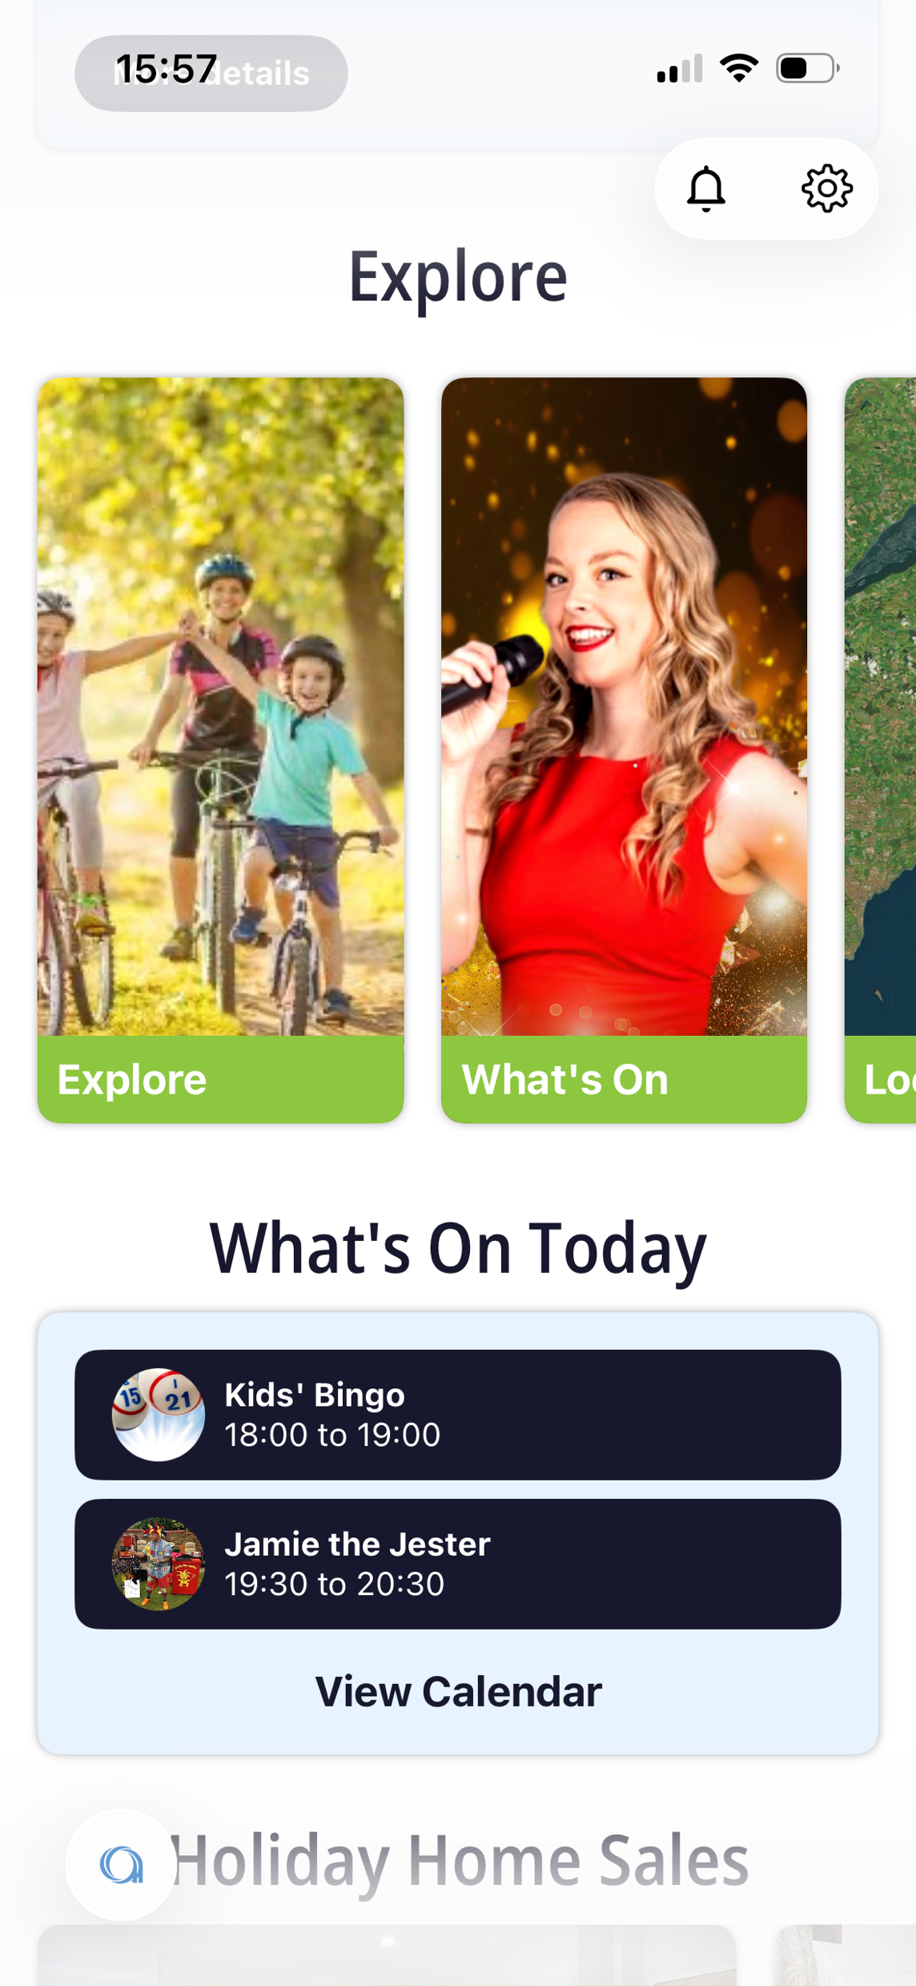
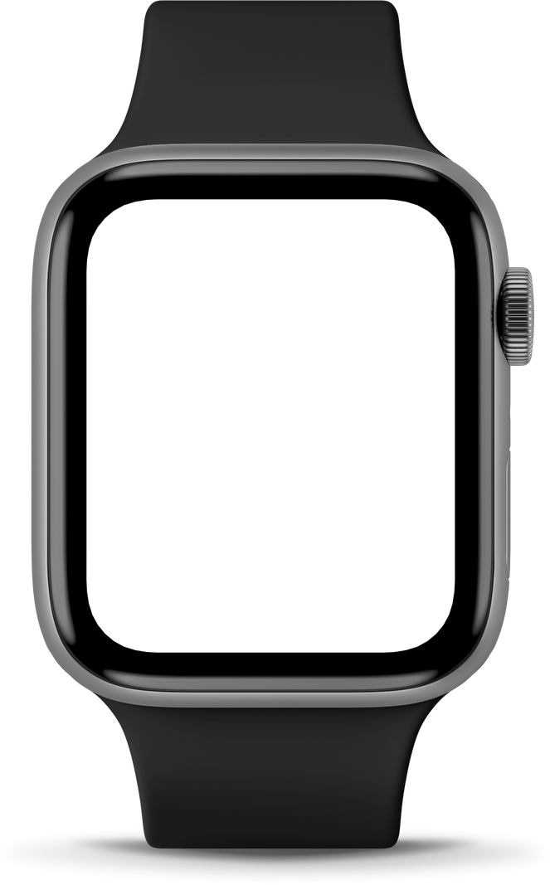

Holidaymaker Powering…
Notes:
“And this is where it all comes together. Holidaymaker isn’t just an app — it’s an ecosystem that connects with guests everywhere: powering their website, on their phone, on the park’s SeeView screens, through kiosks, via HeyGuest chat, and soon even on their in-lodge TV. Each touchpoint reinforces the journey, gathers insight, and brings guests back again. That’s the power of a truly connected guest experience — across every surface, at every stage.”

Slide 20
Thank You
Let’s keep shaping the future of tourism technology — together.
David Lakins
www.holidaymakerapp.co.uk
Co-Founder & CEO
david@holidaymakerapp.co.uk
Notes:
To wrap up — the connected guest journey is no longer just an idea, it’s happening right now. From pre-booking through arrival, stay, and rebooking — every interaction can happen within one joined-up ecosystem.
None of this would be possible without our incredible development team, who continue to bring these ideas and technologies to life — and a huge thank-you also to our partners, testers, and park teams who’ve helped shape Holidaymaker into what it is today.
Exciting times ahead – we are looking forward to shaping the future of tourism technology, together.

