Slide 1
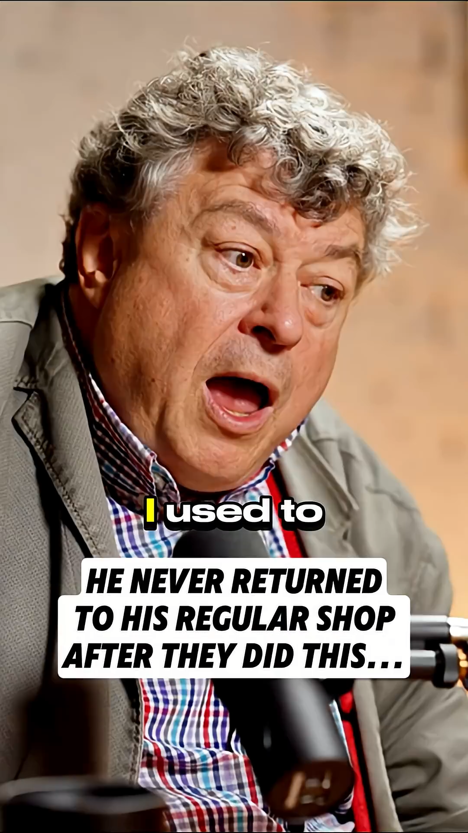


Slide 2
The Internet
You go to the internet

Slide 3
The Internet
PC
You go to the internet

Slide 4

PC
You go to the internet
The internet comes to you

Slide 5

Smartphone
PC
You go to the internet
The internet comes to you

Slide 6

Smartphone
PC
You go to the internet
The internet comes to you
You are the internet

Slide 7

Smartphone
AI
PC
You go to the internet
The internet comes to you
You are the internet

Slide 8
Some basic behaviours that build relationships with customers…
Precision
Uniqueness
Comparison
Effort/Labour

Slide 9
Some Successful Examples
Precision (Guiness)
Uniqueness (Aperol) – also called Social Proof.
Comparison (Red Bull)
Effort/Labour (Dyson)

Slide 10
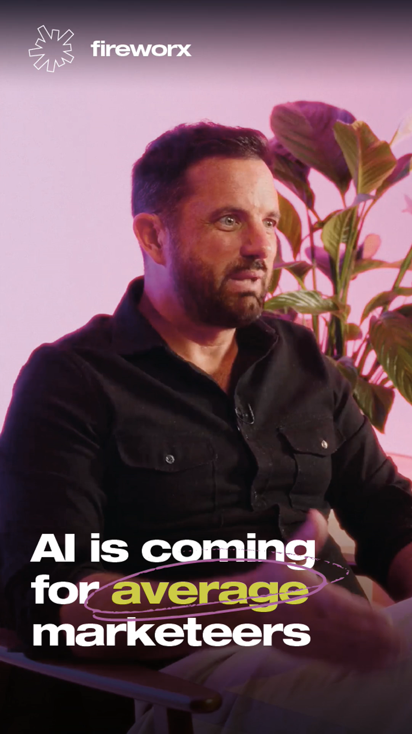

Slide 11
Enshittification
Treat users wonderfully
Treat clients (advertisers/merchants) wonderfully
Users become reliant/addicted
Treat users appallingly
Sell users data to clients
Clients become reliant.
Steal products/ideas/prices from clients
Play clients off against each other
Treat clients appallingly

Slide 12
90% of the hospitality platforms attention/solution is price, price, price.
AI could reinforce this….. In the eyes of guests - through the creation of AI slop..

Slide 13
Hiding in Plain Sight

Slide 14
Hearts and Minds
Statistics and Facts
Imagery
Crafting a message
Partners
Creating a community around a message

