Slide 1
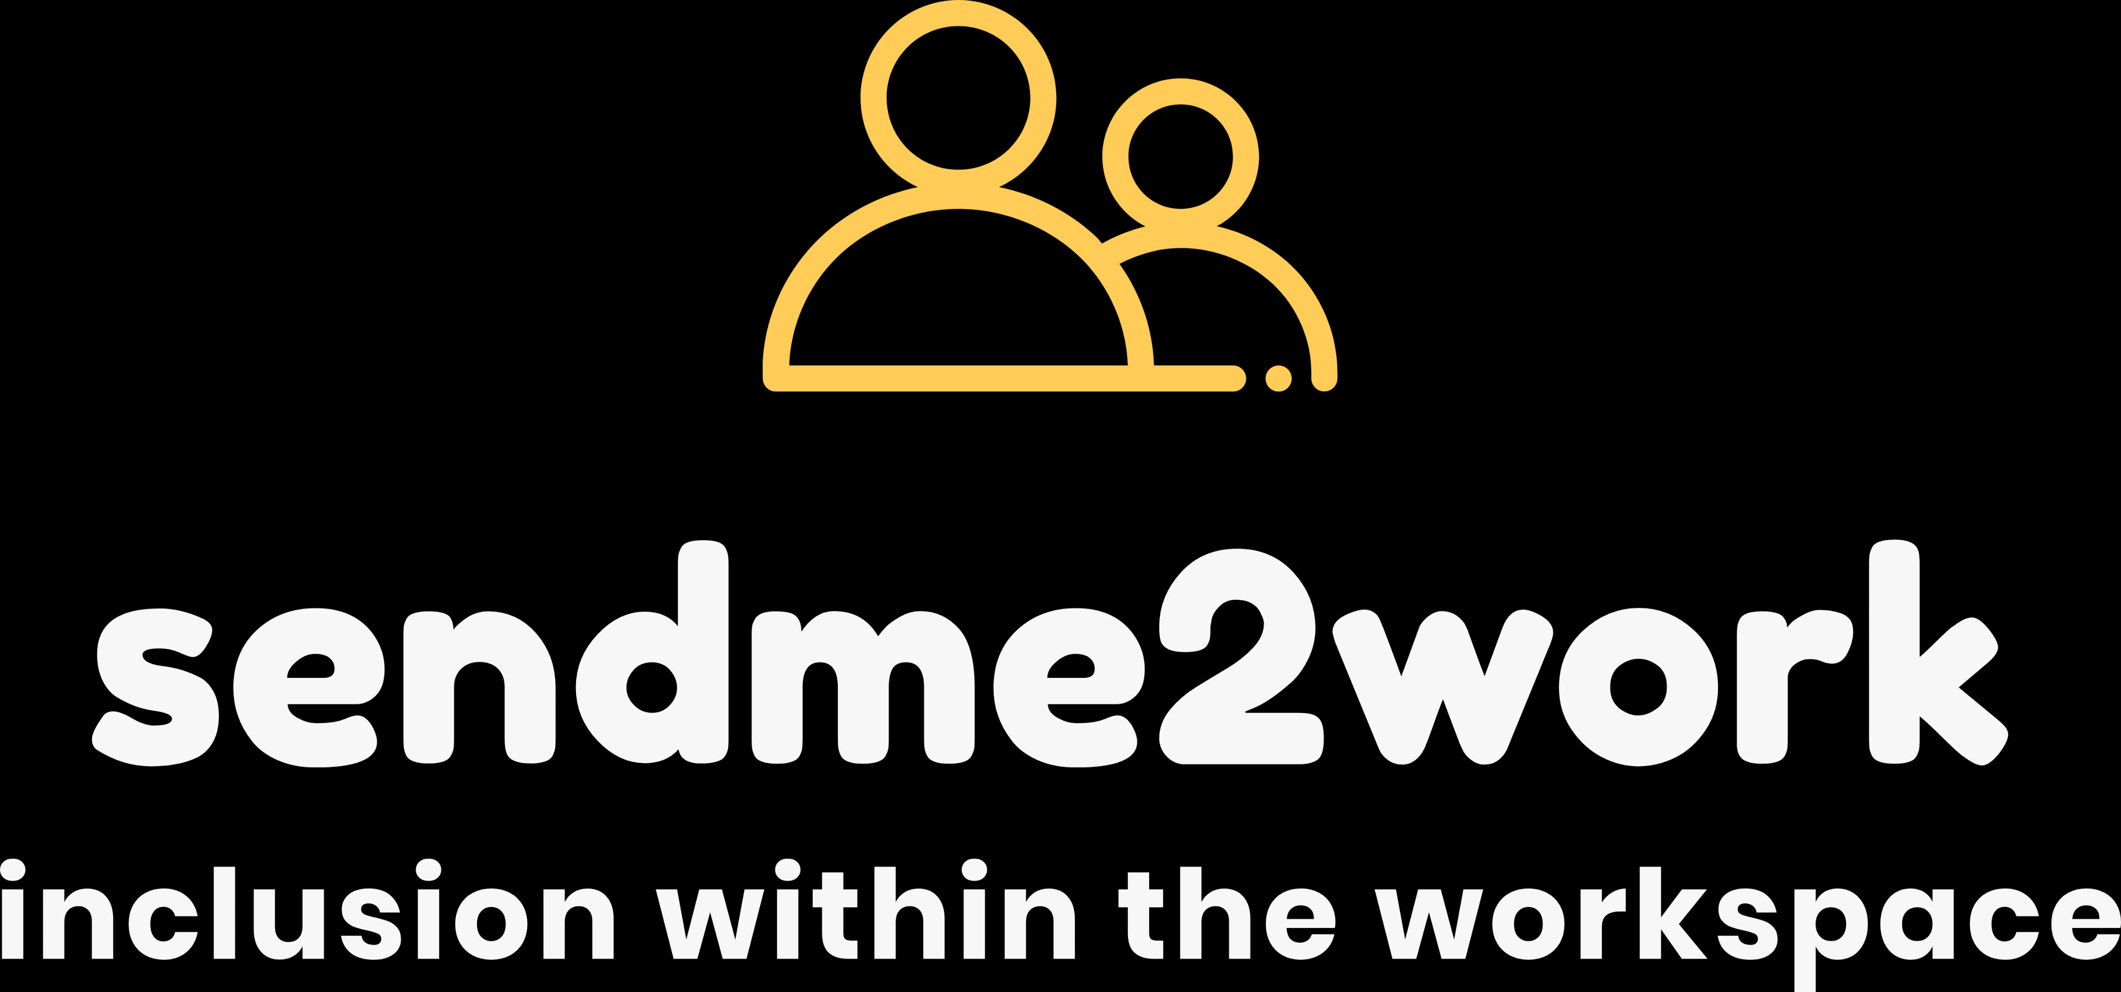
Bi-Monthly Network Support Workshop
22.10.25
Hidden Opportunities
Notes:
Thank you for finding the time to join us today. Here’s my snapshot on Digital Accessibility
About me…
30 years in Disability confidence and neuro-inclusion
Inclusion and Accessibility consultant
Founder of sendme2work – we help business create disability confident and neuro-inclusive workspaces through employer training, coaching development, accessibility audits and consultancy,
Project Manager for SI’s with Dorset Council – In year 4 of the Internships Work - DfE funded project

Slide 2
About me
About me
Notes:
2:00
Thank you for finding the time to join us today.
A little about me…I have had over 30 years in SEND (working in special schools, foundation learning depts. within colleges, AP’s, PRU).
My passion is all about creating, nurturing and enabling more inclusive workspaces.
I was co-founder of Employ My Ability (a vocational training provision, in 2014, took over some old walled gardens, invested in turning barns in to learning spaces, put in a café, visitor shop & delivered horticulture, hospitality & retail qualifications).
I worked as an Enterprise Coordinator for The Careers & Enterprise Company, who are the national body for Careers Education in England and for 4 years was part of the Dorset Careers Hub supporting 81 schools & colleges.
Project Lead for Removing Barriers – training employers for inclusion & disability confidence, working with 12 businesses & organisations across the whole of Dorset
Currently the Project Manager for SI’s with Dorset Council – Part of the Internships Work Initiative funded by the DfE until Mar ‘25
I’m a wellbeing coach as part of the RAwW programme.
Founder of sendme2work – we provide employer training, workshops, consultancy, accessibility audits and coaching development

Slide 3




The Removing Barriers to Inclusion Project
Notes:
Back in 2022...
I led on the yearlong Removing Barriers to Inclusion project, funded by DCH, The CEC & Dorset LEP, across both LA’s with the aim of increasing the number of Disability Confident Employers

Slide 4












12 employers on Dorset Removing Barriers Project
Notes:
Onboarded 12 employers to the yearlong project…
1x engineering & manufacturing
1x tech, data & defence
1x charity
1x care provider
3x hospitality
2x education providers
1x local government
1x training provider
1x arts, leisure & entertainment
As you can see a wide range, so open to all…

Slide 5

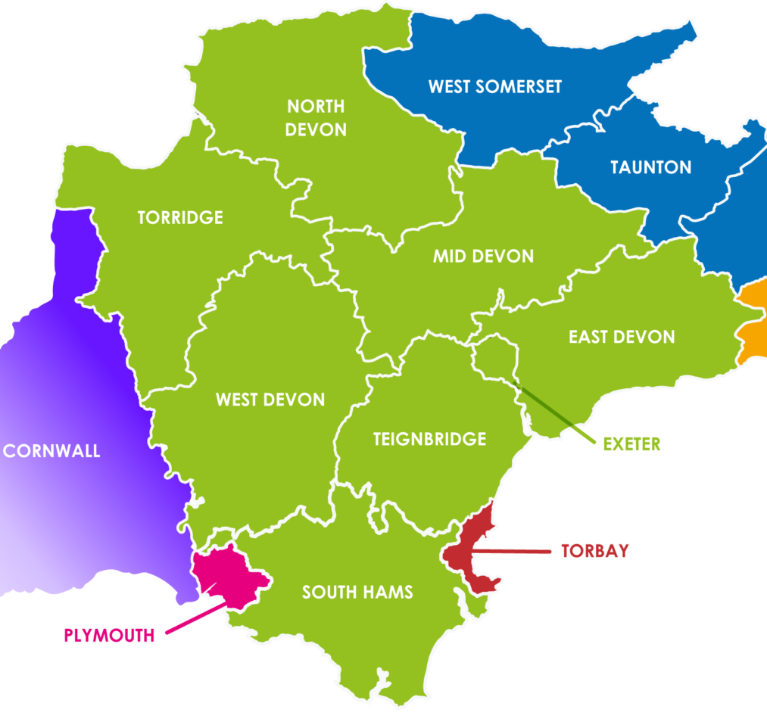

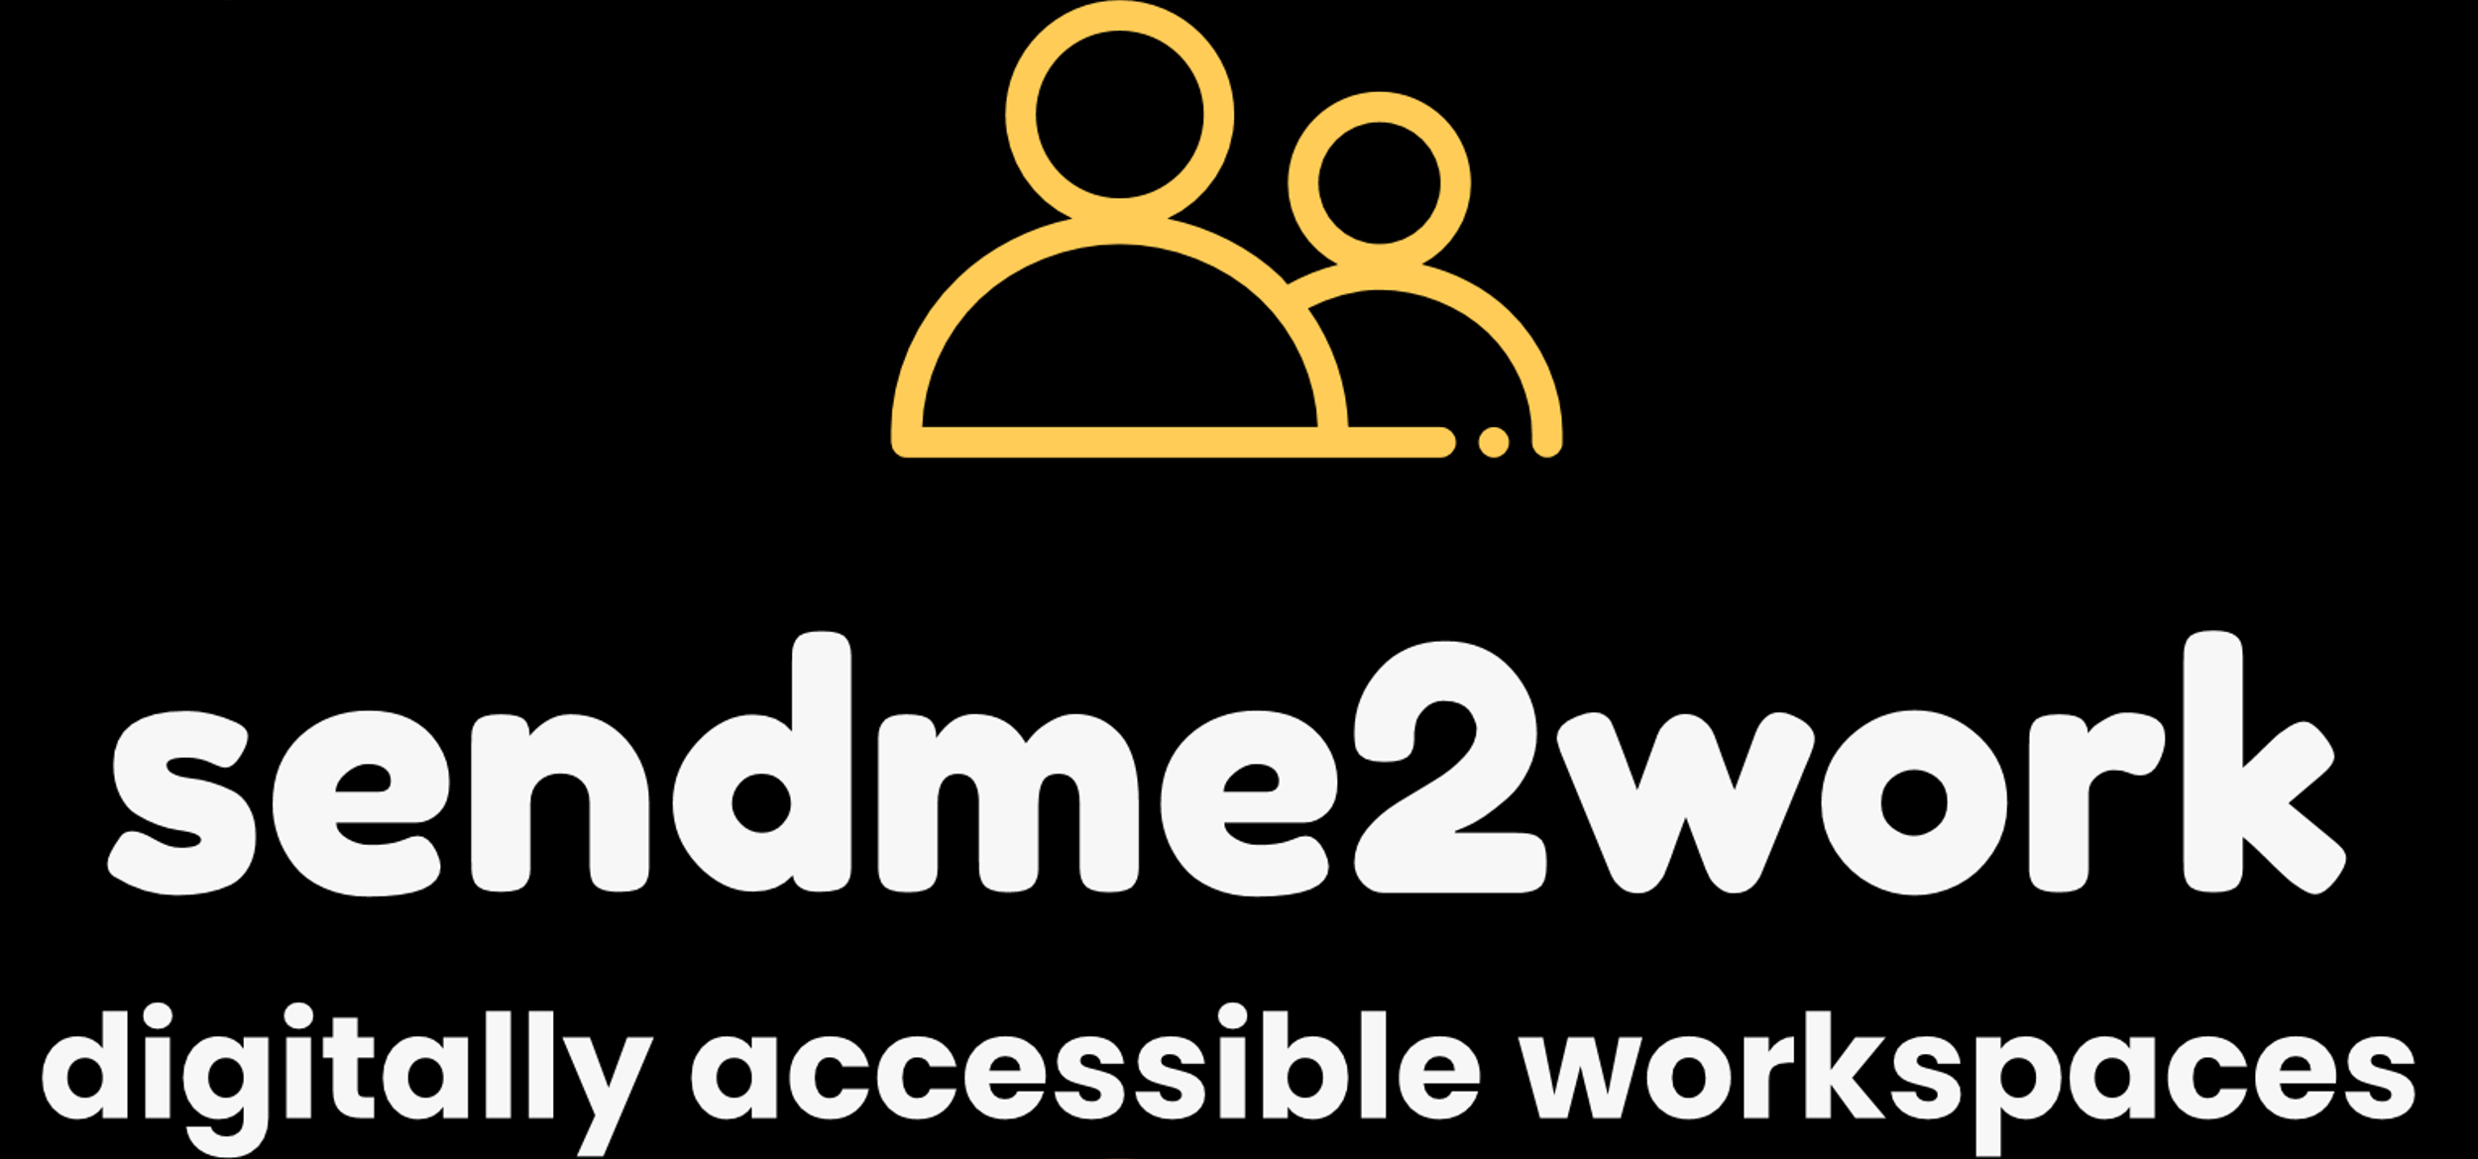
Inclusive Digital Skills: Empowering Disabled & Neurodivergent Adults and Young People in Devon
Notes:
Currently leading a project for Devon County Council, across all eight LA’s
Funded by UK Government & the Essential Skills Fund.
Following our work with employers in creating digitally inclusive workspaces – now bridging the gap between learners/participants and employers.
Based on all the in-built technologies within M365, Google, smartphones/tablets and everyday living eg, banking apps

Slide 6


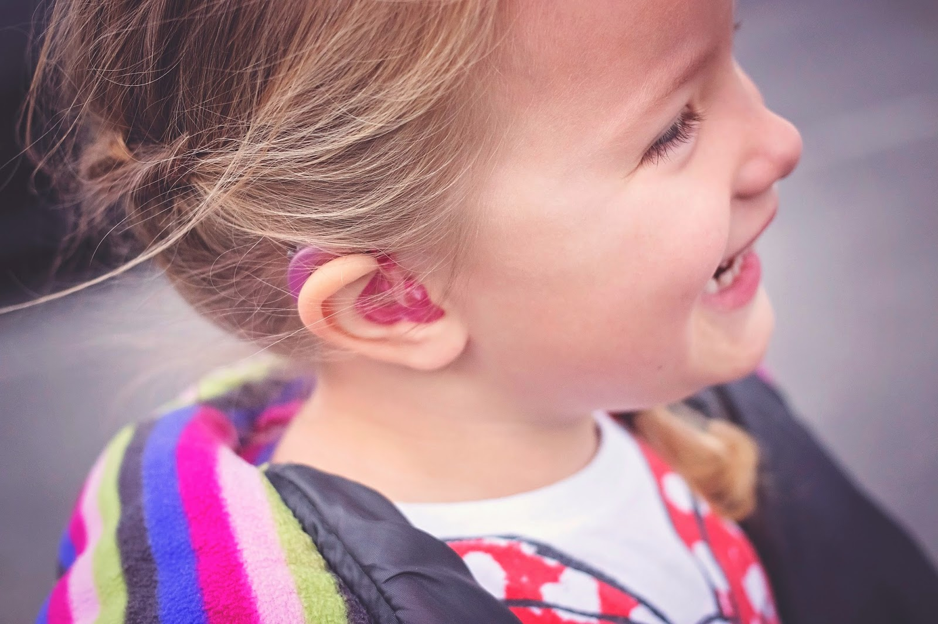
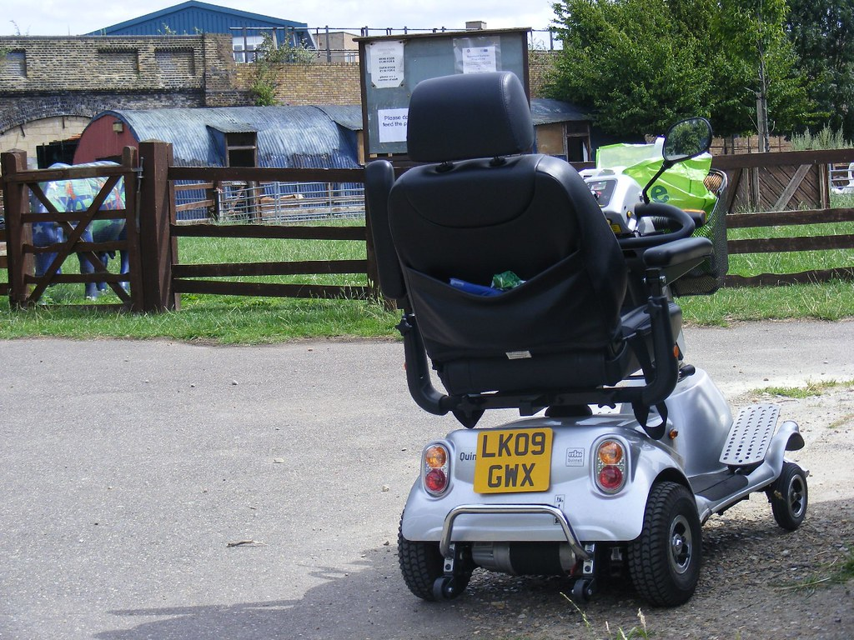
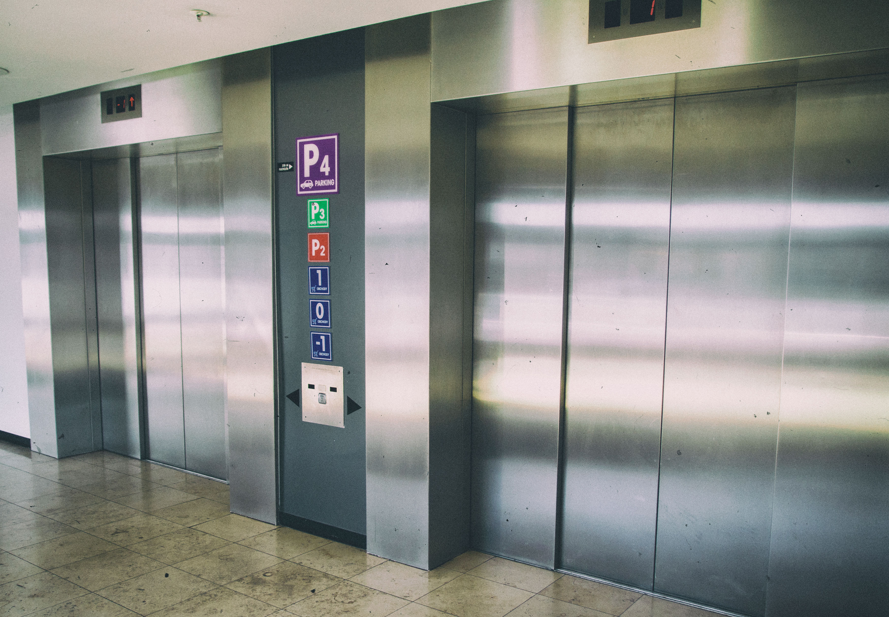
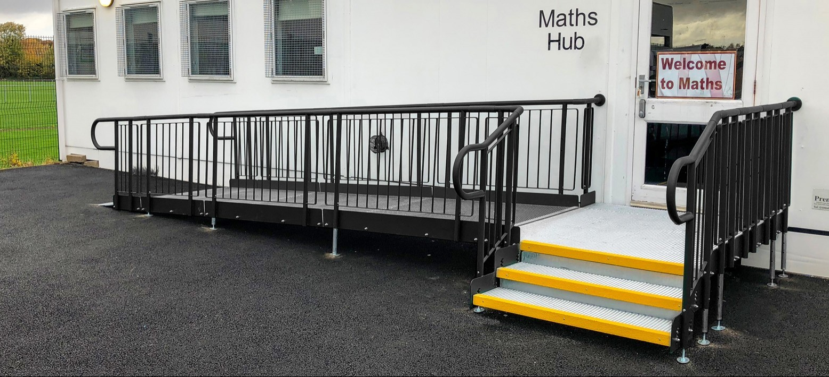
What are the adaptations, accommodations and adjustments used in our every day?
This Photo by Unknown Author is licensed under CC BY-SA
Notes:
These adaptations benefit a wide variety of people…for example, children, elderly, families with buggies

Slide 7
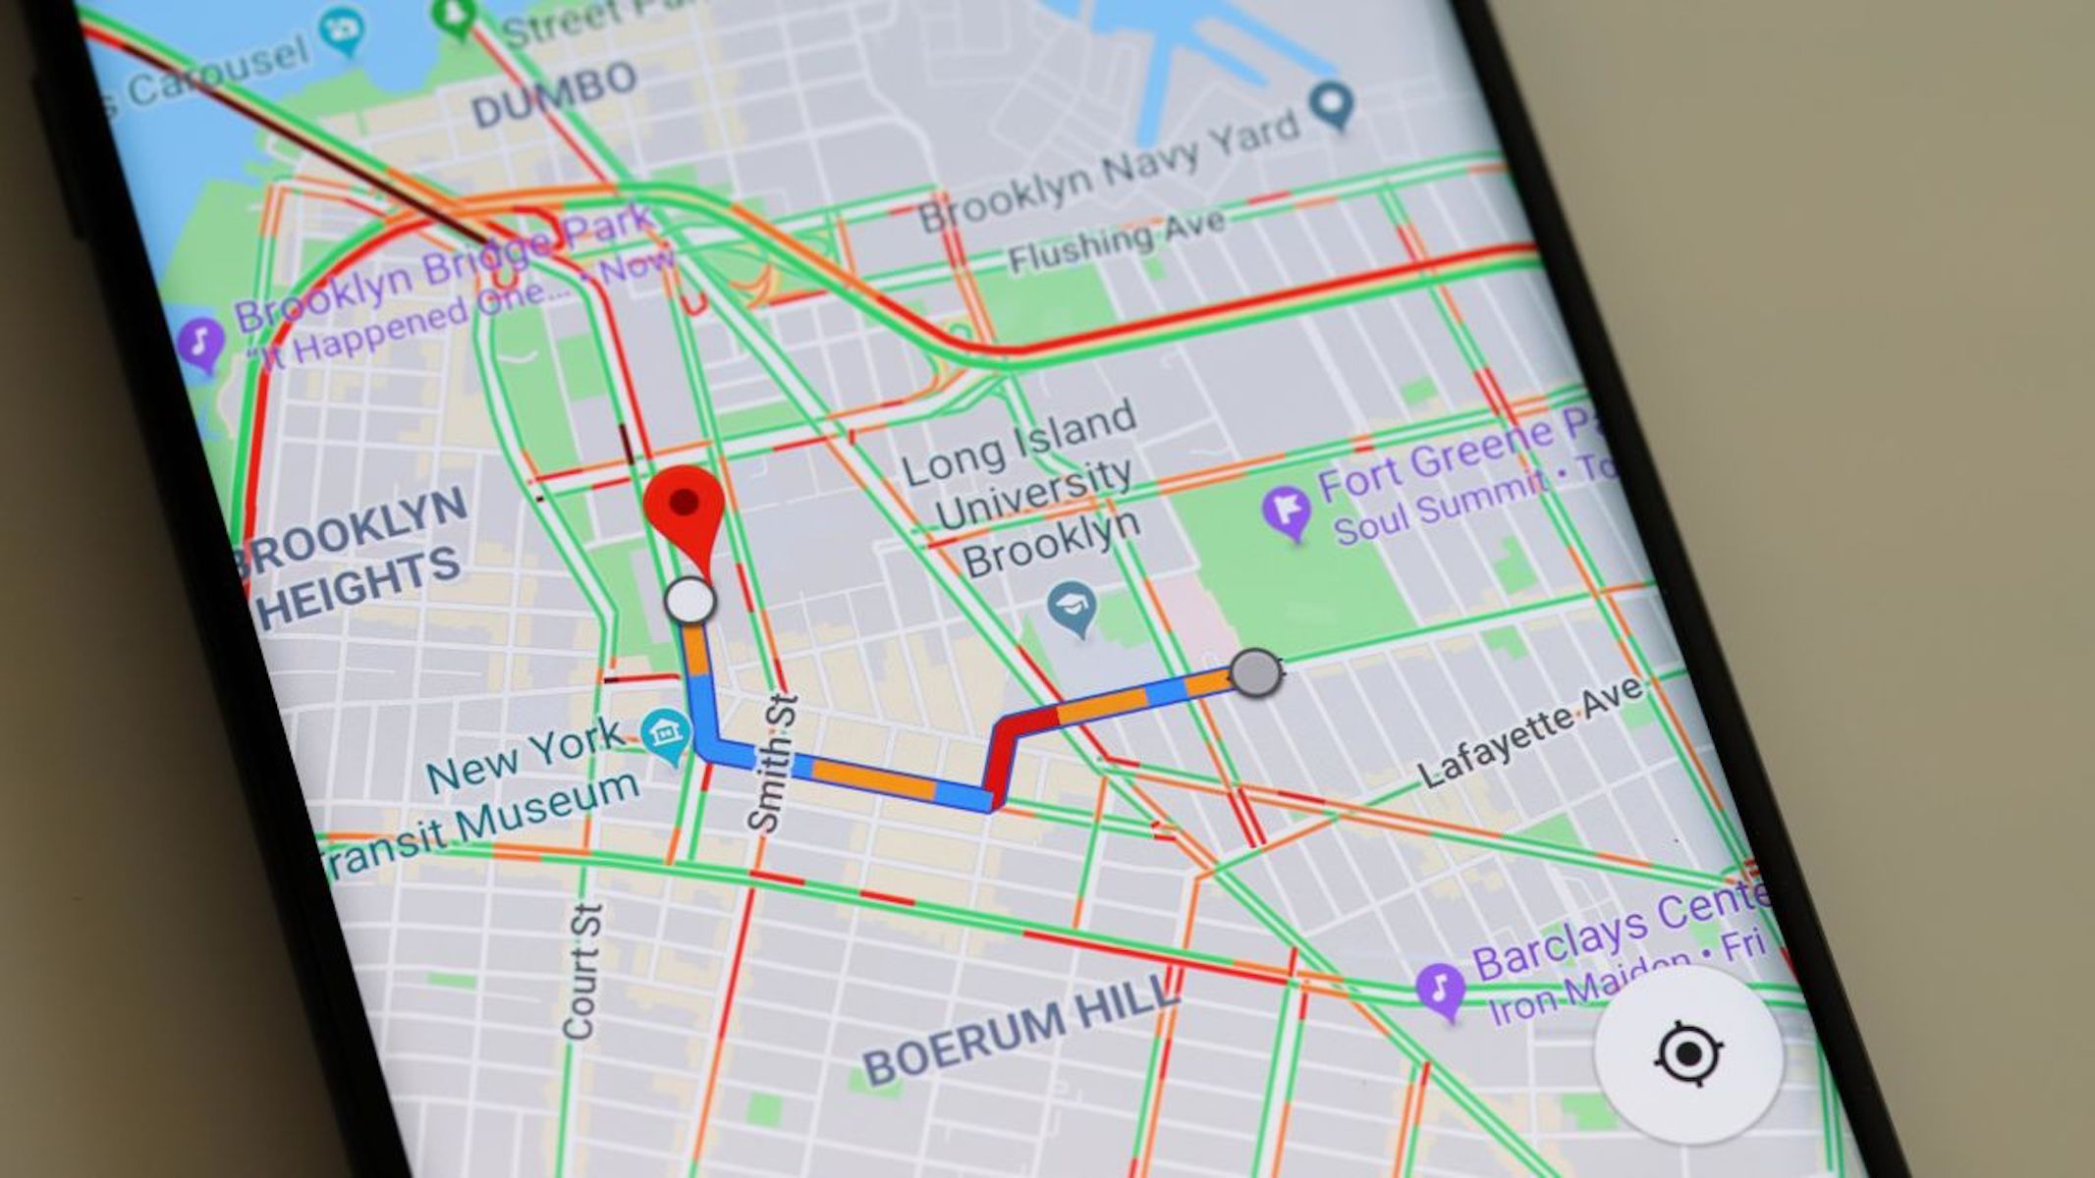

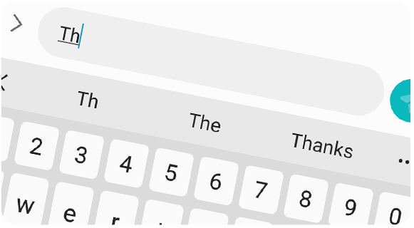
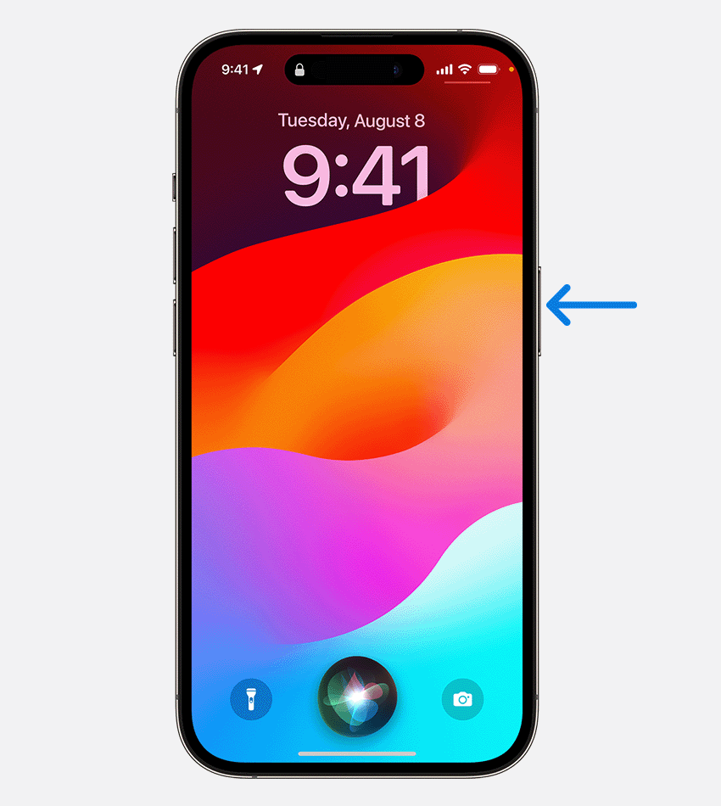
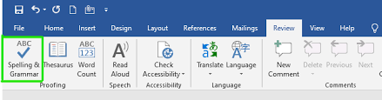
What are assistive technologies used in our every day?
Notes:
What digital & tech adjustments are accepted & embedded within our everyday society?
Things that we use everyday and have just become accustomed to.
All in the premise of making it easier for us…

Slide 8
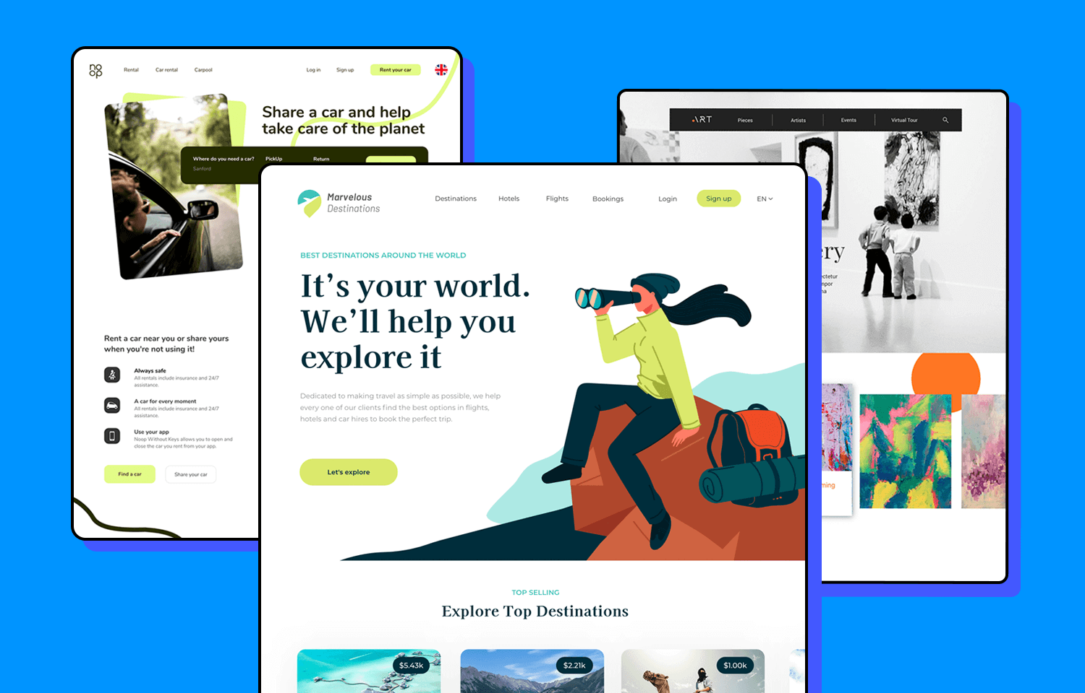


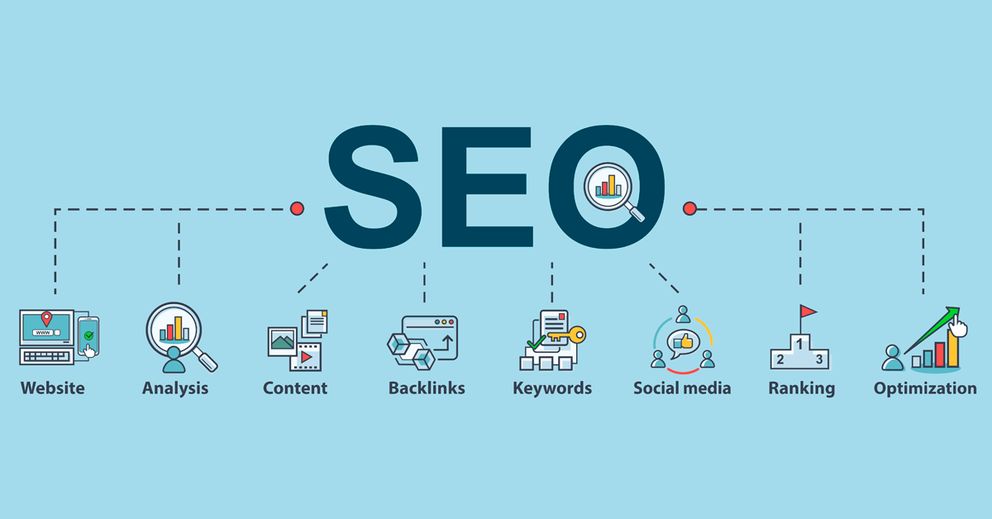

The story of the internet…

Slide 9
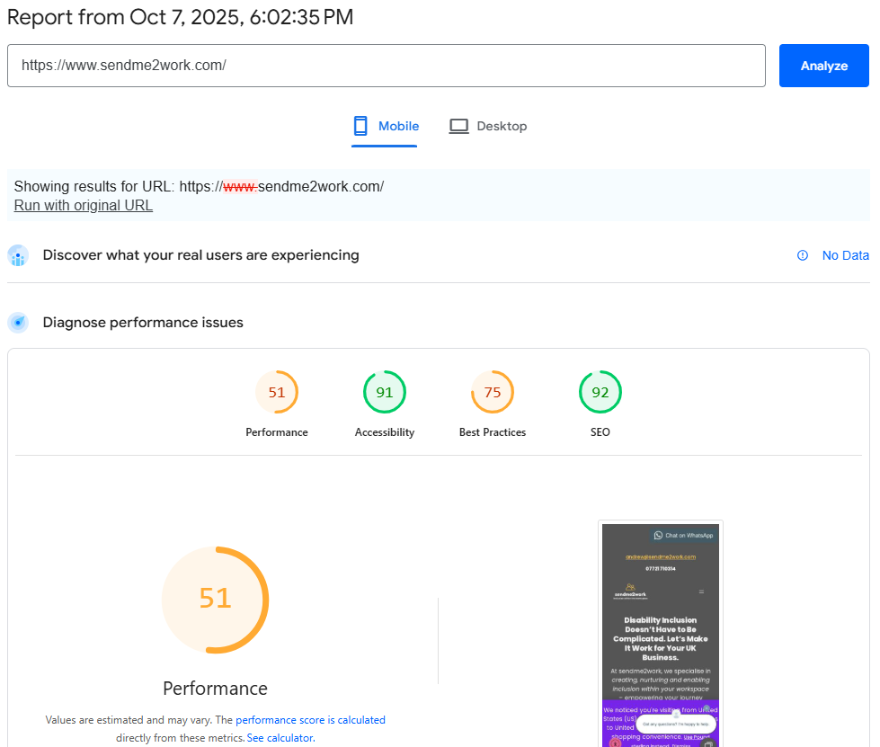

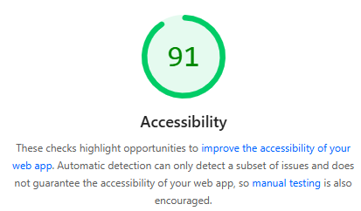
https://pagespeed.web.dev/

Slide 10
Website Accessibility - WCAG
The foundations of web accessibility are based on 4 key WCAG principles:
P.O.U.R.
🧠 Perceivable – Can people see or hear your content?
🖱️ Operable – Can everyone navigate and interact with it?
📖 Understandable – Is it clear and easy to follow?
💻 Robust – Does it work well across browsers, devices and assistive tech?
Notes:
When your site uses plain text, good colour contrast, and video captions, it becomes Perceivable and Understandable to more people

Slide 11


Website Accessibility - WCAG
🧏‍♀️ Screen reader, Alt Text, Captions (Deaf/hard of hearing barrier)
👩‍🦯 Website navigation (Physical/motor barrier)
📱 Text, colours and contrast (Visual barrier)
🧠 Use of text and language (Neurodivergent/cognitive barrier)
Want to check if your marketing content & website follows WCAG basics/compliance?
Notes:
Get in touch to find out about free accessibility tools or full audits.
If you need PDF remediation and/or marketing design.
Currently testing 2 AccessBot GPT’s…for website and document audits.

Slide 12
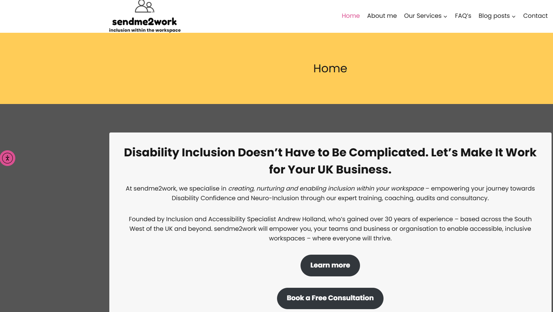


Slide 13
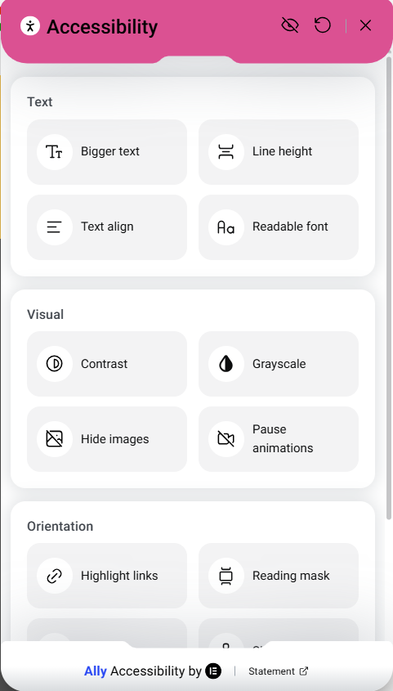
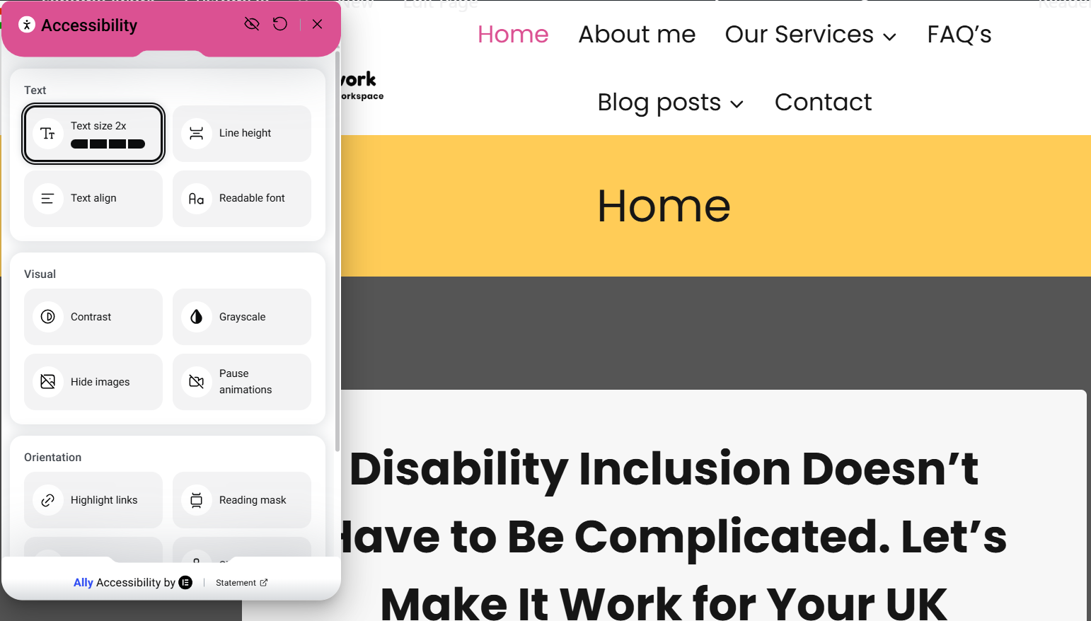

Slide 14
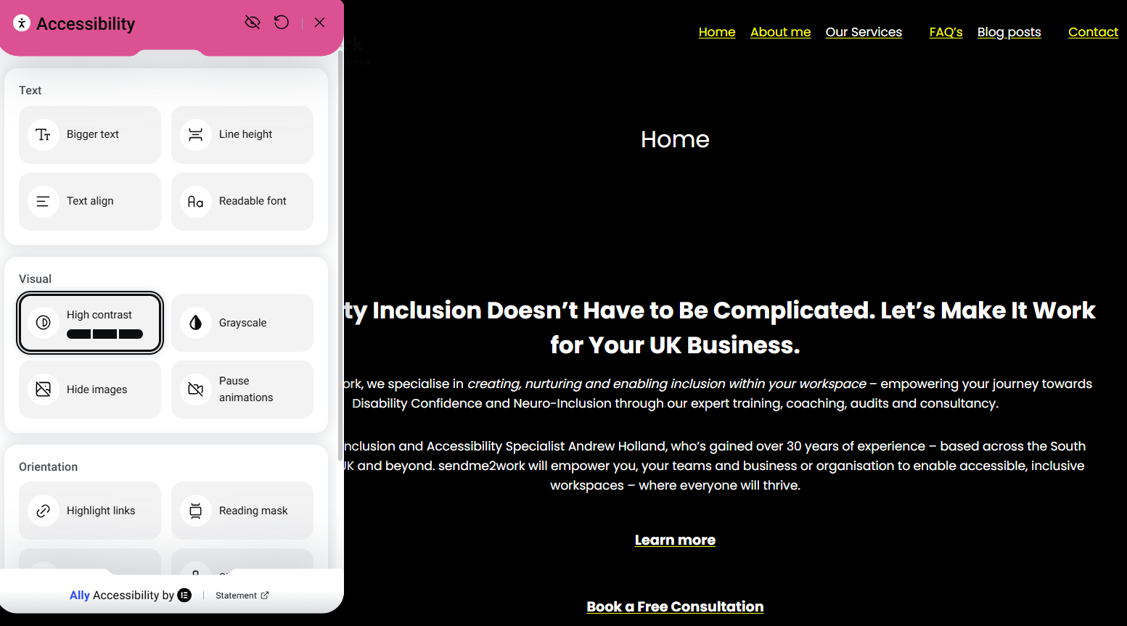

Slide 15
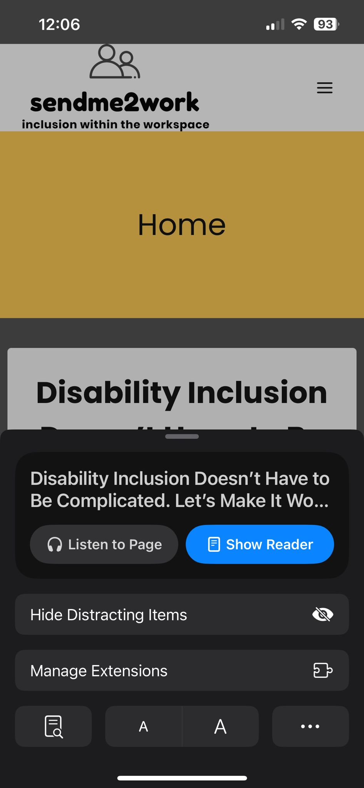
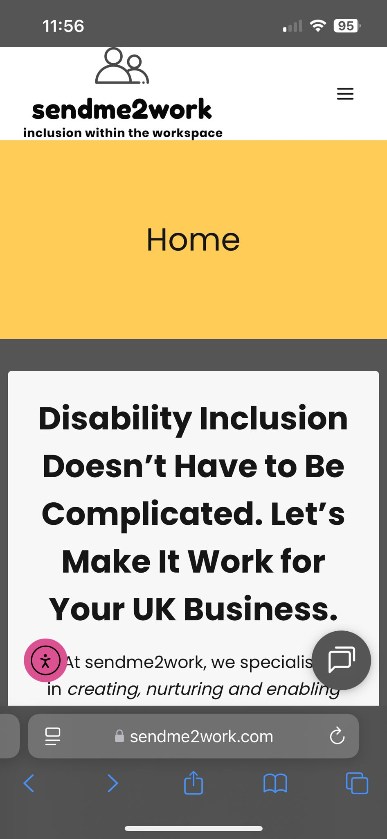

Notes:
Go check your own website…

Slide 16
European Accessibility Act (EAA) — 10 Essentials for New Businesses
Came into force June 2025 - Applies to any business selling digital products/services in the EU
Digital must be accessible – Websites, apps, content, platforms
Design smart, design early - Use accessible fonts, contrast, layouts
Know EN 301 549 - EU standard aligned with WCAG 2.1 AA
Covers more than websites - Includes e-books, smartphones, ATMs, e-commerce
Notes:
28th June this year
Especially important for websites and content – how much of businesses content is fully compliant
Wordpress themes, mobile friendly, accessibility widgets
WCAG – Website Compliance Accessibility Guidelines

Slide 17
European Accessibility Act (EAA) — 10 Essentials for New Businesses
Add an Accessibility Statement - Share what’s accessible and support options
Better UX = Better Business - Accessibility improves SEO, reach, conversions
Micro exemptions exist - But it's safer to design with access in mind
Penalties for non-compliance - Including UK brands trading in the EU
Inclusive brands stand out - Accessibility is a creative edge

Slide 18

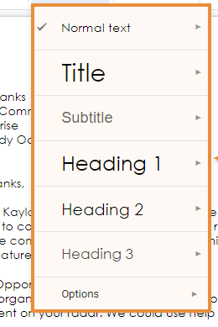


4 Essentials…for everybody
Notes:
Ensure Alt Text is added to all images and its meaningful
Use Heading styles in documents or webpages & blog posts
Add captions to all videos
Ensure Inclusive Design (Create a Word Doc or build PowerPoint slides or plan marketing and content creation with accessibility at the forefront)

Slide 19
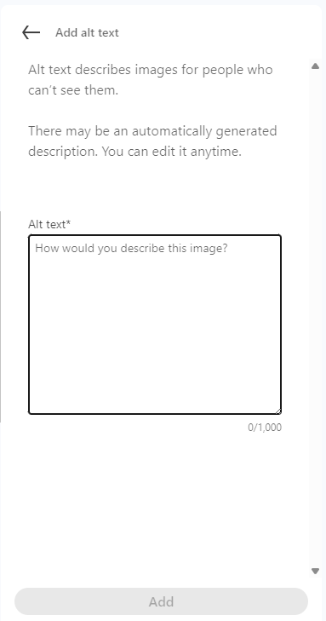



Alt text – How would you describe these images?
Notes:
This is taken from our Inclusive Social Media training…

Slide 20
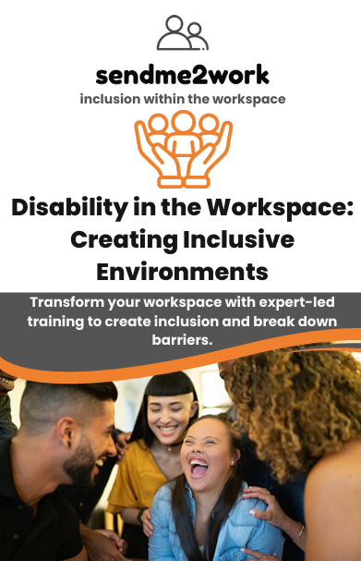
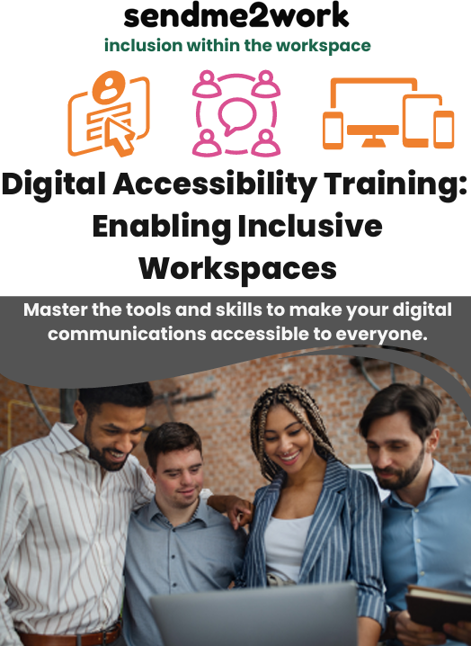
Disability in the Workspace
Digital Accessibility
Notes:
A series of 5 online Disability in the Workspace training starting today…also available for your business & organisation.
Digital accessibility – website access & compliance
Accessibility features built within apps (dictate, read aloud, editor, alt text, CC’s, turn –on accessibility features, larger cursor, changed the colour – just easier to see/find)
Teams – transcript, sign language.
When using social media, limited use of emoji’s, ensuring all pictures have alt text, all videos have Closed Captions. When converting word docs to PDF’s files, again ensuring accessibility features are turned on & used.
Microsoft 365 Accessibility within Everyday Technology
Accessibility within Word, Outlook and Teams
Accessible communications & social media
Accessibility within OneNote, Excel and PowerPoint
Whilst these sessions have been designed for employers – trialling some workshops for Young Adults who are Neurodiverse to better support them as they transition into employment.
Also, developing the equivalent content for Google Accessibility features, maybe one day Apple too…
We have monthly lunch & Learns & quarterly Network Support Workshops

Slide 21
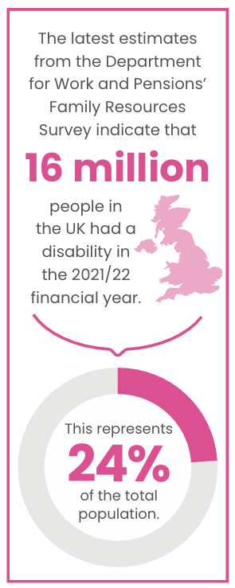
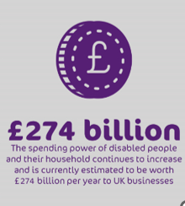
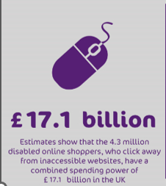
Why does this all matter to my business…
70% of disabled consumers will click away from inaccessible websites
70% of disabled consumers will click away from inaccessible websites.
Notes:
The Purple Pound is the term for the combined spending power of disabled people and their households in the UK, which is estimated to be worth approximately £274 billion per year:
Number of disabled people
There are an estimated 16 million disabled people in the UK, which is 1 in 4 of the population.
Business losses
Businesses lose approximately £2 billion a month by ignoring the needs of disabled people.
70% of disabled consumers will click away from inaccessible websites.
Why is this important? If you are putting out content on a public & open platform, if your content is inaccessible, then you’re putting off future customers…
Will the UK follow the US and EU in having an Accessibility Act?
Are you looking to increase revenue and customer base?
Will you look to sell your company in 10/15 years time?

Slide 22

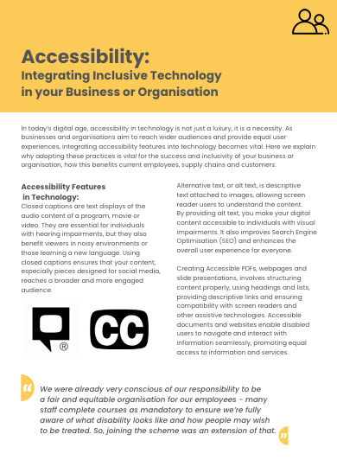
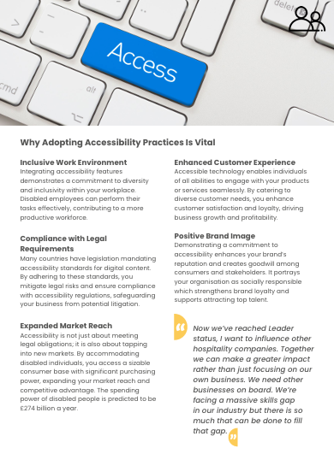
Removing Barriers to Inclusion – An Employer Toolkit for Disability Confidence
Notes:
Let me know if you would like to receive a free copy of the Employer toolkit.

Slide 23
Removing Barriers to Inclusion – An Employer Toolkit for Disability Confidence
Notes:
Let me know if you would like to receive a free copy of the Employer toolkit.

Slide 24
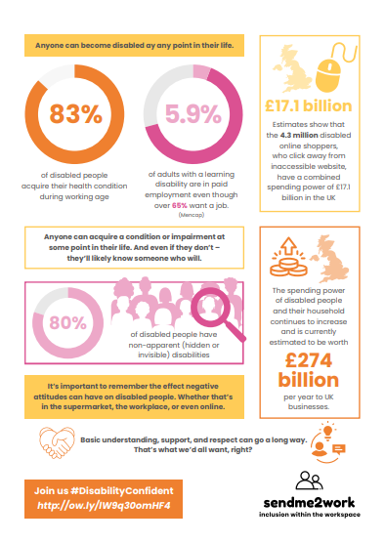
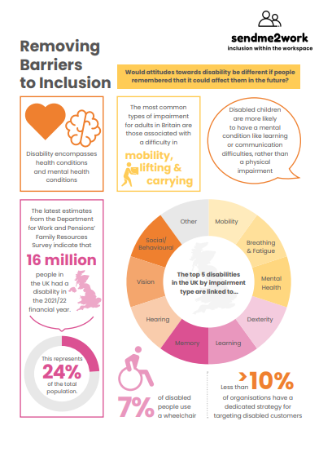
Removing Barriers to Inclusion - Infographic
Notes:
Let me know if you would like to receive a free copy of the Infographic

Slide 25
Removing Barriers to Inclusion - Infographic
Notes:
Let me know if you would like to receive a free copy of the Infographic

Slide 26
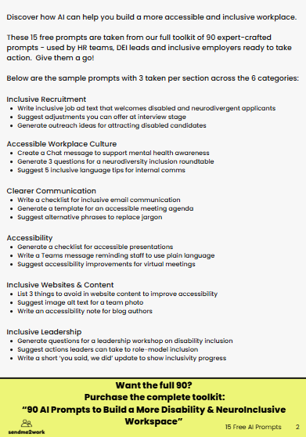
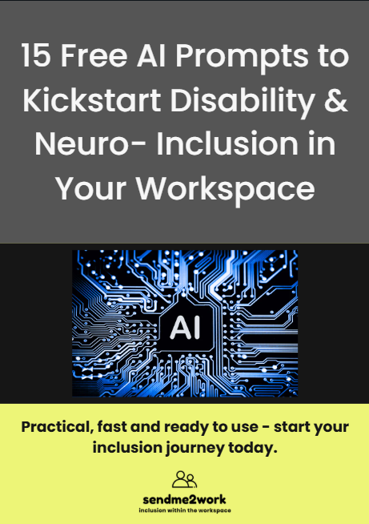
15 Free AI Prompts to Kickstart Disability & Neuro-Inclusion in Your Workspace
Notes:
Let me know if you would like to receive a free copy of the Employer toolkit.

Slide 27
15 Free AI Prompts to Kickstart Disability & Neuro-Inclusion in Your Workspace
Notes:
Let me know if you would like to receive a free copy of the Employer toolkit.

Slide 28
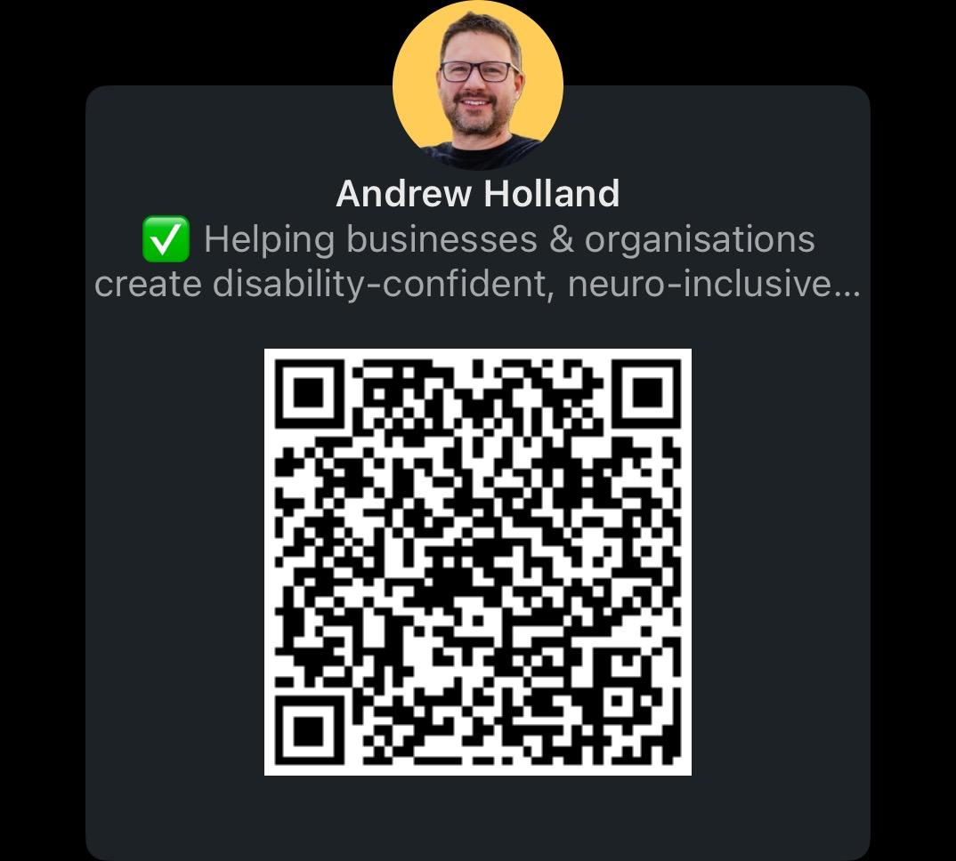
LinkedIn QR code & contact details
Thank you!
andrew@sendme2work.com
07721 710314
linkedin.com/in/andrewjmholland
linkedin.com/company/sendme2work

